Slide 1
Time Management
Tracy Kaske
Learning Support Specialist
Alyx Chandler
Learning Support Specialist

Slide 2

Time Management
Time Limit
Time Personality
Time Management Strategies

Slide 3

Time Limit
We have no control over the amount of time.
We do have control over how we use it.

Slide 4

Time Personality
Definition: Your attitude towards time and how you use it.

Slide 5

Time Personality
    1. The Firefighter
    You can quickly work through a to-do list.
    You are results-driven and will often act without much thought for the urgency or importance of the task.

Slide 6
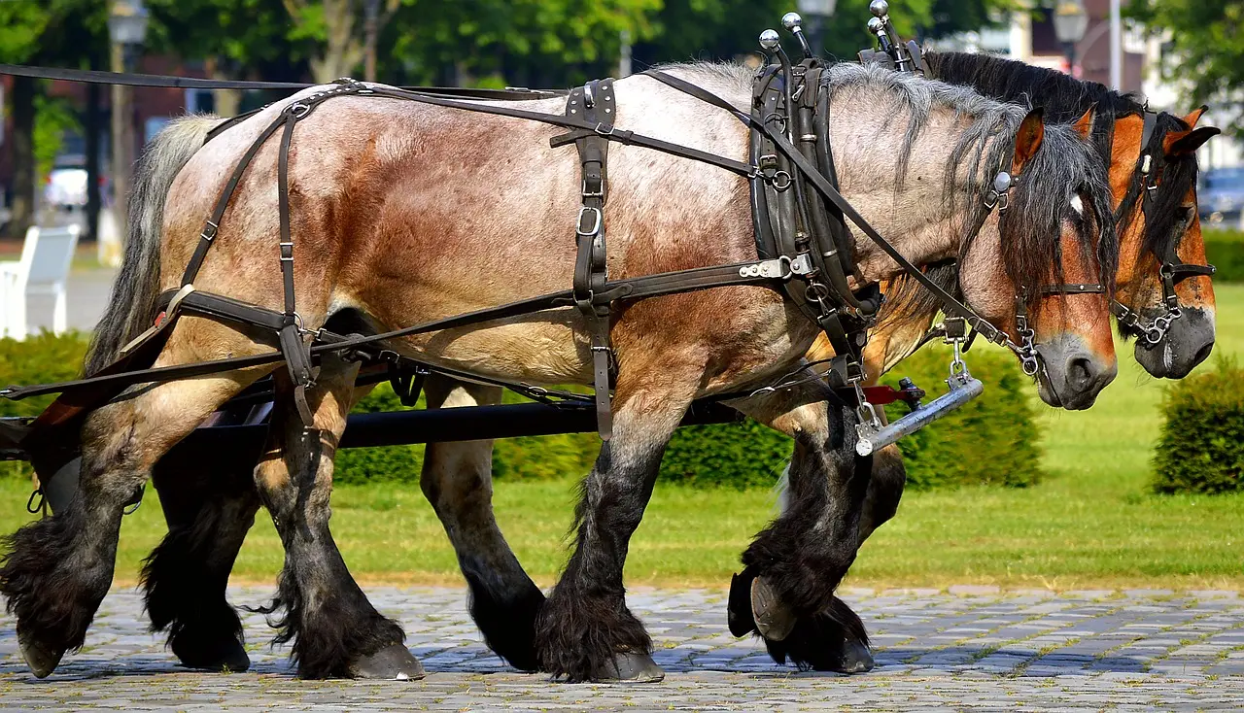
Time Personality
    2. The Workhorse
    You are cautious and methodical.
    You can be overcautious and unwilling to share work with others.

Slide 7
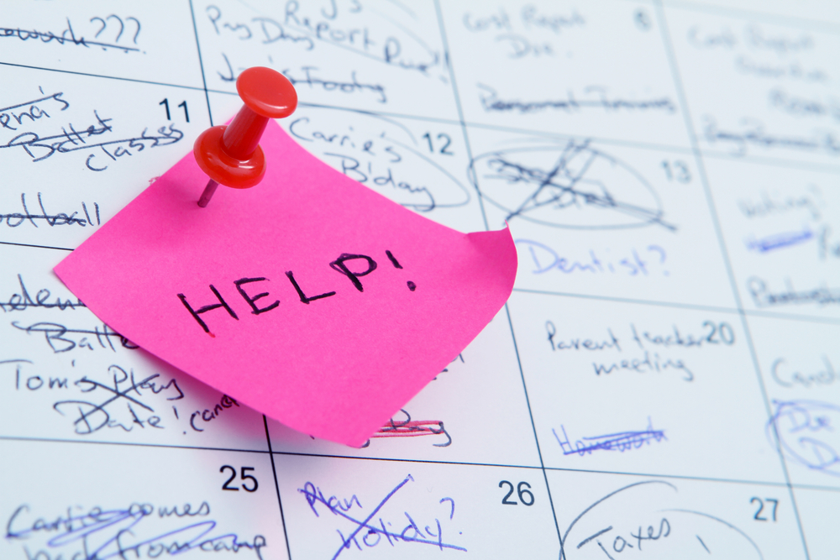
Time Personality
    3. The Over-committer
    You are the ultimate team player.
    You can’t say “no” and end up biting off more than you can chew.

Slide 8

Time Personality
4. The Procrastinator
    You have no sense of urgency.
    You get to things when you get to them

Slide 9

Time Personality
    5. The Chatty Cathy
    You are upbeat, friendly, and talkative.
    Every interaction becomes a long drawn out conversation, and you get little done.

Slide 10

Time Personality
    6. The Perfectionist
You are focused on quality over quantity.
Because accuracy is so important to you, you can feel overwhelmed if you have too much on your plate.

Slide 11
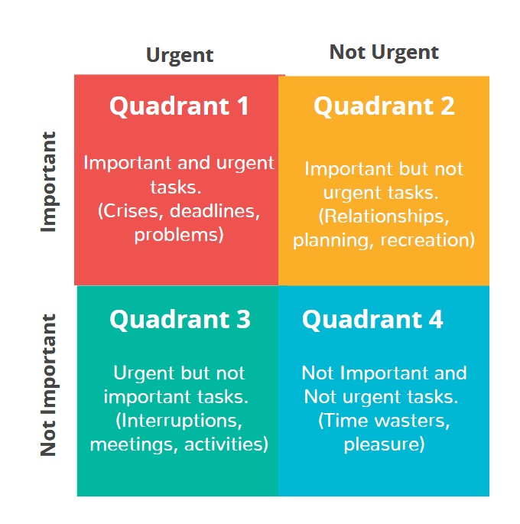
Time Management Strategies
Time Management Matrix

Slide 12
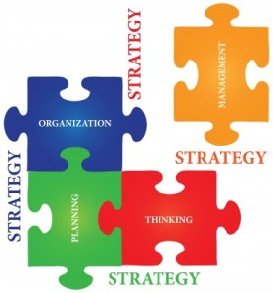
Time Management Strategies
The Firefighter/The Workhorse:
Prioritize your tasks (time management matrix).
Use a to-do list.
The Over-committer:
Learn to say “no.”
Take breaks.
The Procrastinator:
Accept procrastination as a habit.
Use daily or weekly planner.
Complete an easier task first.
Study with a motivating friend.
The Chatty Cathy:
Break projects into smaller steps.
Use a daily or weekly planner.
Limit social interaction.
The Perfectionist:
Prioritize your tasks (time management matrix).

Slide 13
Additional Time Management Strategies
Create a calendar
  Have all your important tasks in one place.
Set deadlines
  Set personal and realistic calendar deadlines.
Start your day with a to-do list
  Add items you have already done so you can cross them off the list.
Block out time for rest
  You’re only human! Prioritize eating, sleeping, and taking care of yourself.
Find time for things that bring you joy
  Walk the dog, spend time with your kids, go to the gym, read a book, listen to music.

Slide 14

Additional Time Management Strategies
Multitasking
Beware of multitasking–it can
make finishing tasks even harder!
It can take a lot of mental energy
to switch tasks so stick to
completing one task at a time,
or break large tasks into chunks.
Getting in the Zone
Getting started can be the hardest part.
But once you can get past that initial uncertainty, you can get into a rhythm.
  This is the part of work where you have to be careful to stay focused and not lose track of time.

Slide 15
Learning Support Department
In-person and online tutoring
Online Resources
  Drop-off Essay/Assignment Review
  Tutor.com
  Grammarly
  Student Resource Guides
  ADA Accommodations
Contact Information
  Phone: 847-947-5512
  Email: tkaske@nl.edu, achandler9@my.nl.edu, or learn@nl.edu
  Learning Support Website

