Slide 1
Discussion Board Posts

Slide 2
Substantive
meaningful or considerable
should help the overall discussion move forward.

Slide 3
Provide concrete examples, perhaps from your own experience, that highlight ideas from a reading or the discussion.
Describe possible consequences or implications of ideas in a reading or the discussion.
Challenge something that has been stated in a reading or posted in the discussion – perhaps by playing “devil’s advocate.”
Pose a clarifying question in regards to a reading or a classmate's discussion post.
Suggest a different perspective or interpretation of a reading or a post in the discussion.
Pull in related information from other resources – books, articles, web sites, other courses, etc. - that support what is said in a reading or in the discussion.

Slide 4
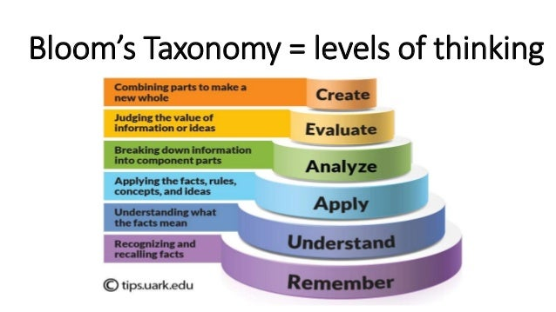

Slide 5
To analyze
explain or to interpret the structure of a piece of information.

Slide 6
To evaluate
form an idea about the value of something.

Slide 7
To synthesize
take ideas and information from multiple different sources and combine them into a new idea or theory of your own.

Slide 8
Discussion Board Posts

