Slide 1
Teachers of Tomorrow: Application of ChatGPT for Pre-Service Teachers
Neal Green, Thera Tilmon, Jordan Lucas, Eric Santos, Alex Flores-Vasquez
National Louis University
August 21, 2024
Author Note
This research was supported by the Scholarship of Teaching and Learning (SoTL) Fellowship at National Louis University.

Slide 2
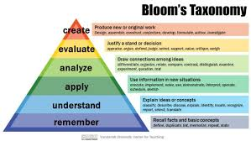
Research Objectives
Examine the impact of AI tools on lesson planning processes for pre-service elementary and early childhood teachers.
Evaluate how AI can support efficiency, creativity, and quality in lesson planning.
Identify challenges and benefits experienced by participants using AI in educational settings.

Slide 3
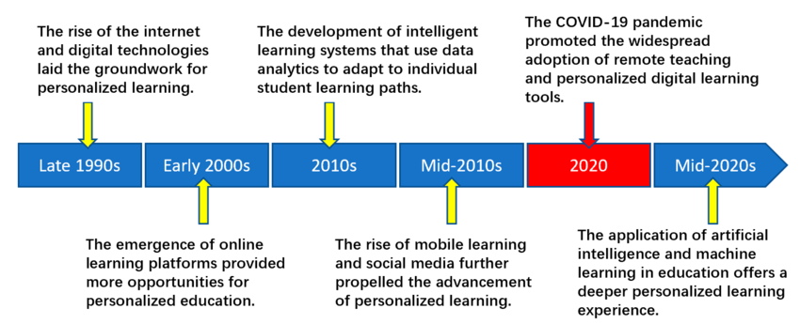
Motivation Behind the Research
Growing Need for Technological Integration: With the evolution in education, there is need to tap on technology in teaching.
The Need for Pre-Service Teachers Support: Frequently, pre-service teachers experience challenges in their lesson planning, and here AI offers them some support to improve their instructional practice.
Improved Learning Outcomes: This study looks at how AI can help in lesson planning that leads to improved student academic performance.
Source: Song, Chuanxiang & Shin, Seong-Yoon & Shin, Kwang-Seong. (2024). Implementing the Dynamic Feedback-Driven Learning Optimization Framework: A Machine Learning Approach to Personalize Educational Pathways. Applied Sciences. 14. 916. 10.3390/app14020916.

Slide 4
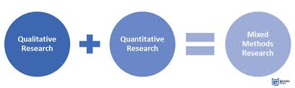
Mixed-Methodology Overview
Participants: 11 pre-service elementary and early childhood teachers.
AI Tool Used: ChatGPT.
Data Collection: Focus Group, Pre and Post-AI Enhanced Lesson Plan Rubric Scores, Post-AI Lesson Plan Reflection, Final Survey

Slide 5
Research Questions and Data Collection
RESEARCH QUESTION |  |  |  | FINDINGS BY SOURCE
 |  | Focus Group | Pre- AI Lesson Plan Rubric | Post- AI Lesson Plan Rubric | Post-AI Lesson Plan Reflection | Follow Up (Final) Survey
RQ # 2- Time |  | X | X |  | X | X
RQ #3- Quality |  |  | X | X | X | X
Guiding Research Question 1: Can ChatGPT’s guided utilization reduce time spent and improve quality of lesson plans for pre-service elementary and early childhood teachers during student teaching?
Research Question 2: Can ChatGPT reduce the time spent on administrative tasks (e.g., formatting lesson plans, finding resources, aligning with curriculum standards) related to lesson planning for pre-service elementary and early childhood teachers during student teaching?
Research Question 3: Does the use of ChatGPT lead to improvements in the quality of lesson plans created by pre-service elementary and early childhood teachers during student teaching?

Slide 6
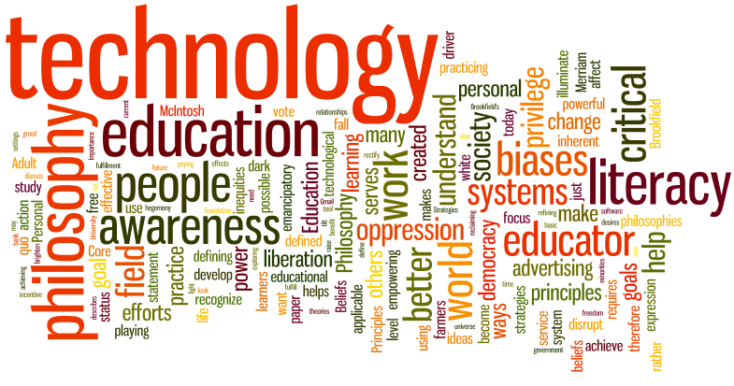
Challenges Reported by Participants
Initial Skepticism
Personal Touch
Tech Difficulties
Frustration-Interface and Functionality
Balance
AI and My Teaching Philosophy
Personal Touch- Quote: “At first, I was skeptical about using AI for lesson planning because I worried it might take away from my personal touch as a teacher."
Tech Difficulties- Quote: “It took me a while to get used to the interface, and sometimes it felt like the tool was more of a hindrance than a help.”
AI and Me- Quote: “The AI provided some great ideas, but I found it challenging to make sure that my own voice was still coming through in the plans."

Slide 7

Benefits Reported by Participants
Enhanced Creativity and Efficiency | Support in Organizing and Structuring Plans | Increased Confidence in Lesson Plans/Improved Quality of Plans
“AI gave me ideas I hadn’t considered, which really opened up new possibilities for my lessons.” | “It helped me structure my lessons in a way that made sure I covered all the key points and learning outcomes.” | “Knowing that the AI was there to support me gave me more confidence in my lesson plans, especially as a new teacher.”

Slide 8
Student Experience and Feedback
Overall Theme-Percetption of AI as a Planning Companion
“The AI tool was a great resource, and I’ll likely continue using it in my future teaching.”
Suggestion for an Improved AI Experience
“I think it would be even better if the AI could learn more about my style over time.”

Slide 9

Implications for Future Practice
AI as a Support Tool: AI could be used as support in several preparation tasks in lesson preparation for pre-service teachers and also in everday, administrative tasks.
Professional Development: Students and educators need targeted professional development concerning effective usage of AI tools, including knowledge on how to create appropriate prompts and developing an understanding of the limitations of AI-generated content.
Ethical Considerations: Biases, data privacy, plagiarism, student dependency on the tool, equity of access to AI, data secuity, human oversight and accountability, and more related to AI usage in education are pending.

Slide 10

Next Steps
Research Long-Term Outcomes
-Research how the use of AI, as well as learning, will be affected in the long run.
-Research how the actual AI tools themselves are enhanced through long-term classroom experiences.
Improve Alignment of AI Tools
-Continue to create a better alignment of the AI-developed materials to the classroom situation or setting.
-Make the AI tools more adaptable across a variety of learning environments.
Collaborate on Development of AI in Ed
-Ensure collaboration between educators, AI developers, and researchers.
-Ensure that AI tools are developed for the benefit of teachers and students alike.

Slide 11
Q/A
Discussions about AI are critical to overcoming our own understanding and potential uses for the tool! Let's talk!

Slide 12
Findings
Total Scores Analysis
 | Total Pre-AI Scores | Total Post AI Scores | Score Improvement
Student 1 | 78 | 116 | + 38
Student 2 | 104 | 122 | + 18
Student 3 | 104 | 92 | - 12
Student 4 | 124 | 92 | - 32
Student 5 | 96 | 122 | + 26
Student 6 | 98 | 114 | + 16
Student 7 | 118 | 140 | + 22
Student 8 | 84 | 110 | + 26
Student 9 | 88 | 112 | + 24
Student 10 | 106 | 104 | - 2
Total | 1000 | 1124 | +124

Slide 13
Findings
Instructional Strategies
 | Pre-AI Scores | Post AI Scores | Difference
Student 1 | 14 | 16 | + 4
Student 2 | 16 | 16 | 0
Student 3 | 16 | 20 | + 4
Student 4 | 16 | 20 | + 4
Student 5 | 16 | 20 | + 4
Student 6 | 16 | 16 | 0
Student 7 | 16 | 20 | + 4
Student 8 | 12 | 16 | + 4
Student 9 | 16 | 16 | 0
Student 10 | 16 | 20 | + 4
Total | 154 | 180 | + 28

