Slide 1

ChatGPT &
Higher Education
Enlighten in Eleven
Angela Elkordy &
Donna Wakefield
March 17, 2023

Slide 2
Agenda
What is ChatGPT?
What can ChatGPT do?
What can ChatGPT not do? Or do poorly?
5 Things Folks in Higher Ed Are Talking About
What Can ChatGPT Do For Higher Ed?
What can Educators do?
Additional Resources

Slide 3
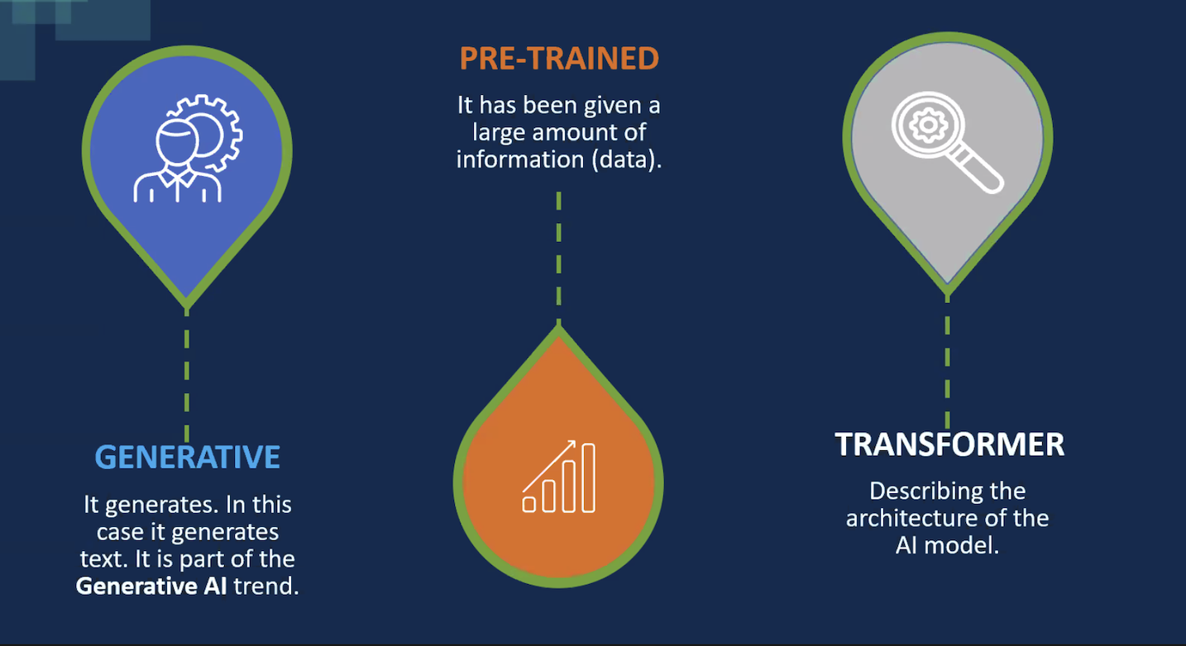
What is ChatGPT?
HELEN COMPTON -
Notes:
Currently released as a research beta by OpenAI, 11/30
Is not connected to the Internet
Generative means it creates text
Large language model
It is capable of generating human-like text and has a wide range of applications, including language translation, language modelling, and generating text for applications such as chatbots. It is one of the largest and most powerful language processing AI models to date, with 175 billion parameters.
https://www.sciencefocus.com/future-technology/gpt-3/

Slide 4
What is ChatGPT?
Artificial intelligence (AI) tool developed by OpenAI (est. 2015)
Classed as a chatbot (conversational robot)
GPT means - Generative Pre-trained Transformer
Currently, GPT-3, GPT-4 (just released)
Trained on a database to respond to natural language (NLP) prompts by generating text through a neural network
AMA (ask me anything) - answers in natural language
Notes:
Currently released as a research beta by OpenAI, 11/30
Is not connected to the Internet
Generative means it creates text
Large language model
It is capable of generating human-like text and has a wide range of applications, including language translation, language modelling, and generating text for applications such as chatbots. It is one of the largest and most powerful language processing AI models to date, with 175 billion parameters.
https://www.sciencefocus.com/future-technology/gpt-3/

Slide 5
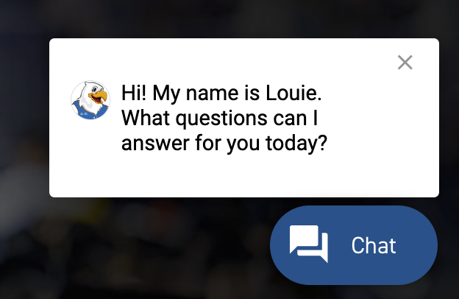
What is ChatGPT?
AI Tools you may already use (or may be interested in using):
  Grammarly
  TurnItIn
  Text to image generators, eg. Canva
  Curipod - writes a lesson plan and produces a slide deck
  Block survey - generates surveys using AI
  NLU’s own Louie
Notes:
Currently released as a research beta by OpenAI, 11/30
Is not connected to the Internet
Generative means it creates text
Large language model
It is capable of generating human-like text and has a wide range of applications, including language translation, language modelling, and generating text for applications such as chatbots. It is one of the largest and most powerful language processing AI models to date, with 175 billion parameters.
https://www.sciencefocus.com/future-technology/gpt-3/

Slide 6
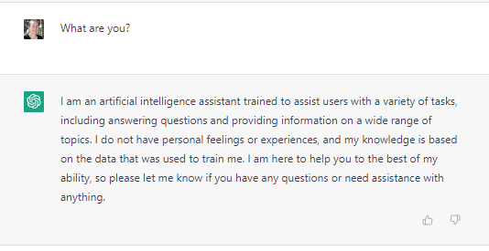
What is ChatGPT?
An artificial intelligence (AI) tool that uses natural language processing techniques to respond to user-generated prompts.
Put simply: You ask ChatGPT a question or provide a prompt, it replies using natural language.
Screenshot of ChatGPT prompt and response.

Slide 7
What can ChatGPT do?
Write stories (at various language levels and complexity)
Write lesson plans
Draft curriculum
Summarize text (at different reading levels)
Analyze data
Give advice
Notes:
Two skills of ChatGPT are considered resolutely innovative: the robot's ability to break down a relatively complex task into several small elementary tasks, as a computer program would do, in order to facilitate its execution for the benefit of humans.
ChatGPT can also be creative: it can be asked to tell a story with different characters taken from existing books.

Slide 8
Short demo
https://watch.screencastify.com/v/7LAE8pM1d9HOp7EuLxYK

Slide 9
What can ChatGPT do?
Write in the style of - eg. Shakespeare, 4th grade level reading level, critical analysis
Create a table of contents for a proposed book
Create an outline for a presentation
Create a structure for a professional development session
Organize a response into a table format
Respond to any questions in a conversational manner
Notes:
Two skills of ChatGPT are considered resolutely innovative: the robot's ability to break down a relatively complex task into several small elementary tasks, as a computer program would do, in order to facilitate its execution for the benefit of humans.
ChatGPT can also be creative: it can be asked to tell a story with different characters taken from existing books.

Slide 10
What can ChatGPT not do? Or do poorly?
Generate text on events after 2021
Cite its sources or make up sources
Describe its own feelings or make emotional judgements
Can incorporate common biases and opinions
Talk about topics that violate its code of ethics or terms of service
Common sense reasoning
Understand context or causality
Advanced math

Slide 11
5 Things Folks in Higher Ed Are Talking About
Large scale plagiarism and cheating -
AI Text Generators: Sources to Stimulate Discussion among Teachers
Inaccurate or misleading information
The Next Great Misinformation Superspreader: How ChatGPT Could Spread Toxic Misinformation At Unprecedented Scale
Makes things up!
ChatGPT: Understanding the new landscape and short-term solutions

Slide 12
5 Things Folks in Higher Ed Are Talking About
3. Bias and censorship
4. Privacy concerns - don’t enter personal data! Users are
free labor to refine the algorithms
5. Huge opportunity to re-evaluate teaching and learning in higher education

Slide 13
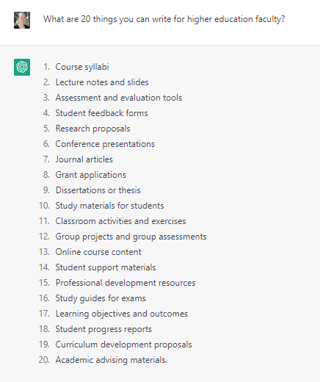
What Can ChatGPT Do For Higher Ed?
Write many different things for higher ed faculty.

Slide 14
What can Educators Do?
How to Leverage ChatGPT Use -
Don't Ban the Tool
Focus on Higher Order Thinking
Incorporate Authentic Student Experience and Student Connections Into Questions
Use ChatGPT Detectors With Caution
Have Open Discussions About ChatGPT and Its Uses in Your Class

Slide 15
What can Educators Do?
Update syllabi
Talk with students about academic integrity
Redesign assignments. Be transparent about assignments
Encourage risk-taking, productive struggle, and learning from failure
Reconsider the approach to grading
Shift from extrinsic to intrinsic motivation

Slide 16
What can Educators Do?
.Use ChatGPT as an educational tool.
  Engage students in critiquing and improving ChatGPT responses.
  Analyze how ChatGPT generates text for different audiences.
  Help students build their information literacy skills.
  Have students generate prompts for ChatGPT and compare and contrast the output.

Slide 17
What can Educators Do?
“As the adage goes “Adapt or Die.” Just as during the pandemic schools had to overnight adapt to a new style of teaching and learning, ChatGPT will force this as well.”
Alice Keeler, Educational Technology Specialist
“Obviously, teachers are less delighted about the computer doing a lot of legwork for students. And students still need to learn to write. But in what way, and what kinds of writing? A third side effect of this new medicine is that it requires all of us to ask those questions and probably make some substantive changes to the overarching goals and methods of our instruction.”
Sarah Levine, assistant professor of education

Slide 18
Learn More - Resources
Try ChatGPT
https://chat.openai.com/chat

Slide 19
Additional Resources
Curated Collections of Resources
ChatGPT through an Education lens slide deck
AI Text Generators: Sources to Stimulate Discussion among Teachers (curated Google Doc)
AI in Education (Wakelet Curation)
Resources for exploring ChatGPT and higher education (blog)
Twitter Thread compilation of resources
SFCC Library LibGuide for ChatGPT
A Small Collection of ChatGPT Articles and Resources
School Libraries ChatGPT
Generative AI (ChatGPT) Resources (Padlet)

Slide 20
Additional Resources
Social Media Spaces for Learning
Higher Ed Discussions of AI Writing
AI
White House: Blueprint for an AI Bill of Rights
A checklist of eighteen pitfalls in AI journalism
A People’s Guide to AI

Slide 21
Additional Resources
Articles
Has AI reached the point where a software program can do better work than you?
Teaching Students to Write with AI: The SPACE Framework
What are We Doing About AI Essays?
AI Homework
ChatGPT: A Must-See Before the Semester Begins
ChatGPT Is Not Ready to Teach Geometry (Yet)
ChatGPT with My Students
ChatGPT Is Dumber Than You Think

Slide 22
Additional Resources
Articles
NYC education department blocks ChatGPT on school devices, networks

Slide 23
Additional Resources
Syllabi Information
Sentient Syllabus Project for potential language you might use in your syllabus about ChatGPT.
Update Your Course Syllabus for chatGPT.

Slide 24
Design Elements used for Accessibility
Font used - Lexend Deca
Font Color - Dark Blue 2
Background Color - Light Grey 2
Slides clear, simple and uncrowded
One subject per slide, using no more than six bullet points
Bold used for emphasis, no italics, highlighting, or underlining
Text aligned to the left

