Slide 1
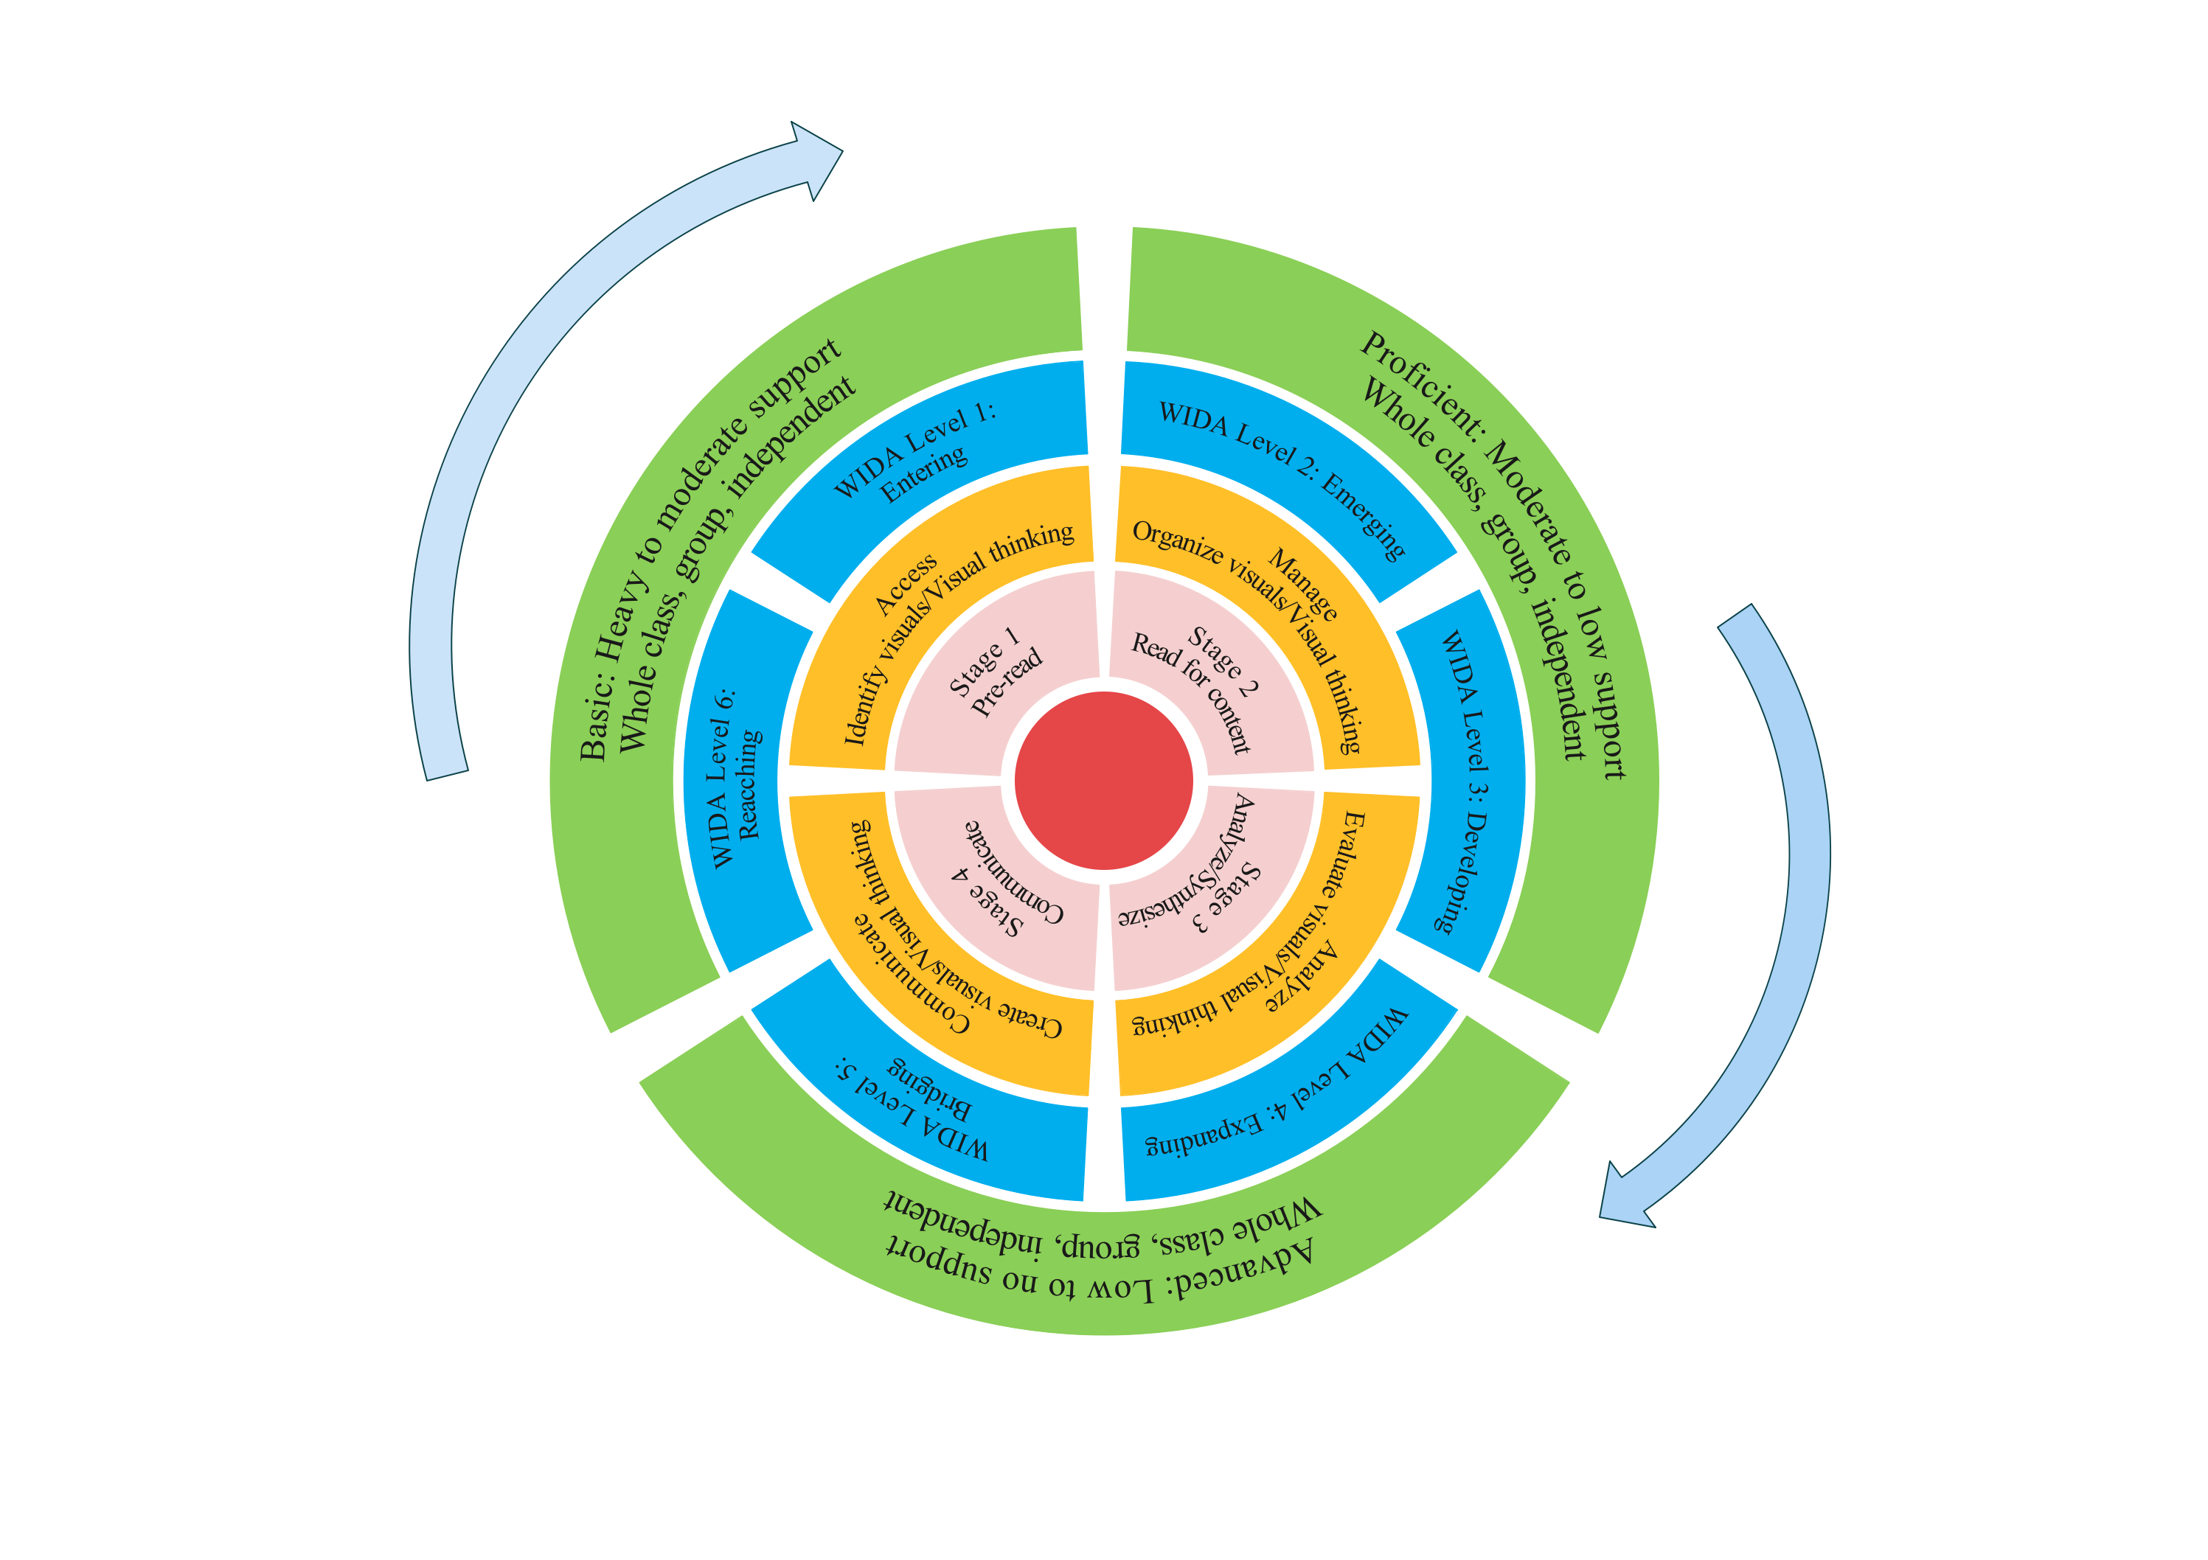
The Visual Literacy Framework
A progressive learning sequence for all learners
Xiaoning Chen and Mark Newman
How can students move to higher levels of competency over time?
How can teachers chart student progress over time?
How can teachers ensure the individual needs of all students are met?

Slide 2
The Visual Literacy Framework
Strategies for multilingual learners
Stages of Visual Literacy with Multilingual Learner Support
1. Pre-read
• access prior knowledge
• pre-teach vocabulary
• identify provenance
• examine/pose questions using sentence stems
2. Read for content
• identify pertinent information
• manage information using
graphic organizer
• answer, pose questions using
sentence stems
3. Analyze/ synthesize
• Synthesize findings using graphic
organizer
• Evaluate findings
• create thesis using sentence stems
4. Communicate
• Develop answer using graphic
organizer
• create answer using sentence stems
• present findings
WIDA Levels
1. Entering
little or no English
2. Emerging
limited proficiency in speaking, listening, reading, and writing
3. Developing
some understanding of academic
content and can complete limited
academic tasks at grade level
4. Expanding
complete more academic tasks at
grade level
5. Bridging
complete academic tasks with
more independence
6. Reaching
complete academic tasks
independently

Slide 3
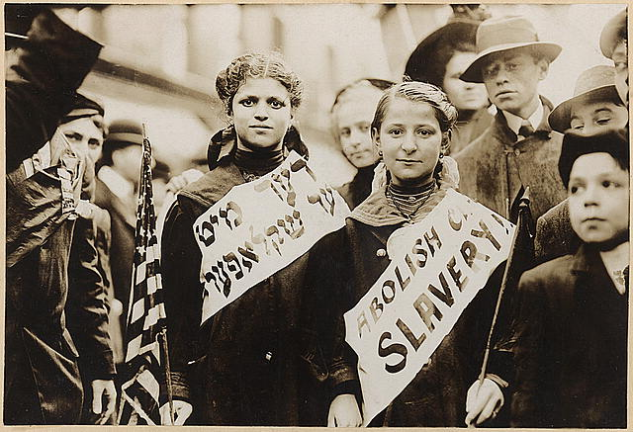
The Visual Literacy Framework
Multilingual learners: Reading for content
How it works with an example
Basic
Teacher modeling thinking steps and visual literacy strategies (e.g., the rule of thirds) for the whole group
Explicitly addressing the cultural symbol and its meaning if necessary
Students working in small groups to complete the partially filled graphic organizer (e.g., who, when, where, what, and how)
Answering questions posed by the teacher using provided word bank and sentence stems
Summary: Photograph shows half-length portrait of two girls wearing banners with slogan "ABOLISH CH[ILD] SLAVERY!!" in English and Yiddish, one carrying American flag; spectators stand nearby. Probably taken during May 1, 1909 labor parade in New York City. Retrieved from http://hdl.loc.gov/loc.pnp/ppmsca.06591

Slide 4
The Visual Literacy Framework
Multilingual learners: Reading for content
How it works with an example
Proficient
Student think, pair, share facilitated by teacher: What steps do you take to make sense of the photo? What are applicable visual literacy strategies?
Students working in small groups/pairs to complete the graphic organizer (e.g., who, when, where, what, and how) & research the cultural symbol if needed
Answering questions posed by peers and raising additional questions with the support of word bank and sentence stems
Summary: Photograph shows half-length portrait of two girls wearing banners with slogan "ABOLISH CH[ILD] SLAVERY!!" in English and Yiddish, one carrying American flag; spectators stand nearby. Probably taken during May 1, 1909 labor parade in New York City. Retrieved from http://hdl.loc.gov/loc.pnp/ppmsca.06591

