Slide 1
Teaching during Tumultuous Times
Sophie Degener

Slide 2
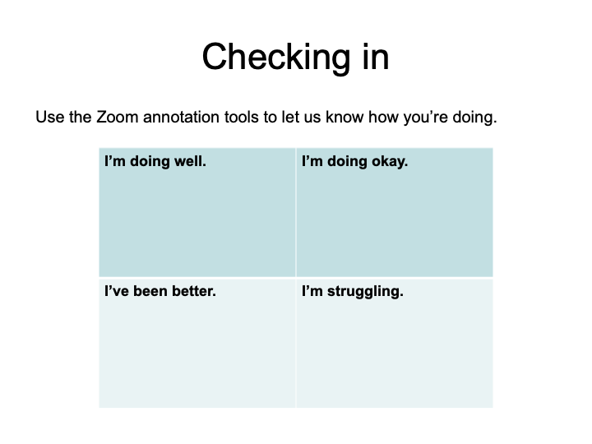

Slide 3
Preliminary studies reveal that the pandemic has most impacted:
Black and Brown students
Students from low-SES backgrounds
Students with mental health concerns
Students with physical concerns and disabilities
And...students who contracted COVID

Slide 4

Our Students Are Stressed!

Slide 5
What you can do before class even starts
Carefully consider your syllabus and class policies
Survey your students
Community building

Slide 6
Things to consider in syllabus
Tone: How approachable are you?
Late assignment policies
Attendance policies
Camera on/off policy
Listing NLU resources, e.g. food pantry, mental health services, etc.

Slide 7
Syllabus: Attendance Policy
Old Language:
Attendance Policy: You are expected to attend and participate in each class session--- more than one absence or multiple tardies may negatively affect your grade. If for any reason you have to miss class, you must notify me by phone or email. It is your responsibility to arrange with another student to obtain notes and other materials for the class you will miss as well as find out about weekly assignments. Leaving class early, entering class late, and/or missing more than one class may result in the lowering of your grade. If you miss more than two classes, it may result in receiving an incomplete (I) for the course or repeating the course.
New Language:
During the pandemic, there may be medical or personal circumstances beyond your control. Please make sure you communicate with me about this. I will make every effort to accommodate you, when possible, to ensure successful completion of the class, but I can’t help you if I am not aware. Note that there will be plenty of opportunities to meet with me one-on-one during virtual office hours. I am here to support you!

Slide 8
Syllabus Inclusion Statement
Inclusivity: Inclusivity is as important in this class as it is in your own classrooms. Every student in this class, regardless of personal history or identity categories, is a valued class member. Your experiences are valuable, and you should feel free to share them as they become relevant to our class. No student in this class is ever expected or believed to speak for all members of a group.
In this class, you have the right to determine your own identity. You have the right to be called by whatever name you wish and for that name to be pronounced correctly. You have the right to be referred to by your pronouns. You have the right to adjust these things at any point in your education.
If you find that there are aspects of course instruction, subject matter, or class environment that result in barriers to your inclusion, please contact me privately without fear of reprisal. It is important to me that every class member feel included and valued.

Slide 9
Pre-Class Survey to find out:
Which program and how long?
Internet capabilities for Zoom class
Information about themselves as learners
What’s on their mind? What’s worrying them right now?
https://docs.google.com/forms/d/1XB1tZR9LDMMI097reYK5UcRBgoI7fc57n3sSrd0S95I/edit

Slide 10
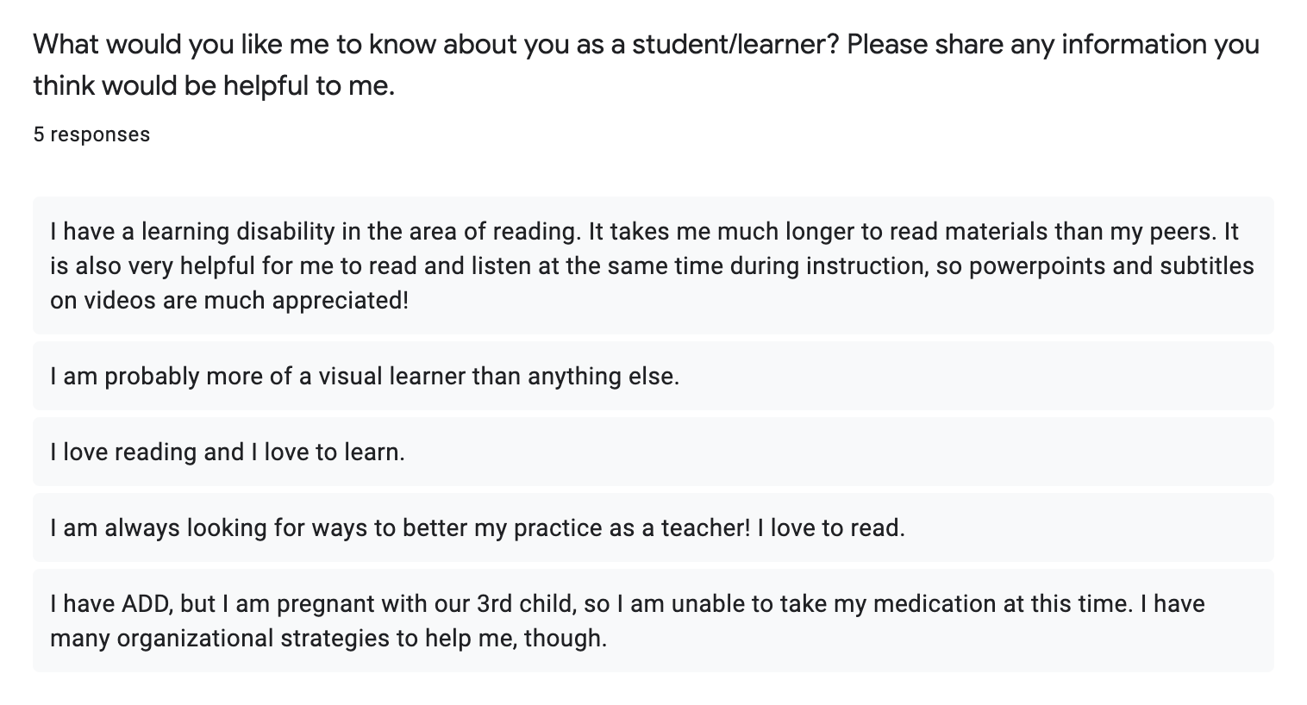

Slide 11
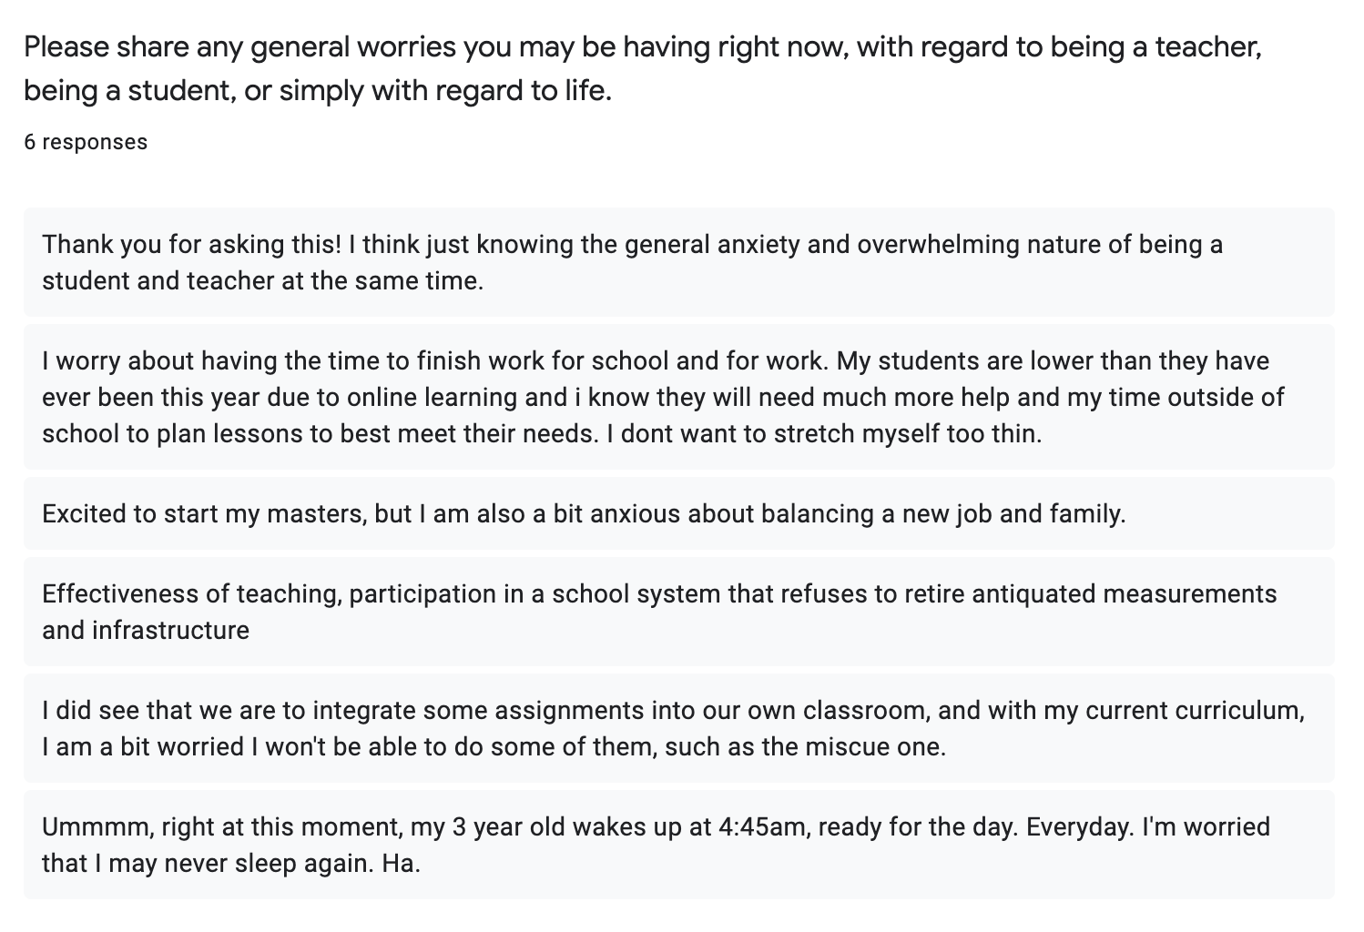

Slide 12
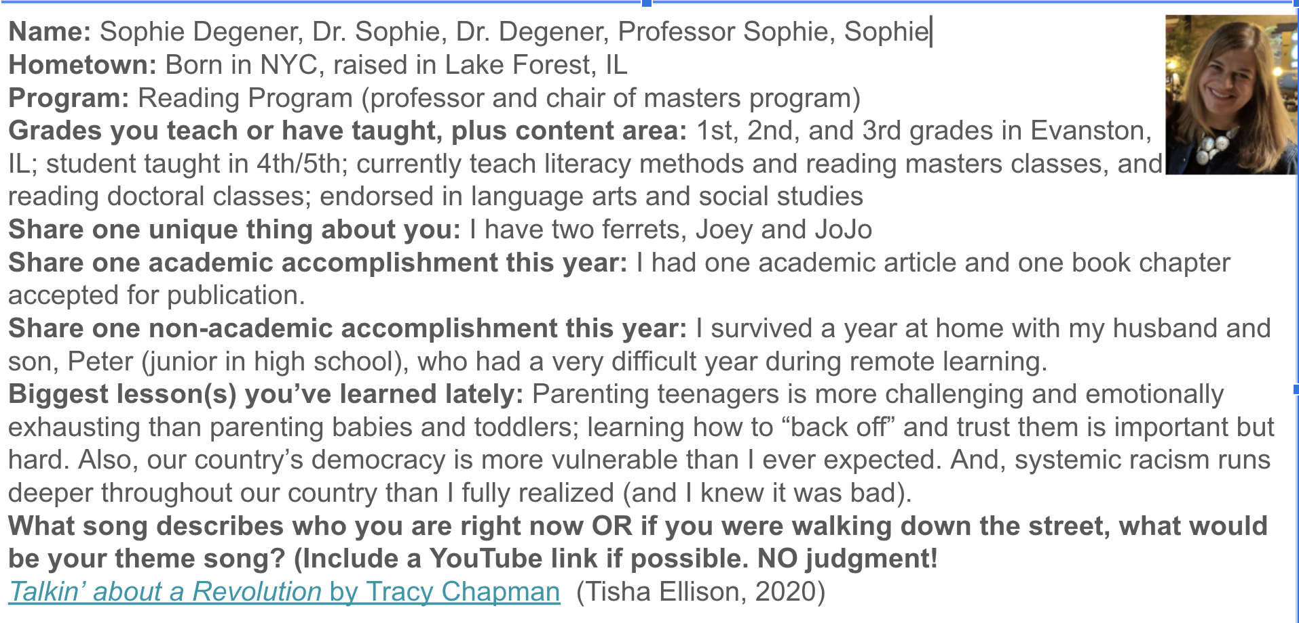
Community building before class starts

Slide 13
Strategies during class
Weekly check-in at beginning of class
Meditation
Community building
Checking in via survey after class

Slide 14
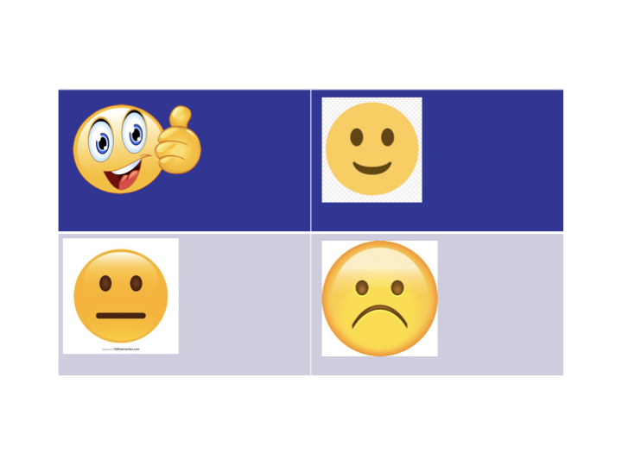

Slide 15
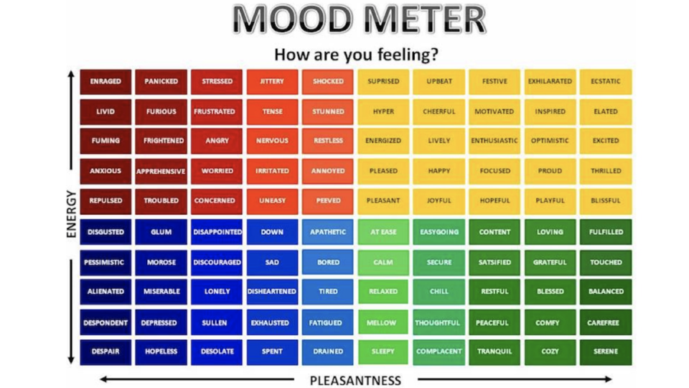

Slide 16
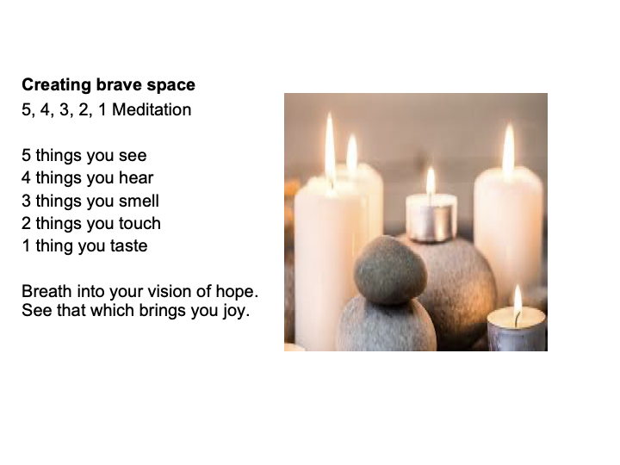

Slide 17


Slide 18
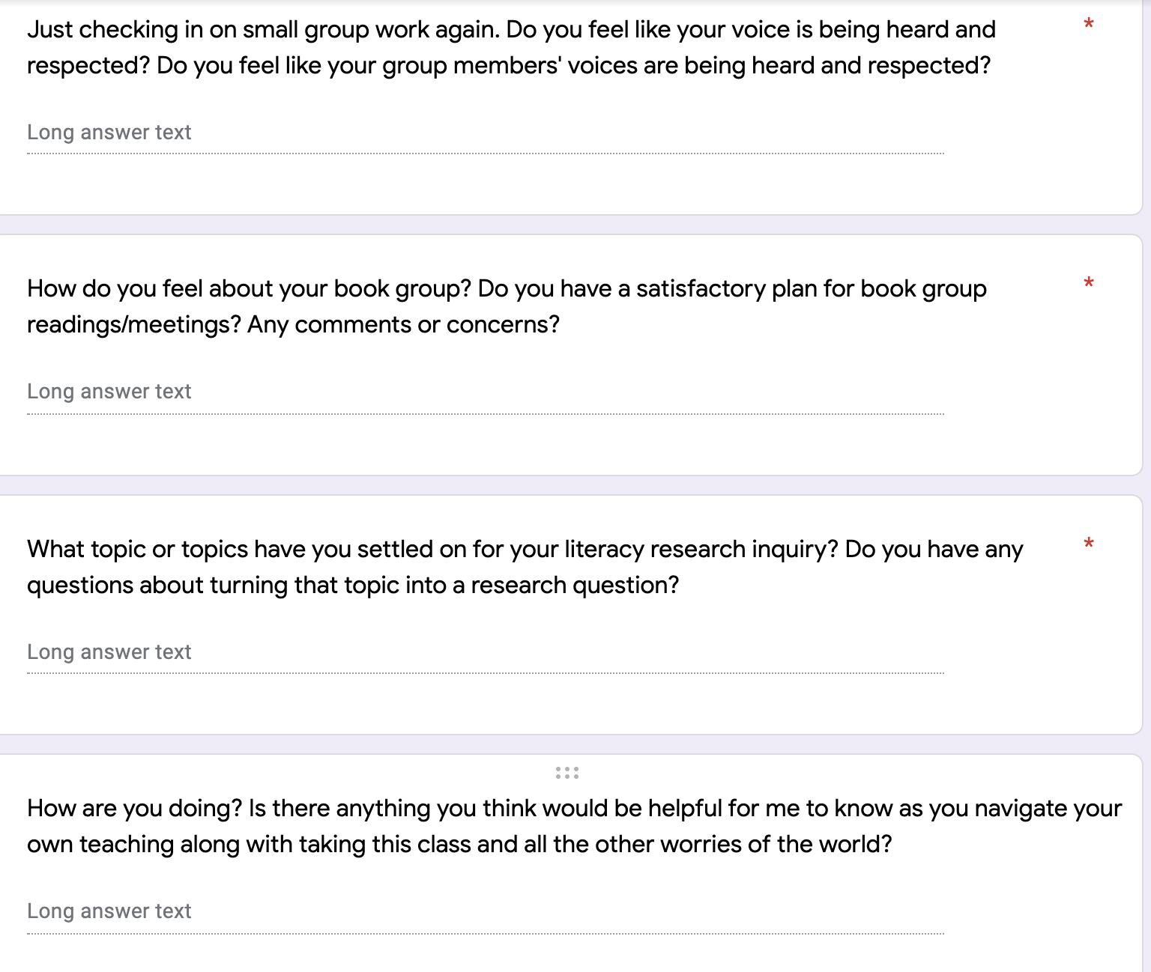

Slide 19
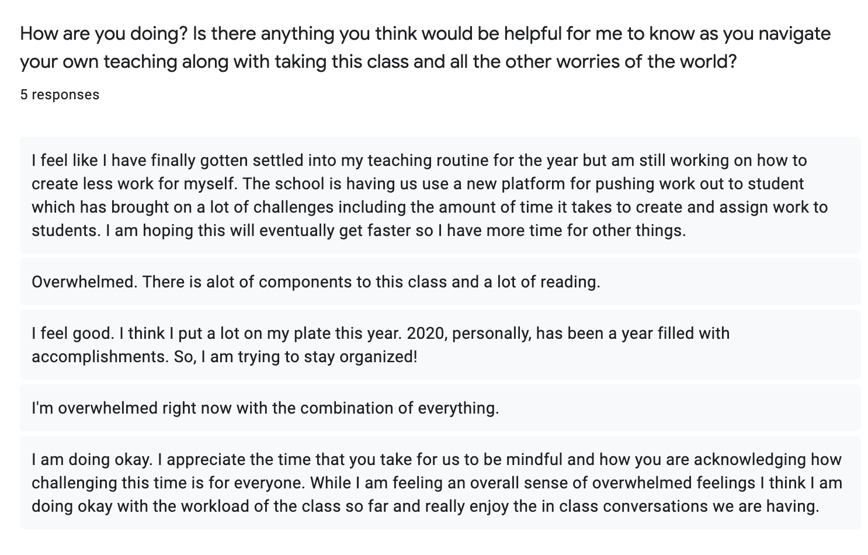

Slide 20
Please share any final thoughts about the class, the quarter, the online nature of our class, any suggestions for the future, etc.
I loved your flexibility and support. Thank you so much for everything. It really helped me get through the tough times I was facing outside of class. Your support allowed me to finish the course strong. Thank you, thank you!
I just wanted to say thank you for everything, Sophie. You were truly a God send to me this semester. Through writing and through your patience with me, I was able to work through so many difficulties. I do not have the words to ever properly express my gratitude. Please know that you have rejuvenated my spirit in many ways, and you have reminded me the importance of seeing my students as people first, as you did for me.
I truly loved the class! Thank you for always taking time in the beginning of live classes to do a check in and give us a moment to pause and be present.
I really appreciate your kindness and the way that you have been so receptive and responsive to us as students and to the world.

Slide 21
Kindness costs nothing but means everything.

Slide 22
10 Course Policies to Rethink on Your Fall Syllabus
https://www.chronicle.com/article/10-course-policies-to-rethink-on-your-fall-syllabus?cid=gen_sign_in

