Slide 1
Self-Care Part II: Growing from Trauma
Presentation to the NLU Faculty
Leah Horvath
Jon Oelke
Judah Viola
Notes:
In round two of this Self-Care workshop, we explore post traumatic growth. This concept helps us break from the pop culture implications that all trauma immediately leads to Post-Traumatic Stress Disorder (PTSD). Leah Horvath and Jon Oelke, along with Judah Viola will provide insights into how we can reframe traumatic events, such as the Covid Crisis, as traumatic injuries that can be treated and healed. As a takeaway, we will share the DEAR MAN approach for resolving conflict or making a request (such as when setting boundaries).

Slide 2
Previously on Self-Care with Leah and Jon
Defining self-care
Thinking through barriers to self-care
Building your resilience toolkit
  Setting Boundaries
  Mindfulness
  Self-compassion
Today, we’re going to focus on trauma and giving ourselves space to move through that trauma.

Slide 3
Trauma--Broadly defined
•Threat to cognitive or psychological integrity-- a severe challenge to individuals’ past ways of understanding the world and their place in it, their personal identity.

Slide 4
Trauma & Cognition
Challenging or shattering the assumptive world or core beliefs about
•benevolence
•safety
•predictability
•controllability
•vulnerability
•self-esteem
•morality (moral injury)

Slide 5
Trauma and narrative
•Trauma is often a turning point in our life narrative, a watershed event.
•Events are traumatic when they disrupt the anticipated course of life or the plan people had for their lives.
•If an event divides life into “before and after” it may be traumatic, and also, growth-enhancing.

Slide 6
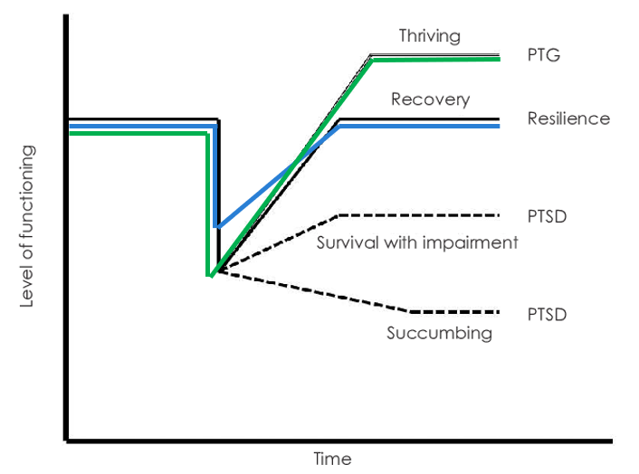
Notes:
Large majority of people who experience trauma go through a natural recovery process. Everyone experiences posttraumatic symptoms at first, but they lessen with time.
Although traumatic events undoubtedly can cause significant emotional distress, a newer perspective suggests that actually, from pain can arise positive change
-This is what we know as posttraumatic growth, or positive psychological and life changes that result from struggling with the aftermath of a trauma.

Slide 7

Post Traumatic Growth (PTG)
Posttraumatic Growth is both a process and an outcome: The experience of positive changes in oneself as a result of the struggle with traumatic events.
Changes are transformative and involve changes in perspective.
Notes:
•Resilience: “The ability to recover readily from illness, depression, adversity or the like.” The ability to regain shape.
•PTG: A new level of functioning and perspective--transformative responses to adversity.
Benefits may not = growth
PTG focuses on personal transformation, beyond otherwise important benefits such as changes in health practices.

Slide 8
Philosophy of PTG
▪ There is a sense of possibility for growth in the aftermath of trauma
▪ Paradigm shift to living with past experiences vs. extinguishing them
▪ People see themselves as suffering not because of character defects, but because of what happened; relieves shame & self-stigma
▪ PTG model posits that in order to facilitate PTG, trauma survivors will benefit from expert companionship; the process is common and often occurs naturally

Slide 9
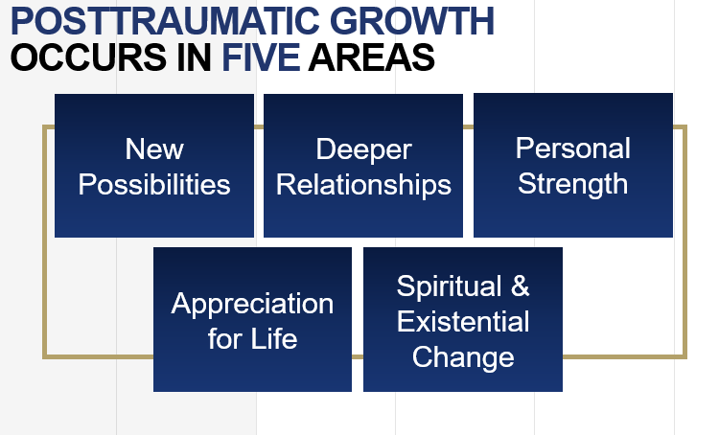
Notes:
Can happen across one, a few, or all of five domains
But, growth is not universal. Many people have resilience going into a trauma and make it through without their world being “shattered,” so PTG isn’t even necessary.
If you don’t notice PTG – it may mean that you were already resilient enough going into the trauma that it didn’t profoundly change you in these different ways!

Slide 10
Examples of PTG
A soldier who lost his friend during a convoy
•I struggled with Dave’s death for a long time. I still struggle with it. But I look at my daughter, my wife, my home…and I feel appreciative. I’m sad that he died, but because of his death I no longer take things for granted and I cherish so many things in my life. Dave gave this gift to me.

Slide 11
A bereaved mother
•Before Roberto’s death I often said that family was my priority. I believed that, but my actions didn’t always show it. Now, family is a priority in my heart, head, and in my actions. I am there for my other children and my husband. Not a day goes by that I don’t grieve for my beautiful boy, but not a day goes by that I don’t thank him for giving me perspective and making our family stronger. We all love each other deeper…and can love deeper…
I love deeper because of him.

Slide 12
5 Steps typically involved
1. Appreciating and using dialectical thinking.
2. Constructing meaning.
3. Seeking, finding, reminding, and constructing benefits for oneself and others.
4. Establishing and maintaining a future orientation with altered priorities.
5. Constructing a coherent narrative, with purpose or meaning that transform loss into something good.
Notes:
The path to PTG looks different for different people. But generally, we see the trauma survivor go through 4-5 different stages. PTG is achieved through a process of repeatedly thinking about, making sense of, and finding meaning in an experience, which in turn can lead to growth
•Empirically based on model of PTG process
•Compatible with empirically supported PTSD therapies
•Integrative: Cognitive, Narrative, Constructivist, Existentialist

Slide 13
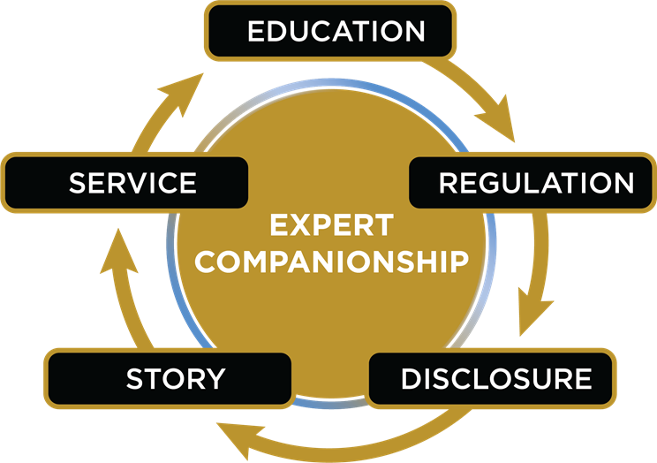
Five Phases for Facilitating PTG
Notes:
Note: Growth is not universal. Many people have resilience going into a trauma and make it through without their world being “shattered,” so PTG isn’t even necessary.
If you don’t notice PTG – it may mean that you were already resilient enough going into the trauma that it didn’t profoundly change you in these different ways.
How might a trauma survivor support PTG in his or her own recovery?
One is to let yourself experience painful thoughts and emotions that arise, as this is an important initial step in processing trauma. Growth can’t occur until that distress becomes less intense.
What we call self-disclosure, is important. This is expressing your experience of the trauma. Self-disclosure serves as a space for that deliberate reflection that is so important to building PTG. This doesn’t have to mean talking to another person, or therapy or anything (in fact, many people experience PTG without the help of a professional). It can be writing about the trauma, or creating art. This gives you the ability to answer questions like, How did I change as a person from “before” to “after”? What things do I do now that I didn’t do before? How has my outlook on life changed? On how I view myself?
The journey is iterative and requires patience, perseverance, and a commitment to doing the hard work.

Slide 14
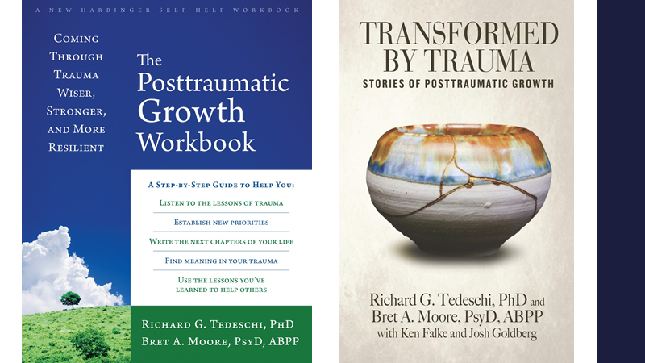

Slide 15


Slide 16
“But I don’t have time!”
If you’re finding that you don’t have time for self-care…. why is that?
  Priorities?
  More than likely it’s projects that you’ve agreed to.
  “Oh, please just join this meeting, it won’t take a ton of your time.”
  The next thing you know, you’re writing a grant.
How did we make this leap?
Boundaries

Slide 17
DEAR MAN - A Strategy for Maintaining Boundaries
D - Describe
E - Express
A - Assert
R - Reinforce
M - mindfully
A - appear confident
N - negotiate
Notes:
DEAR MAN skills are an important part of the interpersonal effectiveness training in DBT, an evidence-based psychological treatment.
These skills can be helpful in lots of situations - I regularly teach them to clients and use them myself. They provide a clear, structured way to organize thoughts and feelings, articulate one’s needs or wants, and do so in a way that balances the relationship and maintaining self-respect

Slide 18
DEAR MAN Situation
Your program chair (or dean or boss or manager) has come to ask you to teach a last minute class. It’s a topic that you really enjoy and you want to be helpful and maintain a good relationship with your program chair. At the same time, you are already overbooked with teaching and other professional obligations and you are the primary caregiver for an elderly parent, which means you are juggling a lot of competing demands. You worry that if you take on this class, your well-being will suffer. But you also worry that if you do not take on this class, you’ll disappoint your chair and the students and you may not have the chance to teach this class again.

Slide 19
What to do?
First, consider what your goals in this situation are:
Objective Goal - to say no to teaching this extra class
Relationship Goal - to maintain a good relationship with your chair
Self-Respect Goal- to feel good about yourself for upholding your boundaries and being respectful in your interaction

Slide 20
Describe
Just the facts
Think about the who, what, when, where of the situation
Example -
You asked me to teach this extra class, which is a topic I really enjoy teaching. This semester, I am teaching overload already and caring for my elderly parent.

Slide 21
Express
Say how you feel about the situation
Example -
I feel torn in this situation. I want to be seen as a good colleague and want to help out the program and the students, and I also worry that I will sacrifice my well-being if I take on additional responsibilities at this time.

Slide 22
Assert
Ask for what you want or clearly say no
This must be explicit and direct - no assuming the other person will guess your wants/needs
Example -
As much as I would like to teach this course, I am declining the request. I am not able to teach this class this semester.

Slide 23
Reinforce
Offer a reinforcement or incentive to the other person
Oftentimes a “thank you” may be enough here
Example -
I appreciate your understanding. I know that I’ll be better able to fulfill my other course and professional responsibilities if I say not to taking on this extra class.

Slide 24
MAN - the “how” skills
Be Mindful - this is a reminder to stay focused on the topic at hand. Sometimes when people don’t like the request we are making or the ask we are refusing, they may try to change the topic. This is a reminder to be a broken record and keep coming back to the topic.
Appear Confident - even if you feel very nervous about making your request or saying no, do your best to appear confident. The more prepared you are - the easier this will be (do your homework first)
Negotiate - you may need to be willing to give a little to get. Be open to negotiating to get your needs met.
Notes:
Depending on time and number of participants - I could give folks an example to practice with (in the small or large group)

