Slide 1
Self-Care: Building Your Resilience Toolkit
Presentation to the NLU Faculty
Jon Oelke
Leah Horvath

Slide 2
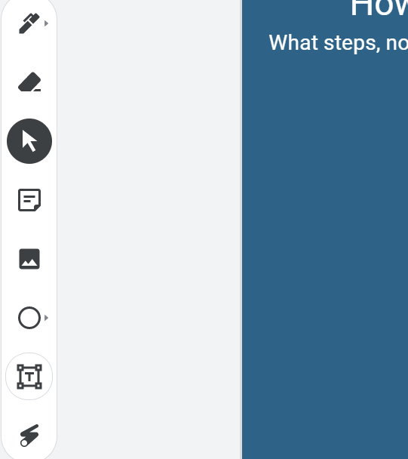
Check-in Icebreaker
Use the JamBoard to share some progress you’ve made on self-improvement since the beginning of the pandemic. You can add an image or use a sticky note.
Link to JamBoard - or copy the link below
Sticky Note
Add an image
https://jamboard.google.com/d/1TOVIy7IS-4w7SJEK3gGFwP418RpVDwkaWA9giLUm-Oc/edit?usp=sharing
Notes:
My thought here is that we’d want to show people how resilient they’ve already been. Many have read books, taken online classes, or learned a new language in the past 18 months. I plan to recap by telling them how great they’ve done and asking that they give themselves more credit.

Slide 3
Defining Self-Care
What comes to mind when you hear these words?
Consider how you care for yourself in each of these domains:
Physical
Emotional/Well-being
Spiritual
Social/Relationships
Intellectual/Work
Financial
Environmental
Notes:
Self-care isn’t just about doing things that you enjoy or that seem like an indulgence (e.g. a massage or a bubble bath). Self-care involves being kind to yourself and true to yourself across all of the domains of your life. It involves a regular check-in and examination of how you’re doing in these key areas (and you may have other areas you’d add to the list) and making changes to keep your life in line with your values.

Slide 4
What gets in the way of self-care?
We all know self-care is good for us - but we aren’t always the best at prioritizing our health and well-being.
So what gets in the way for you?
Too busy/not enough time
Not making myself a priority/putting other people’s needs first
Fear of asking for help
Difficulty setting boundaries and saying no
Not part of your routine
Not something that was taught or modeled for you

Slide 5
Share What Helps You Cope
Outdoor activities (hiking or biking)
Sports
Working out
Board games
Chatting with friends
People-watching
Binging a new show on Netflix
Reading that new novel that’s meant to be for tweens, but omg you just can’t get enough

Slide 6
Building Your Resilience Toolkit (Bank Account)
Think of self-care as more than an activity -it’s a daily practice - a way of living.
If we are in the habit of taking care of our whole self and regularly checking in on areas that need attention, we’ll be better positioned to manage bigger crises.
Just like it’s recommended to have a safety net of financial savings (if possible), we want to have a safety net of resiliency.
Notes:
Our resilience is a finite resource - it we are overtaxed or overstressed, we need to draw from our resilience bank account. If we don’t have that (we haven’t been taking care of ourselves), we are more likely to experience depression, anxiety, uncontrolled anger, or impulse control which can show up as binge eating, substance abuse, unsafe sex, excessive spending, gambling, etc.
- You need to build your resilience bank account so that you can continue to thrive in this crisis – sleep, nutrition, exercise, meditation, self-compassion, gratitude, connection, and saying no.

Slide 7
Building Your Resilience Toolkit (Bank Account)
Physical
Exercise, sleep, nutrition, treating illnesses, taking medications as prescribed
Emotional/Well-being
Managing stress, expressing emotion, engaging in therapy, cognitive reframing, doing things you enjoy
Spiritual
Connecting with your beliefs and values and living in accord with those
Social/Relationships
Tending to relationships with family, friends, partners, co-workers, neighbors; pruning unhealthy relationships
Intellectual/Work
Staying curious, learning, finding meaning/value in your work
Financial
Living within financial means, creating a budget, spending in a values-consistent way
Environmental
Caring for your surroundings, inside and out; avoiding clutter, keeping things that have meaning

Slide 8
Building Your Resilience Toolkit - Setting Boundaries
Make time to reflect on your boundaries (with work, family, friends, communities, and other relevant areas). Consider:
What is okay for you
What is not okay for you
What you require others to respect about you and your life
Periodically check-in on your boundaries - are you holding to them? Flexibility is okay if it’s done with thoughtful intention.
Practice saying no. Others may be disappointed - and that’s okay.
Notes:
I’m going to share a few ways that you can focus on starting or improving your self-care practice. Some of these may be areas where you are already living in alignment with your values - and some may be areas that could use attention.

Slide 9
Building Your Resilience Toolkit - Mindfulness
Paying attention in a particular way: On purpose, in the present moment, in a nonjudgmental way - Jon Kabat-Zinn
There are many cognitive, emotional, and physical benefits of regular mindfulness practice. “Regular practice” can mean even just 2 minutes a day!
Quick Demo!
The goal here is to simply choose to tune in to your present moment. Decide to open your awareness to whatever comes or to focus your awareness on something particular.
Sounds, sensations, counting the breath, noticing thoughts.
Notes:
Jon leads mindfulness practice

Slide 10
Building Your Resilience Toolkit - Gratitude
Having a gratitude practice shifts your focus to what is good in your life and world.
There are lots of ways to keep this practice:
Gratitude journal
Family sharing at mealtimes
A gratitude jar
Gratitude in prayers
Be specific and think small
Identify specific, small moments for which you are grateful
Share with others (if you want)
Writing notes of thanks and gratitude boost emotions for you and the receiver

Slide 11
Building Your Resilience Toolkit - Self-Compassion
The ongoing practice of relating to yourself kindly and fairly - not a blanket approval or dismissal of your faults and areas of growth
Be your own best friend - when going through tough times, think of how you’d support your best friend
Treat “minor” hurts and rejections - if you had a cut on your finger, you’d bandage it. Otherwise, you risk an infection. Minor emotional hurts need the same attention - ignoring them can lead to worsening outcomes
Check your language - what kinds of things do you say to yourself when you do something wrong or fail?
Use cognitive reframing - consider how to challenge what you say to yourself.
Is what you are saying true?
Is it fair?
Does it take into account other perspectives?
And, even if it is true - is it helpful?
Notes:
As a society, we are really good at ignoring minor hurts and rejections- telling ourselves and others to “buck up” and get over it. But this really doesn’t work. Tending to those hurts with acknowledgement, kindness, and compassion helps us process and heal from that hurt.

Slide 12
Tools for your Toolkit
Values Assessment and Alignment
https://thehappinesstrap.com/upimages/Values_Questionnaire.pdf
Practice Mindfulness
  Check out The Happiness Lab podcast - episode: Coronavirus Bonus: Calm Can be Contagious - https://www.happinesslab.fm/coronavirus-bonus-episodes/episode-4-calm-can-be-contagious
  Increase mindfulness with these recorded practices: https://www.uclahealth.org/marc/mindful-meditations
Practice Gratitude
https://www.mindful.org/an-introduction-to-mindful-gratitude/
Practice Self-Compassion
Assess your self-compassion: https://self-compassion.org/test-how-self-compassionate-you-are/
  Check out The Happiness Lab podcast - episode: Treating the Pain of a Broken Heart https://www.happinesslab.fm/season-3/episode-2-treating-the-pain-of-a-broken-heart
Increase self-compassion with these practice ideas: https://self-compassion.org/category/exercises/
Self-compassion self-help workbook: https://www.cci.health.wa.gov.au/Resources/For-Clinicians/Self-Compassion
Setting SMART-ER Goals
https://oregoncounseling.com/article/how-to-set-mental-health-goals-for-2021/
Notes:
SMART-ER goals = specific, measurable, attainable, relevant, timebound + ethical and rewarding (aligns with our values and brings a sense of satisfaction to achieve them)

Slide 13
References
Butler, L. D., Mercer, K. A., McClain-Meeder, K., Horne, D. M., & Dudley, M. (2019) Six domains of self-care: Attending to the whole person, Journal of Human Behavior in the Social Environment, 29(1), 107-124.
Davis, D. M., & Hayes, J. A. (2011). What are the benefits of mindfulness? A Practice review of psychotherapy-related research. Psychotherapy, 48(2), 198-208.
Doll, A., Hölzel, B. K., Mulej Bratec, S., Boucard, C. C.,, Xie, X., Wohlschläger, A. M., et al. (2016). Mindful attention to breath regulates emotions via increased amygdala-prefrontal cortex connectivity. Neuroimage, 134, 305-313.
Emmons R.A., McCullough M.E. (2003). Counting blessings versus burdens: An experimental investigation of gratitude and subjective well-being in daily life Journal of Personality and Social Psychology, 84, 377–389
Fredrickson B.L., Tugade M.M., Waugh C.E., Larkin G. (2003). What good are positive emotions in crises?: A prospective study of resilience and emotions following the terrorist attacks on the United States on September 11th, 2001. Journal of Personality and Social Psychology, 84, 365–376
Holowaychuk, M. K.(2018). Setting boundaries to protect personal time. Veterinary Team Brief, 13-17.
Nelson, J. R., Hall, B. S., Anderson, J. L., Birtles, C. & Hemming, L. (2018) Self–Compassion as self-care: A simple and effective tool for counselor educators and counseling students, Journal of Creativity in Mental Health, 13(1), 121-133.
Plutt, H., & Wonders, J. (2020). Not able to lead a healthy life when you need it the most: Dual role of lifestyle behaviors in the association of blurred work-life boundaries with well-being. Frontiers in Psychology, 11, 1-15.
Tugade, M.M., Fredrickson, B.L. (2007). Regulation of positive emotions: Emotion regulation strategies that promote resilience. Journal of Happiness Studies, 8, 311–333.

