Slide 1
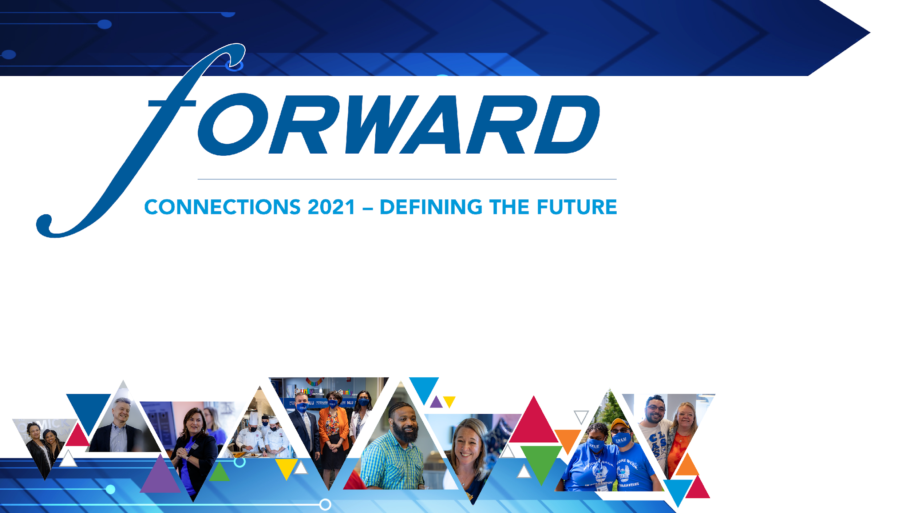
Recognizing Unconscious Bias in the Classroom
Deborah R. Popely, DBA
Associate Professor/Chair of Hospitality Management, Kendall College

Slide 2
Goals for the Session
What are our own unconscious biases, and how might they influence our relationships with students and peers?
How does unconscious bias manifest in the classroom and what can be done to reduce its impact?
How can we help our students recognize unconscious bias and be prepared to promote inclusive environments?

Slide 3
UNCONSCIOUS OR IMPLICIT BIAS
Mental shortcuts that inform our judgments about others, particularly under stress.
If you’re human, you have unconscious biases.
Influenced by the culture, society, the media, individual background and experiences.
Tend to be exhibited toward minoritized groups based on race, gender, class, age, weight, sexual orientation, mental health, etc.
Biases can be positive and negative.
Even well-meaning, fair-minded people have unconscious biases.

Slide 4
Harvard Implicit Association Test (IAT)
Since 1999 administered to millions
Works by presenting associations and measuring small differences in mental processing
Some controversy about validity of the test; best if tests are taken multiple times to average variations.
Should not be seen as diagnosing individuals, although frequently used that way
Best looked at in the aggregate for insights into societal trends
Our goal here is to look at the idea of implicit bias and how it can affect our judgments in education and the industry

Slide 5
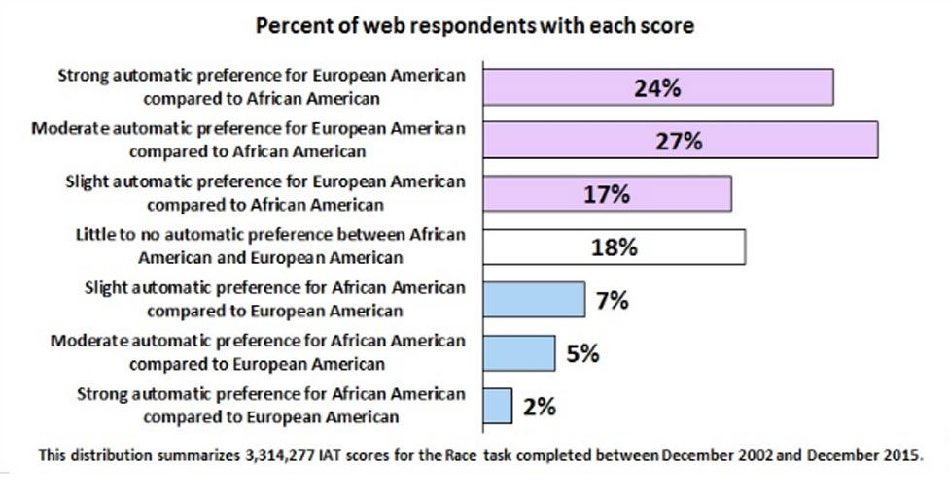
Implicit Bias: Ethnicity
https://implicit.harvard.edu/implicit/takeatest.html
Notes:
Harvard has conducted studies using the implicit bias test. This test is somewhat controversial but is accepted in the scientific community as a valid indicator of subconscious or implicit bias which resides in everyone. This chart shows how people who have taken the test measuring bias for/against African Americans have scored. It illustrates that in the U.S. there tends to be a strong/moderate bias in favor of European Americans and a very limited bias in favor of African Americans over European whites. The test measures other biases as well. You can take the test anonymously to check you own unconscious biases.

Slide 6
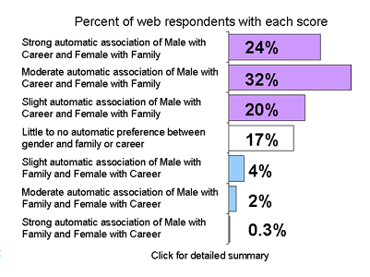
Implicit Bias: Male/Female – Career vs. Family
Notes:
This chart shows the results for male/females in terms of career vs. family. https://implicit.harvard.edu/implicit/takeatest.html

Slide 7
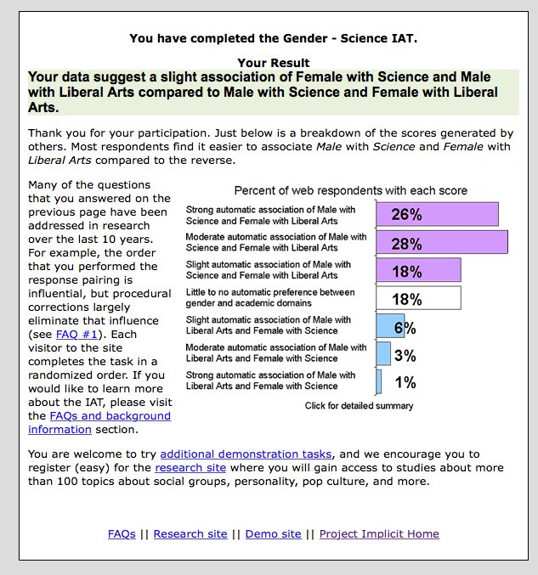
Implicit Bias: Male/Female – Science vs. Liberal Arts

Slide 8
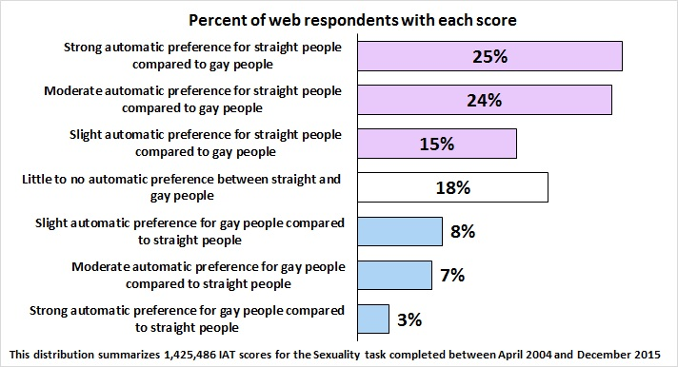
Implicit Bias: Sexual Orientation

Slide 9
Discussion
  Given the prevalence of unconscious bias based on gender, race, sexual orientation, age and other characteristics, how could unconscious biases manifest in our dealings with students?
  What techniques do/could you use to avoid having biases enter into judgements of students, whether you are conscious of them or not?

Slide 10
Confirmation Bias
Confirmation bias in the way we view people
  You meet someone and unconsciously categorize them
  The stereotypes and societal norms linked to those categories are linked to that individual
  You are more likely to notice and remember their behavior which is in keeping with the categories into which you have placed them – thereby reinforcing your opinion of them in that category. You are proving yourself to be correct.
  You are less likely to notice and remember their behavior which does not fit within the category
Impact on decision-making and behavior
  There is potential for unconscious biases to impact on how we perceive others’ ability and how we remember the work they have undertaken and what they have accomplished. For example:
  how good/bad aspects of a students’ performance are noticed and remembered
  how forgivingly mistakes are looked upon or not
  which students are encouraged to pursue further study
There are two things we can do to mitigate our biases:
  try to break the links in the way we interpret and process information and reduce our unconscious biases
  ensure that we acknowledge we have unconscious biases and do what we can to manage them impacting on our decision making and behavior
Source: http://www.sussex.ac.uk/education/cheer/researchprojects/rise/trainingmodule/toolkit/confirmationbias

Slide 11
Active Bystander Strategies
Strategies in the moment
  Name or acknowledge an offence
  Point to the ‘elephant in the room’
  Interrupt the behaviour
  Publicly support an aggrieved person
  Use body language to show disapproval
  Use humor (with care)
  Encourage dialogue
  Help calm strong feelings
  Call for help
Strategies after the fact
  Privately support an upset person
  Talk privately with the person responsible for the inappropriate behaviour
  Report the incident, with or without name
Source: MIT

Slide 12
Other Practical Tips
Develop active listening skills
Improve your understanding of diversity
Be aware of stereotype
Cultivate empathy
5. Consider being a role model
Adapted from material published by the Equality Challenge Unit.

