Slide 1
Using Trauma-Informed Practice in your Teaching and Work: Today’s focus creating the trauma-informed (online) classroom.
Suzette Fromm Reed, Ph.D.
Claudia Pitts, Ph.D.
Judith Kent, Ph.D.
Bettyjo Bouchey, Ed.D.- special thanks
September 14, 2021
Notes:
Suzette kicks off

Slide 2
LEARNING OBJECTIVES
Recognize the importance of brain science, specifically the long-term outcomes of Adverse Childhood Experiences (ACEs), on student behavior.
Consider current online teaching strategies and compare them to techniques which are consciously trauma informed.
Examine their own behavioral and reactive triggers and look at ways to regulate and model self-regulated behavior, co-regulation, and self-care in the virtual, hybrid and in-person classroom.

Slide 3


How familiar are you with
Adverse Childhood Experiences (ACEs)?
ⓘ Start presenting to display the poll results on this slide.

Slide 4

What is your role at NLU?
ⓘ Start presenting to display the poll results on this slide.

Slide 5
OVEREVIEW OF TRAUMA AWARENESS AND ACES STUDY
Understanding the buffering role a supportive environment can play for all students/staff/administrators.
More specifically,
ACEs: what they are, the science, the research, and the importance of the brain.
Context matters
Building a Supportive Environment

Slide 6
LANGUAGE MATTERS
Trauma- a deeply distressing or disturbing experience. (subjective)
A hot topic not only in schools, but in today’s society as well.
Google search returns: 296,000,000 results
Resilience is equally over-used with 239,000,000 results
Community/Context/Organization

Slide 7
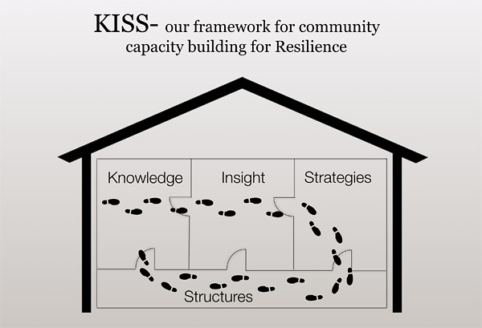
DEVELOPED BASED ON RESEARCH WITH PARTNERS IN WALLA WALLA
Longhi, D., Brown, M., Barila, T., Fromm Reed, S., & Porter, L. (2021). How to Increase Community-Wide Resilience to Decrease Inequalities due to Adverse Childhood Experiences (ACEs): A Case Study. Journal of Prevention and Intervention in the Community special issue on social inequality, 29 (1).

Slide 8

INTRO AND EXPECTATIONS COMPLETE
Moving on to…the significant impact of ACEs on the brain
Notes:
Claudia will copy/paste slides from PPT

Slide 9
HISTORY OF ACES RESEARCH
CDC-Kaiser Permanente Adverse Childhood Experiences (ACEs) Study (1995-1997).
N = >17,000 in Southern California
All items referred retrospectively to respondents’ first 18 years of life.
Three major areas identified as relating to the leading causes of death in ADULTS:
  Abuse
  Neglect
  Household Challenges/ Dysfunction
(Felitti, Anda, Nordenberg, Williamson, Spitz, Edwards, Koss, and Marks, 1998)

Slide 10
10 TYPES OF CHILDHOOD TRAUMA IDENTIFIED (ANDA & FELITTI, 2014)
Physical abuse
Sexual abuse
Emotional abuse
Physical neglect
Emotional neglect
Mother treated violently
Household substance abuse
Household mental illness
Parental separation or divorce
Incarcerated household member
** Immigration and deportation threat (in evaluation)

Slide 11
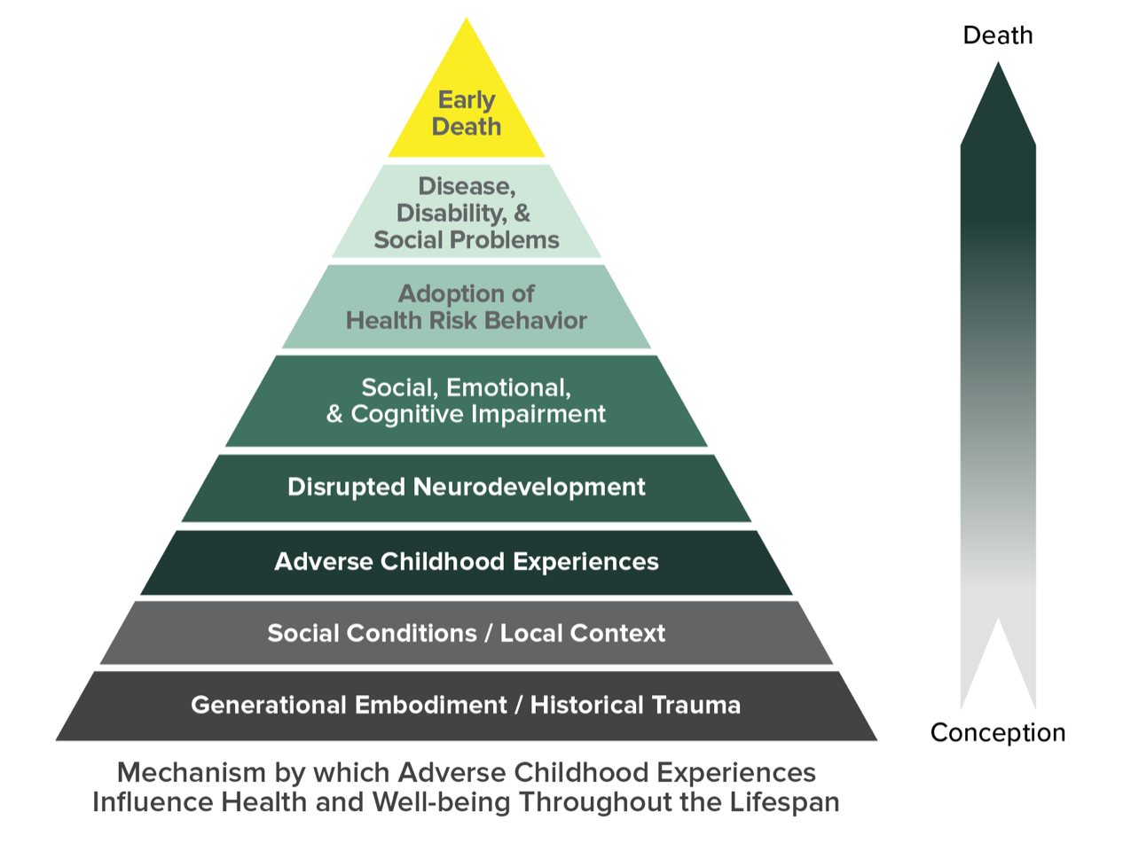
The ACEs Pyramid: from CDC

Slide 12
ACES AND THE BRAIN
Adverse Childhood Experiences can:
alter the structural development of neural networks and the biochemistry of the brain.
have long-term effects on the body, including speeding up the processes of disease and aging and compromising immune systems.

Slide 13
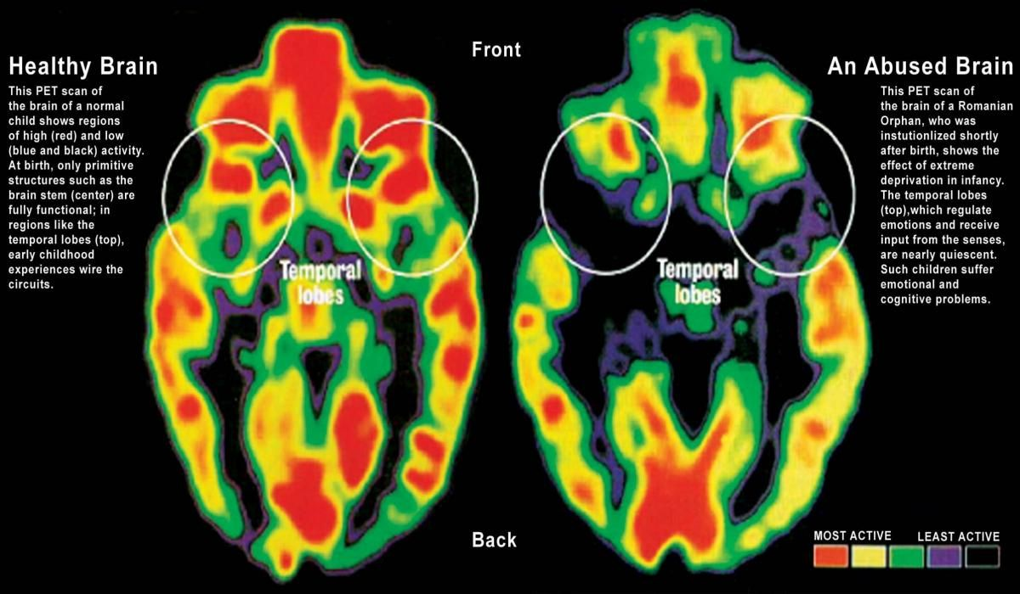
ACES AND THE BRAIN (CDC, 2016)

Slide 14
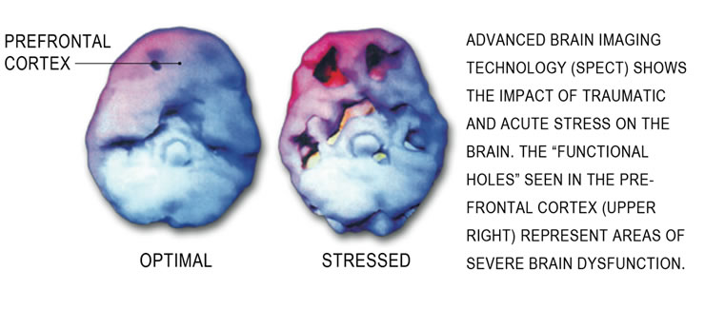
CHRONIC STRESS AND THE BRAIN
Our brains are designed to be reactive to threat - to best handle stress in bursts - for up to about 20 minutes.
Chronic stress causes changes in neural development (which may not be seen until later in life) that lead to things such as include decreased learning and memory, increased anxiety and aggression.
Notes:
ACEs Interface Training (Jan 2019)

Slide 15
CERTAIN TYPES OF MALTREATMENT SEEM TO BE ASSOCIATED WITH GREATER RISK FOR DEVELOPING PSYCHOPATHOLOGY
In a meta-analysis, Norman et al. (2012) reported:
    Higher odds ratio for depression when exposed to emotional abuse compared to physical abuse
    Higher odds ratio for drug abuse when exposed to physical abuse compared to emotional abuse
Norman RE, Byambaa M, De R, Butchart A, Scott J, Vos T. The long-term health consequences of child physical abuse, emotional abuse, and neglect: a systematic review and meta-analysis. PLoS Med. (2012) 9:e1001349. doi: 10.1371/journal.pmed.1001349

Slide 16
LONG-TERM BEHAVIORAL, SOCIAL AND HEALTH ISSUES RESULT IN NEUROBIOLOGICAL DISRUPTION
Clear demonstration of the convergence between neurobiological and epidemiological findings from the ACE study (enumerated on table to follow).
The Enduring Effects of Abuse and Related Adverse Experiences in Childhood (Felitti, Bremner, Walker, Whitfield, Perry, Dube & Giles, 2006)

Slide 17
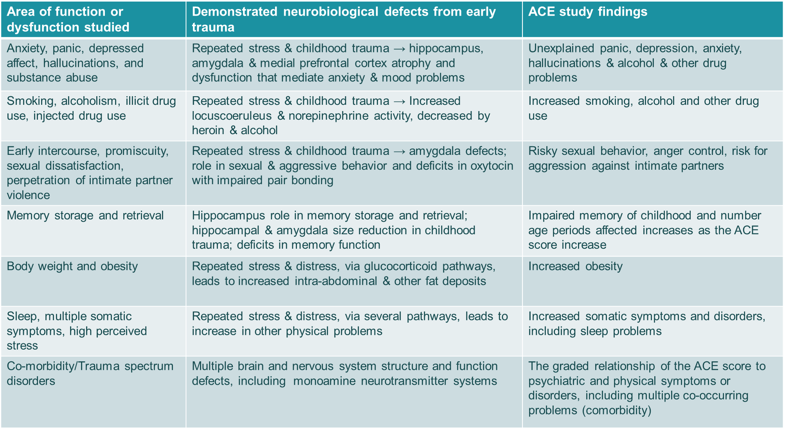
NEUROBIOLOGICAL AND EPIDEMIOLOGICAL FINDINGS FROM THE ACES STUDY
ANDA, ET AL. (2006). TABLE 6 MODIFIED FOR PRESENTATION PURPOSE

Slide 18

PREVENTING ACES COULD REDUCE A LARGE NUMBER OF HEALTH CONDITIONS Source: National Estimates based on 2017 BRFSS; Vital Signs, MMWR November 2019.

Slide 19
ACE AND PSYCHOSOCIAL CONSEQUENCES
ACEs are proposed to affect psychological and psychosocial mechanisms known to contribute to mental disorders, comprising disturbances in cognitive and affective processing such as:
a heightened attention toward threatening stimuli (Dannlowski et al., 2012)
heightened experience of loneliness (Boyda et al., 2015)
social cognitive functioning (Pechtel & Pizzagalli, 2011)
social interactions (Tost et al, 2015)
  including aggressive behaviors (Ferguson, 2011)

Slide 20
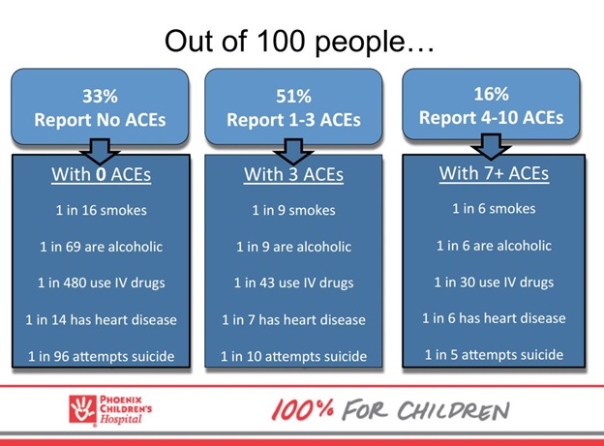
LONG TERM EFFECTS OF ACES

Slide 21
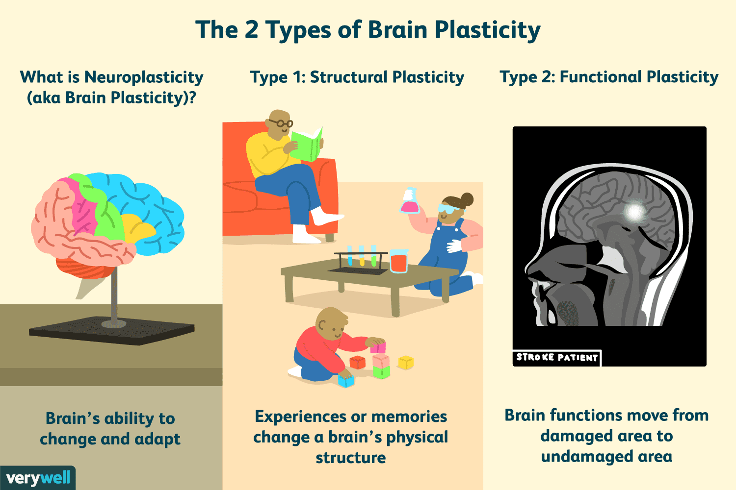
neuroplasticity – there’s hope

Slide 22
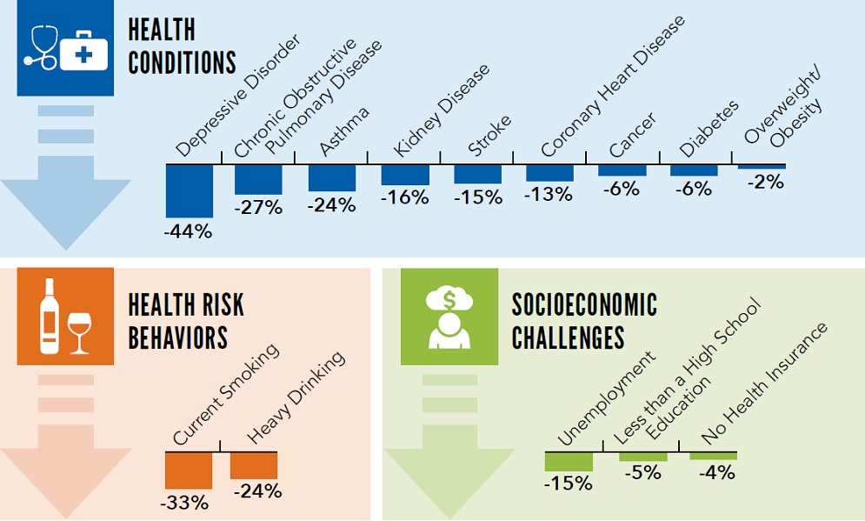
POTENTIAL REDUCTION OF NEGATIVE OUTCOMES IN ADULTHOOD
SOURCE: BRFSS 2015-2017, 25 STATES, CDC VITAL SIGNS, NOVEMBER 2019.

Slide 23
THE LONG-TERM IMPACT OF ACES
Now let’s review the importance of environmental context and offer a framework for what to do in higher educational settings: Safety | Trustworthiness | Choice | Collaboration | Empowerment

Slide 24
REMINDER: NOT ALL ACES ARE TRAUMA
Judith Herman’s book, Trauma and Recovery (1992), describes psychological trauma as characterized by feelings of:
intense fear
helplessness
loss of control
threat of annihilation
ACEs are objectively measurable.
Trauma measurement relies on self-report.
Notes:
You can have a lot of trauma and few ACEs, or visa versa…but the practice of creating a resilient community of learning applies to both

Slide 25
PAST TRAUMA EQUALS THE SUM OF:
Events (circumstances and frequency)
Experience (how a person makes meaning of the event, often influenced by their development and culture, AND context/environment), and
Effects (physical, mental, emotional, cognitive, behavioral, social and spiritual changes).

Slide 26
Harvard’s Project on Human Development in Chicago Neighborhoods (PHDCN) (1994-2005).
Known predictive factors of many social ills:
  Concentrated Disadvantage
  Density
  Concentrated Affluence
  % Minority
  Stability
Key protective factors
  Collective Efficacy
  Child-centered Social Control
In 2004, examined 8,782 Chicago residents, all 343 neighborhood clusters,
Found less child maltreatment when protective factors were present. (read: when people had each other as resources)

Slide 27
Does context matter in Washington State?
In 2009-2011,
Examined: adults and children in 118 communities.
Found: Community processes act as a buffer against known predictive factors (ACEs, poverty and race/ethnic composition) for different outcomes:
  mental and physical health,
  school performance,
  ability to work and
  coping behaviors
Contextual and individual resilience together have significant effects for adults, only contextual resilience for youth.
Notes:
Add international context

Slide 28
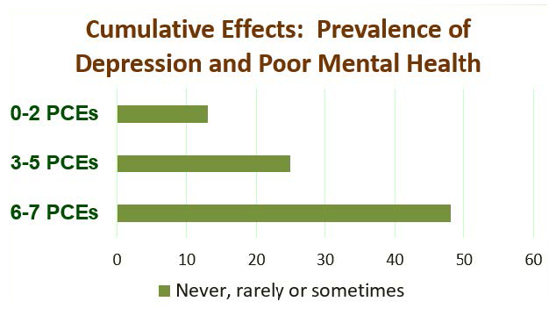
PCEs: Positive Childhood Experiences
(Bethell, Jones, Gombojav, Linkenbach, & Sege, 2019)
Able to talk with my family about my feelings.
Family stood by me during difficult times.
Enjoyed participating in community traditions.
Sense of belonging in high school.
Supported by friends.
Two non-parent adults who took a genuine interest in me.
Safe and protected by an adult in my home.

Slide 29
WHAT CAN WE DO ABOUT THIS RESILIENCE FACTOR?
So much is out of our control. What’s in our control?
Understand resilience is not built in isolation.
  It is TAUGHT, MODELED and PROMOTED.
Acknowledge small steps as building blocks. (READ: Small Wins)
Consider “self”-care and resilience (ingredients for self-regulation, modeling of self-regulation and co-regulation).
For now consider small things you have done to create a resilient environment? Did you smile, show empathy or otherwise serve as the “healthy” emotionally-regulated colleague/adult today?

Slide 30

WE GET THIS IN BABIES, BUT AS WE GET OLDER WE FORGET

Slide 31
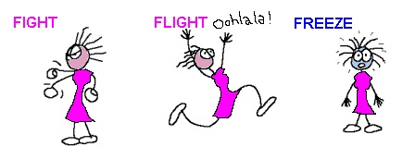
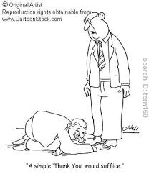
VOICES OF STUDENTS: LEARNED COPING SKILLS
FAWN
Past trauma informs response
Notes:
Connect back to research and brain science

Slide 32
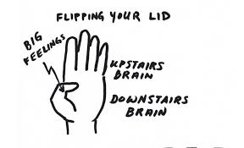
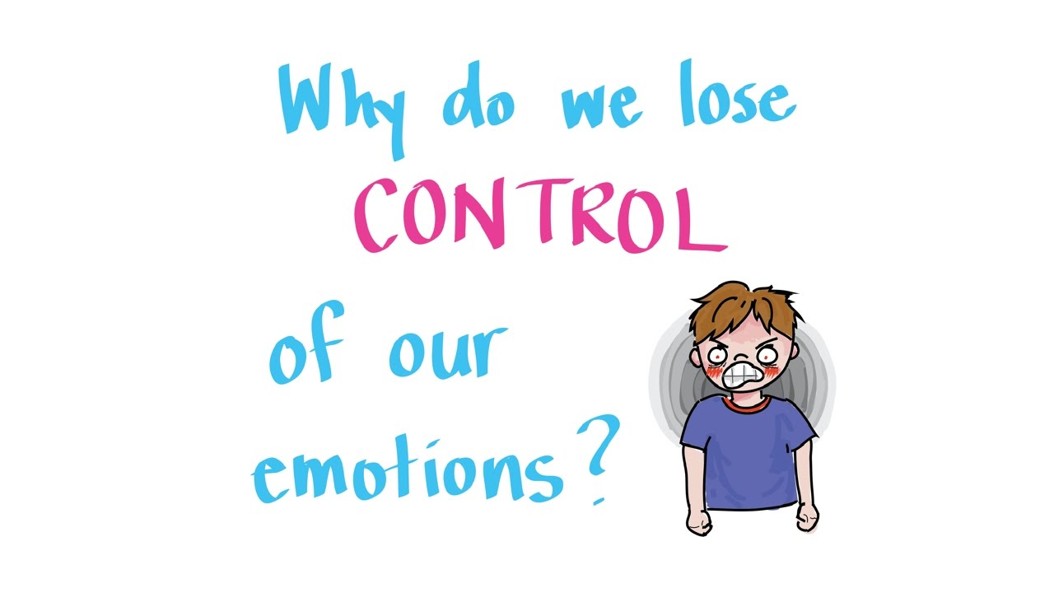
THE BRAIN- AN ACCESSIBLE MODEL TO UNDERSTANDING EMOTIONAL REGULATION
Brain Model- Flip your lid
Notes:
https://www.youtube.com/watch?v=gm9CIJ74Oxw 2 minutes

Slide 33
WHAT CAN I / WE DO? (PLANTING SEEDS)
QTIP
    Do you know our own “stuff”/triggers?
Self-Care
    Is self-care a priority in your workplace?
    Is taking care of self an intentional way of life for you?
Self-regulate. Co-regulate
What is the support and disciplinary process for students, faculty, admin? Punitive or encouraging? S’s
Do we allow for a sense of self efficacy?
Notes:
Build a RESILENT COMMUNITY! How???
Know your stuff
Regulate – a) Emotionally regulate, b) Co-regualation
Create encouraging supportive disciple processes
Is there a sense of self efficacy? Does stakeholders have confidence in their ability to control their own motivation, behavior, and social environment?
What causes low self efficacy?
Because they don't have much confidence in their ability to achieve, they are more likely to experience feelings of failure and depression. Stressful situations can also be very hard to deal with and those with low self-efficacy are less resilient and less likely to bounce back.
https://fpg.unc.edu/sites/fpg.unc.edu/files/resources/reports-and-policy-briefs/Co-RegulationFromBirthThroughYoungAdulthood.pdf

Slide 34
Building a Resilient Community
Longhi, D., Brown, M., Barila, T., Fromm Reed, S., & Porter, L. (2021). How to Increase Community-Wide Resilience to Decrease Inequalities due to Adverse Childhood Experiences (ACEs): A Case Study. Journal of Prevention and Intervention in the Community special issue on social inequality, 29 (1).

Slide 35
UNDERSTAND IMPORTANCE OF CONTEXT AND HAVE A FRAMEWORK: Safety | Trustworthiness | Choice | Collaboration | Empowerment
Now let’s review techniques tied to each of the tenants in relation to learning.

Slide 36
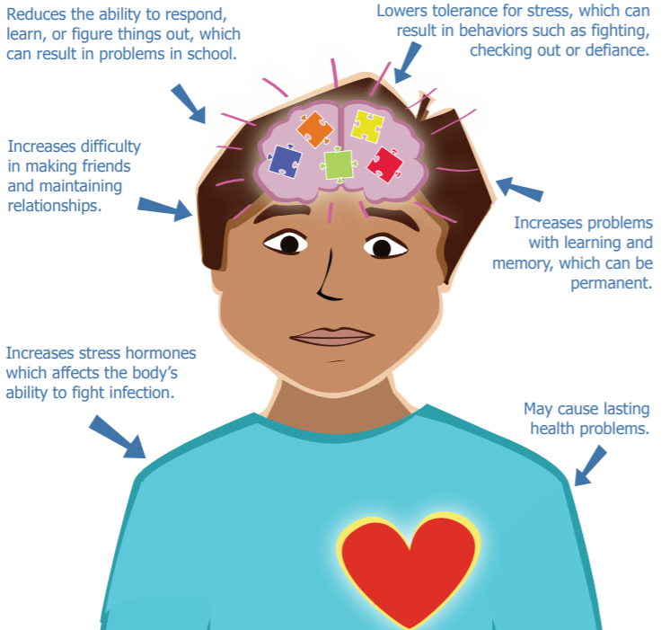
HOW DO ACES AFFECT LEARNING?
HTTPS://WWW.LAPEN.ORG/UPLOADS/1/2/3/8/123897381/PARENT-HAND-OUT-UNDERSTANDING-ACES_RESILIENCE-VERSION-3__1_.PDF
Notes:
Claudia - keep

Slide 37
PRINCIPLES OF TRAUMA INFORMED CARE IN THE CLASSROOM:
A RESOURCE GUIDE FOR EDUCATORS IN HIGHER LEARNING
(OREGON HEALTH AUTHORITY, 2021)
Activities and setting ensure, maximize, and prioritize…
Safety: ensure students’ physical and emotional safety
Trustworthiness: maximize trustworthiness: tasks are clear and consistent with appropriate setting boundaries
Choice: maximize student experiences of choice and control
Collaboration: maximize collaboration and sharing of power between students and instructors
Empowerment: prioritize student empowerment and skill building
Notes:
https://traumainformedoregon.org/wp-content/uploads/2016/03/Trauma-Informed-Care-in-the-Classroom.pdf

Slide 38
Trauma-Informed Online Teaching
Trauma-informed online teaching is an emergent strategy, a collection of interventions meant to create feelings of safety, trustworthiness, choice, collaboration, and empowerment.
  Synchronous versus asynchronous makes a difference in the interventions.
    Synchronous: “live” online instruction, frequently at predetermined times and days.
    Asynchronous: online instruction happens at any time that may or may not be time-bound.
A mixture of synchronous and asynchronous teaching and learning is not only trauma-informed, it’s healthy for everyone.
Not sure about the triggers or nervous? → ethos of care.
Notes:
Bettyjo

Slide 39

Asynchronous Interventions
Structured and predictable online classroom
Syllabus statement of care
Classroom policies that are flexible, but still hold students accountable
Use of images, videos, and pictures to introduce yourself to your students
Safety | Trustworthiness | Choice | Collaboration | Empowerment

Slide 40
Asynchronous Interventions, cont’d.
Use students names and be mindful of their preferred names and pronouns
Alignment in activities, materials, and assessments
Growth mindset grading
Honoring student work by being present and facilitating discussions
Keeping promises
Safety | Trustworthiness | Choice | Collaboration | Empowerment

Slide 41
Synchronous Interventions
Ice breaker and/or casual dialog
Liquid agenda
Brain breaks/switching gears (every 15 minutes, if possible)
Multimodal instruction
Safety | Trustworthiness | Choice | Collaboration | Empowerment

Slide 42
Synchronous Interventions, cont’d.
Be mindful of common triggers in your remarks and be mindful of how you call on students individually for on-the-spot sharing.
Offer off-camera participation options.
Small group breakouts & collaborative work.
Honor all voices, no matter the level of contribution.
Safety | Trustworthiness | Choice | Collaboration | Empowerment

Slide 43
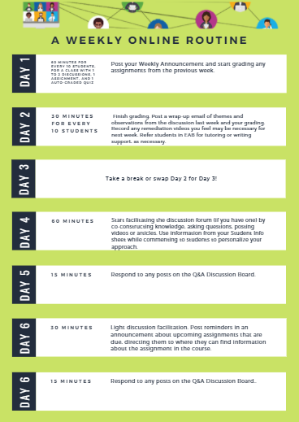
YOU are important to a trauma-informed classroom!
Thinking through what you can be doing for your students…
Set aside time for YOU.
Focus on 1:group interventions and save 1:1 for individualized attention that might be needed.
Schedule blocks of time related to actions.
Know what triggers you have - what do you need?
Know it isn’t always perfect and that it’s OK!
Breathe...

Slide 44

QUESTIONS, COMMENTS, OR CONCERNS

Slide 45
THANK YOU
Claudia Pitts, PhD
claudia.pitts@nl.edu
Suzette Fromm Reed, PhD
suzette.frommreed@nl.edu
Judith Kent, PhD
Jakent@nl.edu

