Slide 1
Modeling Norms from the Field in our Classrooms
CTLE Workshop
4/28/2022

Slide 2
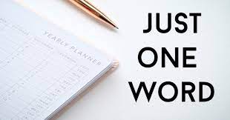
In One Word
Please describe your approach to teaching and learning in one word.
Once you share what and why with your group members, please make sure to add it to this poll as well!
Audience can respond at PollEv.com/bilgecerezci452
Notes:
https://www.polleverywhere.com/free_text_polls/Gr8D6BoqLNgGpryCVmsT8

Slide 3
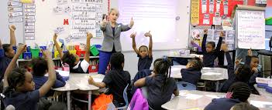
Modelling and Learning
From childhood through adulthood, modeling plays a key role in the acquisition and development of cognitive and meta-cognitive skills, fine motor skills, interpersonal skills, and later professional skills. Each of these is gained primarily through the process of observation.
Modeling is one of the most efficient modes of learning of any new skill or knowledge (Bandura, 1986).

Slide 4

Modelling and Learning
It is difficult to imagine any society that has not relied on models in one form or another to transmit the most important and basic cultural values, customs and beliefs from one generation to the next.

Slide 5

Learning, Modelling and Beyond
Do you remember learning to tie your shoes? Or learning to bake a cake? Or learning to read?
You probably did not learn by watching a video or listening to a lecture. You learned by being shown, and by practice.
The same principle applies to our teaching! We must model for our students.

Slide 6
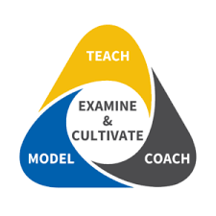
Modelling: Review, Reflect and Practice
Students need to be given opportunities to practice the various strategies associated with learning certain set of skills in order to fully develop and master those set of skills.
Mastering these skills is made easier when models provide “guidance, feedback, and social reinforcement during practice.”

Slide 7
Modelling: Review, Reflect and Practice
Modelling/Demonstration: Someone who is highly skilled in the behavior or skill (either an adult or student) should demonstrate, giving a strong, simple and positive example.
Review and Reflection: Learners should reflect on the modeling. What did they see? What worked? Learners may reflect individually, with partners or groups, or as a whole class.
Practice: Learners should immediately get to try the skill or task being learned while receiving feedback.

Slide 8
Tips!
New information is learned better when it connects to and expands what we already know.
When modelling, don’t narrate. Students should be watching to see what they notice about the demonstration. If you explain what you’re doing as you demonstrate, you rob students of the chance to do the thinking.
Don’t model what not to do. Come to this through reflection!
Allocate time for reflection and practice.

Slide 9
Make it Real!
How to Make Math Fun and Interesting

Slide 10
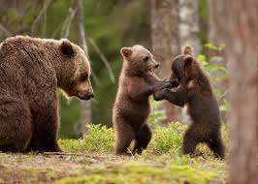
The Importance of Play
From vocal play in human infants to play observed in other animal species such as rats, non-human primates, and dolphins, play seems to be a natural inclination across the animal kingdom and help individuals within a species to learn, grow, and thrive (Pellegrini, Dupuis, & Smith, 2007).

Slide 11
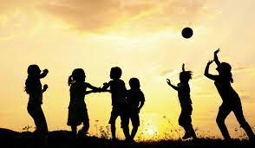
Play and Early Childhood
The importance of play in early childhood education cannot be underestimated because playing is essential to a child’s growth.

Slide 12
Play and Early Childhood
Regardless of whether a play activity falls closer to free play, guided play or games on the continuum, we say that optimal learning through play happens when the activity
  (1) is experienced as joyful
  (2) helps children find meaning in what they are doing or learning
  (3) involves active, engaged, minds-on thinking
  (4) involves iterative thinking (e.g., experimentation, hypothesis testing), and
  (5) involves social interaction
Hirsh-Pasek, Zosh, Golinkoff, Gray, Robb, & Kaufman (2015)

Slide 13
Play and Early Mathematics
Always encouraged my students to make their math lessons fun and engaging for their students.
Use play as a vehicle to help student find the joy in mathematics.
However, occasionally, I felt I fell short in providing the same kind of experience to my students.
As a result, I began to shift my practice to model “the norms” I reinforce in my classes.

Slide 14
Challenging the status-quo: Making math meaningful and playful
Sample
  Twenty-five pre-service early childhood teachers
Setting
  Play-based mathematics methods coursework
  Play as a means of liberating thought, overturning obstacles and discovering fresh approaches to persistent challenges.
  Ten weeks

Slide 15
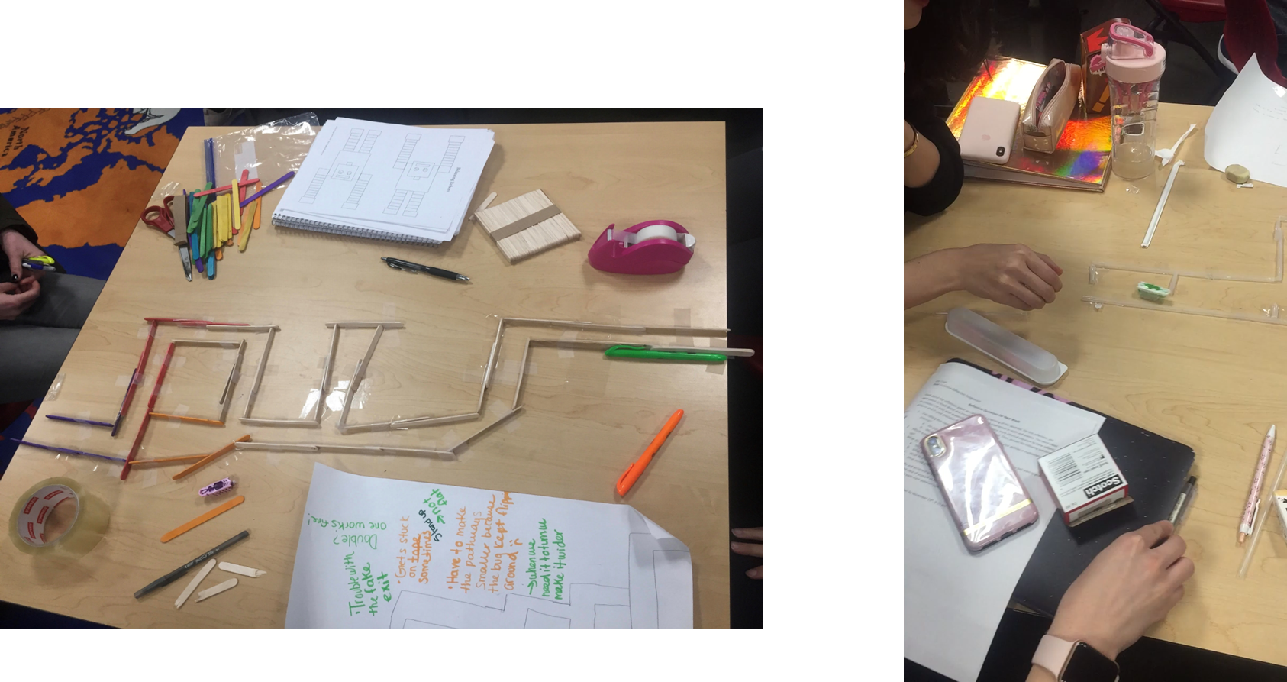
Play is experienced as joyful

Slide 16
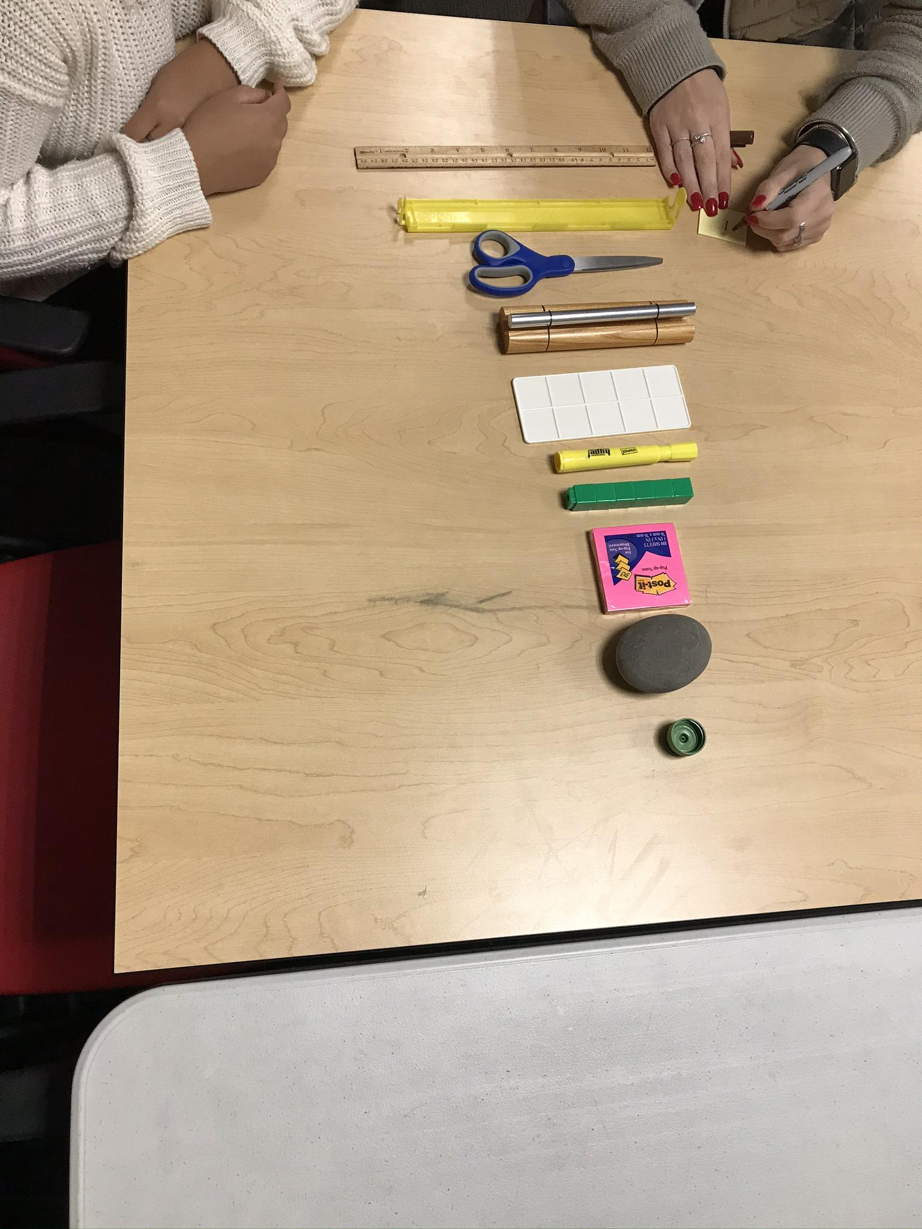
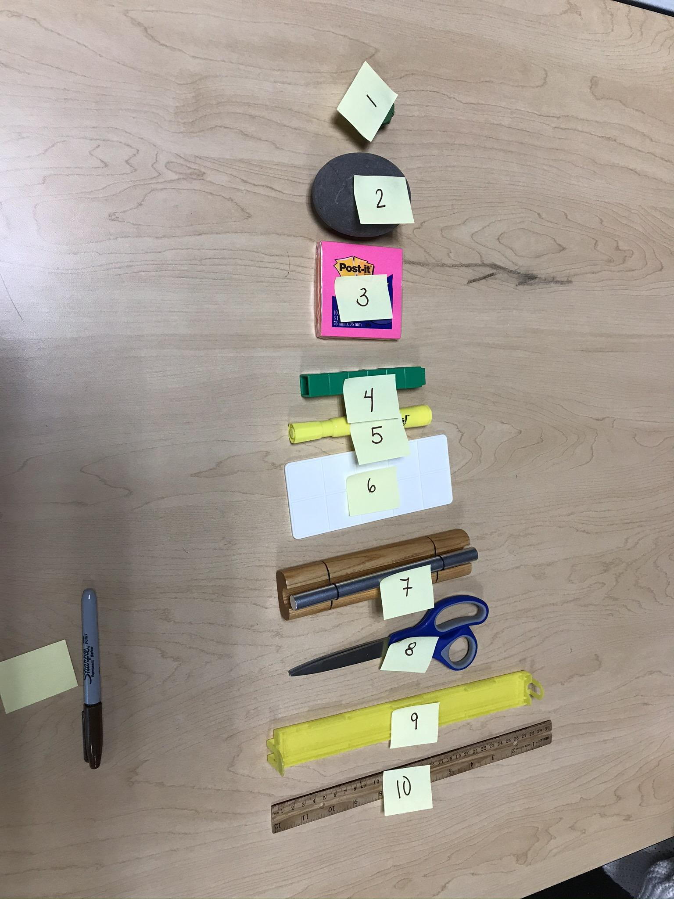
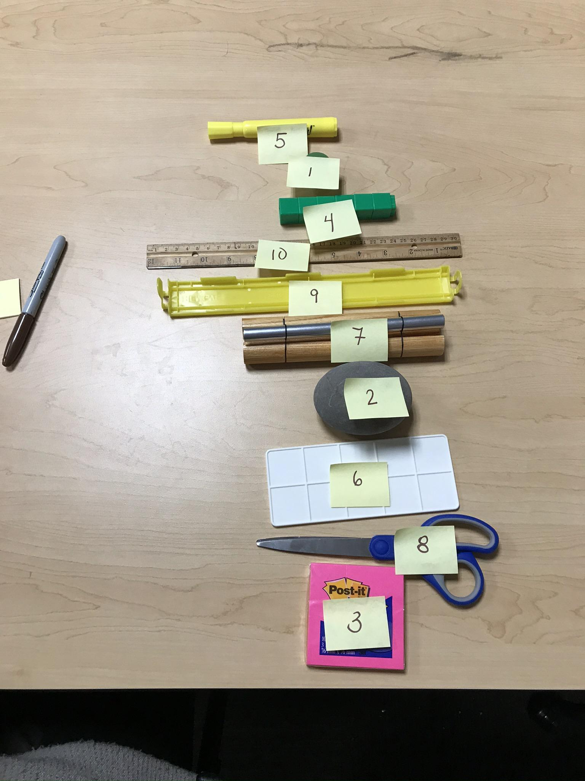
2) Help them find meaning in what they are doing or learning.

Slide 17
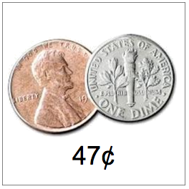
3) Active, engaged and minds-on
What do you notice?
What do you wonder?

Slide 18
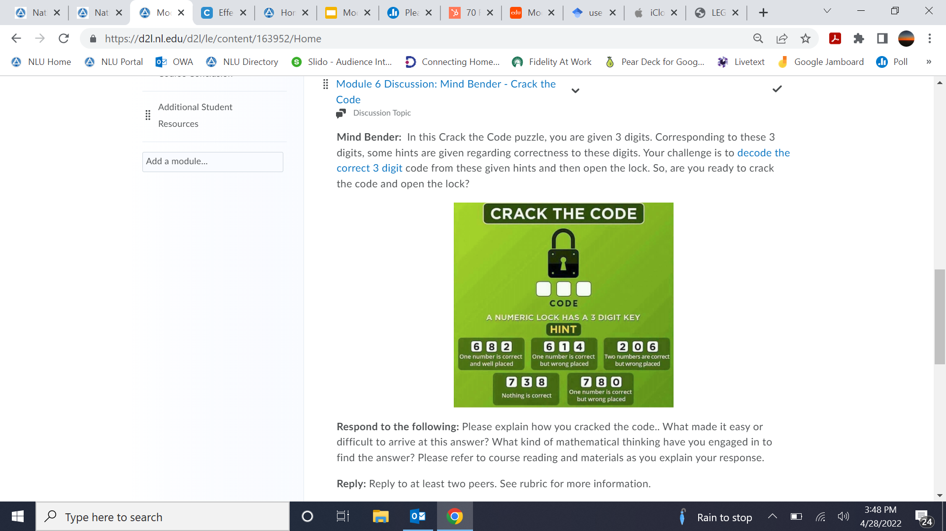
4) Involves iterative thinking

Slide 19
5) Involves social interaction: Let’s wonder together!
STEP 1: Go to this google jamboard
https://jamboard.google.com/d/1cPFShayBgI2O0OyX1u7SkO3ekzgwm6IjcipKsU9HpeA/viewer?f=2
STEP 2: Next, go to your group’s board (e.g., group 1 goes to board 1)
STEP 3: Discuss what you notice and record your thoughts by adding sticky notes

Slide 20
Challenging the status-quo: Making math meaningful and playful
Results:
  The findings revealed the students identified cognitive gains in terms of engagement, retention, and understanding of mathematics.
  More significantly, students indicated that play and playfulness created a unique learning environment that felt safe and encouraged risk taking.

Slide 21
Kristi’s Journey
“I feel that after taking this class, I was able to see that math and science are subjects that actually can be enjoyable. I think my main issue was that I had a very fixed mindset about math because of the way I was taught throughout my school years. I never enjoyed math and it was always my least favorite subject. This class helped to shift my view in a positive way because we learned many different topics that enabled me to view math in a different way. Now I do not think that people are either “math people” or bad at math. I think that there are always things that are more difficult and some more easy, but anyone really can do math if taught and asked to show it in a fair and proper way.”

Slide 22
Hilda’s Journey
“I actually really enjoyed the games that we played in each class. I felt that I really benefited as both a student and a teacher. I benefited as a student because I was able to be engaged and actually do fun games that were actually teaching me things. I benefited as a teacher because I learned many new games that I can do with my class. I actually have started to try out some of the games that we did with my class and it is going very well. I liked that every week we used a different manipulative/tools and also covered many topics. I also liked how interactive and engaging they were. One would think that being adults and doing games that were meant for children would not be fun, but I actually found many of the games to be challenging but also rewarding at the end.”

Slide 23
Let’s Make it Real:
How does this apply to your field?
Notes:
https://padlet.com/bilgecerezci/1htahr0wivxxh7fg

Slide 24
Thank you!
bcerezci@nl.edu

