Slide 1
Class Biography
English 101, Fall 2020 - Professor Margeaux Temeltaş
CRN # 90867
Erase the prompts as you go along, but use them to introduce yourself.
You’re welcome to modify the prompts and share whatever you’d like to tell us.
If you have a nickname or preferred pronouns,
please feel free to include that in your bio.
Notes:
Can have students present to small groups or to whole class, time permitting

Slide 2
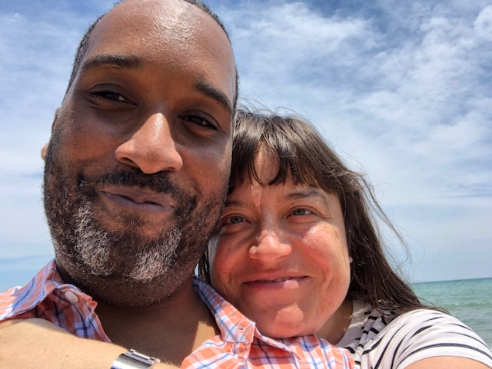
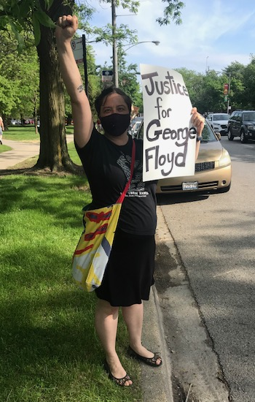
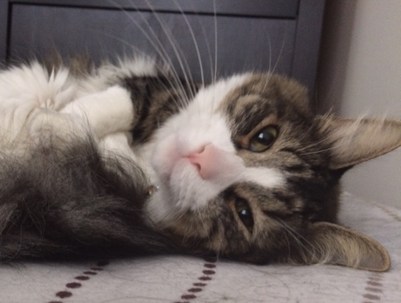
Margeaux Temeltaş (she/her)
Department Chair, English
Interests: Writing & performing stories, swing dancing, doing yoga with my cat, long walks in cities & in nature, poetry, using the lessons of improv to live a happier life
Fun facts:
I’m a California girl pretending Lake Michigan is the ocean.
I lived in Istanbul, Turkey as a child and Berlin, Germany as an adult. I speak Turkish, French, and German, all imperfectly.
The “S” in my name is actually a “Ş” and is pronounced “sh.”
I’m expecting my first child! Due December 15, 2020.
NLU email: mtemeltas@nl.edu
Office Hours: Tuesdays 11:15am-12:15pm
& by appointment, https://nl.zoom.us/j/8689303330
Notes:
Model everything!

Slide 3
YOUR NAME (your pronouns)
Tell us about yourself! Suggestions:
Where are you from?
What do you love to do?
What is your major and what are your career goals?
Who is in your family?
What kind of job do you do?
What are some of your favorite books/TV shows/movies/music?
Do you speak any languages besides English?
Where would you love to travel to?
What is your favorite place in or near Chicago?
How are you coping with the pandemic?
Paste 1 or 2 photos of you.
Maybe include a photo of a pet, family member, or other loved one.
Include your email address (and phone number if you like) so your classmates can stay in touch with you.
Notes:
Make enough copies of this template for each student, and make a copy of the entire presentation before you use it (for multiple sections and/or next time!)

Slide 4
YOUR NAME (your pronouns)
Tell us about yourself! Suggestions:
Where are you from?
What do you love to do?
What is your major and what are your career goals?
Who is in your family?
What kind of job do you do?
What are some of your favorite books/TV shows/movies/music?
Do you speak any languages besides English?
Where would you love to travel to?
What is your favorite place in or near Chicago?
How are you coping with the pandemic?
Paste 1 or 2 photos of you.
Maybe include a photo of a pet, family member, or other loved one.
Include your email address (and phone number if you like) so your classmates can stay in touch with you.
Notes:
Make enough copies of this template for each student, and make a copy of the entire presentation before you use it (for multiple sections and/or next time!)

Slide 5
YOUR NAME (your pronouns)
Tell us about yourself! Suggestions:
Where are you from?
What do you love to do?
What is your major and what are your career goals?
Who is in your family?
What kind of job do you do?
What are some of your favorite books/TV shows/movies/music?
Do you speak any languages besides English?
Where would you love to travel to?
What is your favorite place in or near Chicago?
How are you coping with the pandemic?
Paste 1 or 2 photos of you.
Maybe include a photo of a pet, family member, or other loved one.
Include your email address (and phone number if you like) so your classmates can stay in touch with you.
Notes:
Make enough copies of this template for each student, and make a copy of the entire presentation before you use it (for multiple sections and/or next time!)

Slide 6
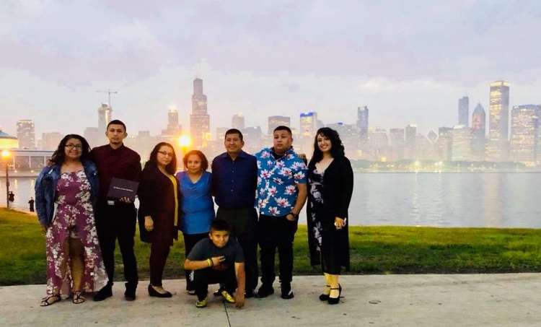
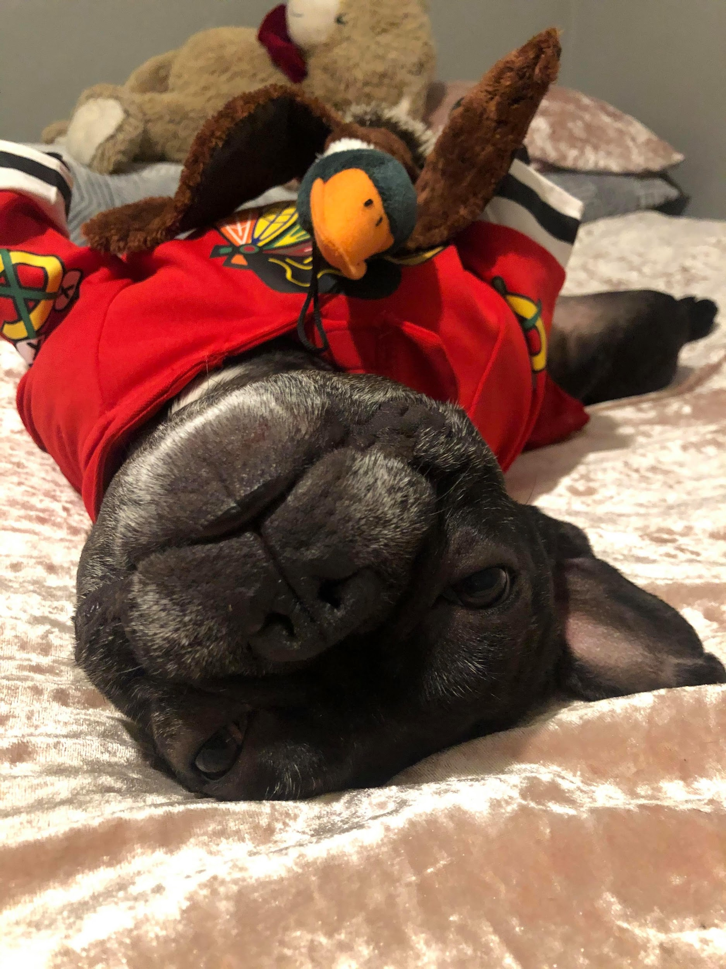

Ciclale Labra (She/Her)
I am from the Southwest side of Chicago, IL.
I like to read, write and listen to music.
My major is Psychology and my plan is to become a therapist to teens.
I have 5 siblings, my parents, 2 nephews, and my dog, Benji.
At the moment, I am a cashier at a TJ Maxx.
My favorite shows are Stranger Things & Outer Banks.
My favorite artists are 5 Seconds of Summer & Bad Bunny.
I am a fluent speaker in English and Spanish.
I would love to travel to Italy.
My favorite place is Target because it’s so therapeutic.
Throughout this whole pandemic, I have tried stayed in
to stay in as much as possible.
Notes:
Sample completed slides with contact info removed to protect students’ privacy

Slide 7
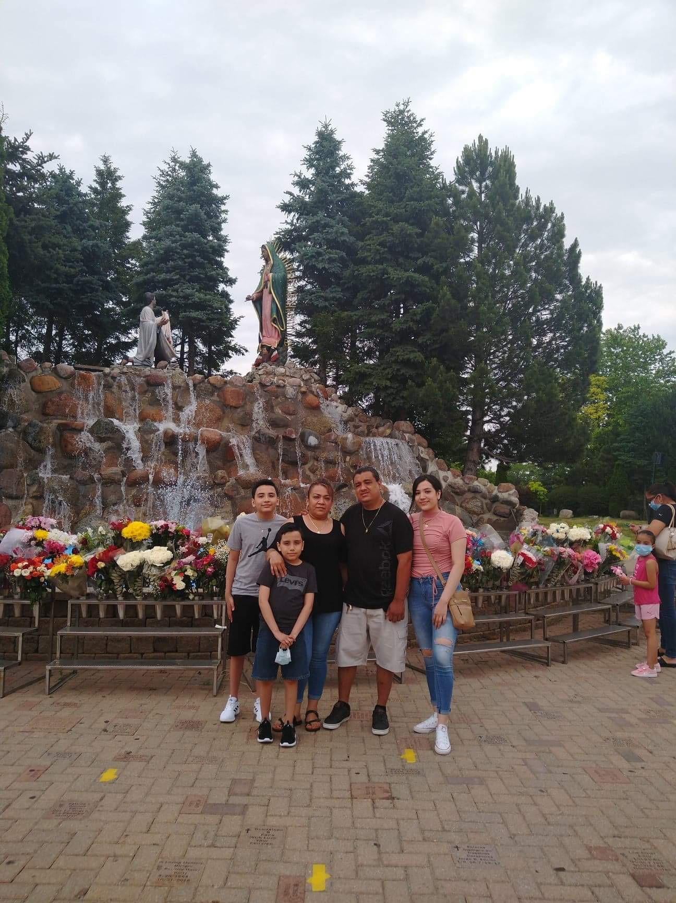
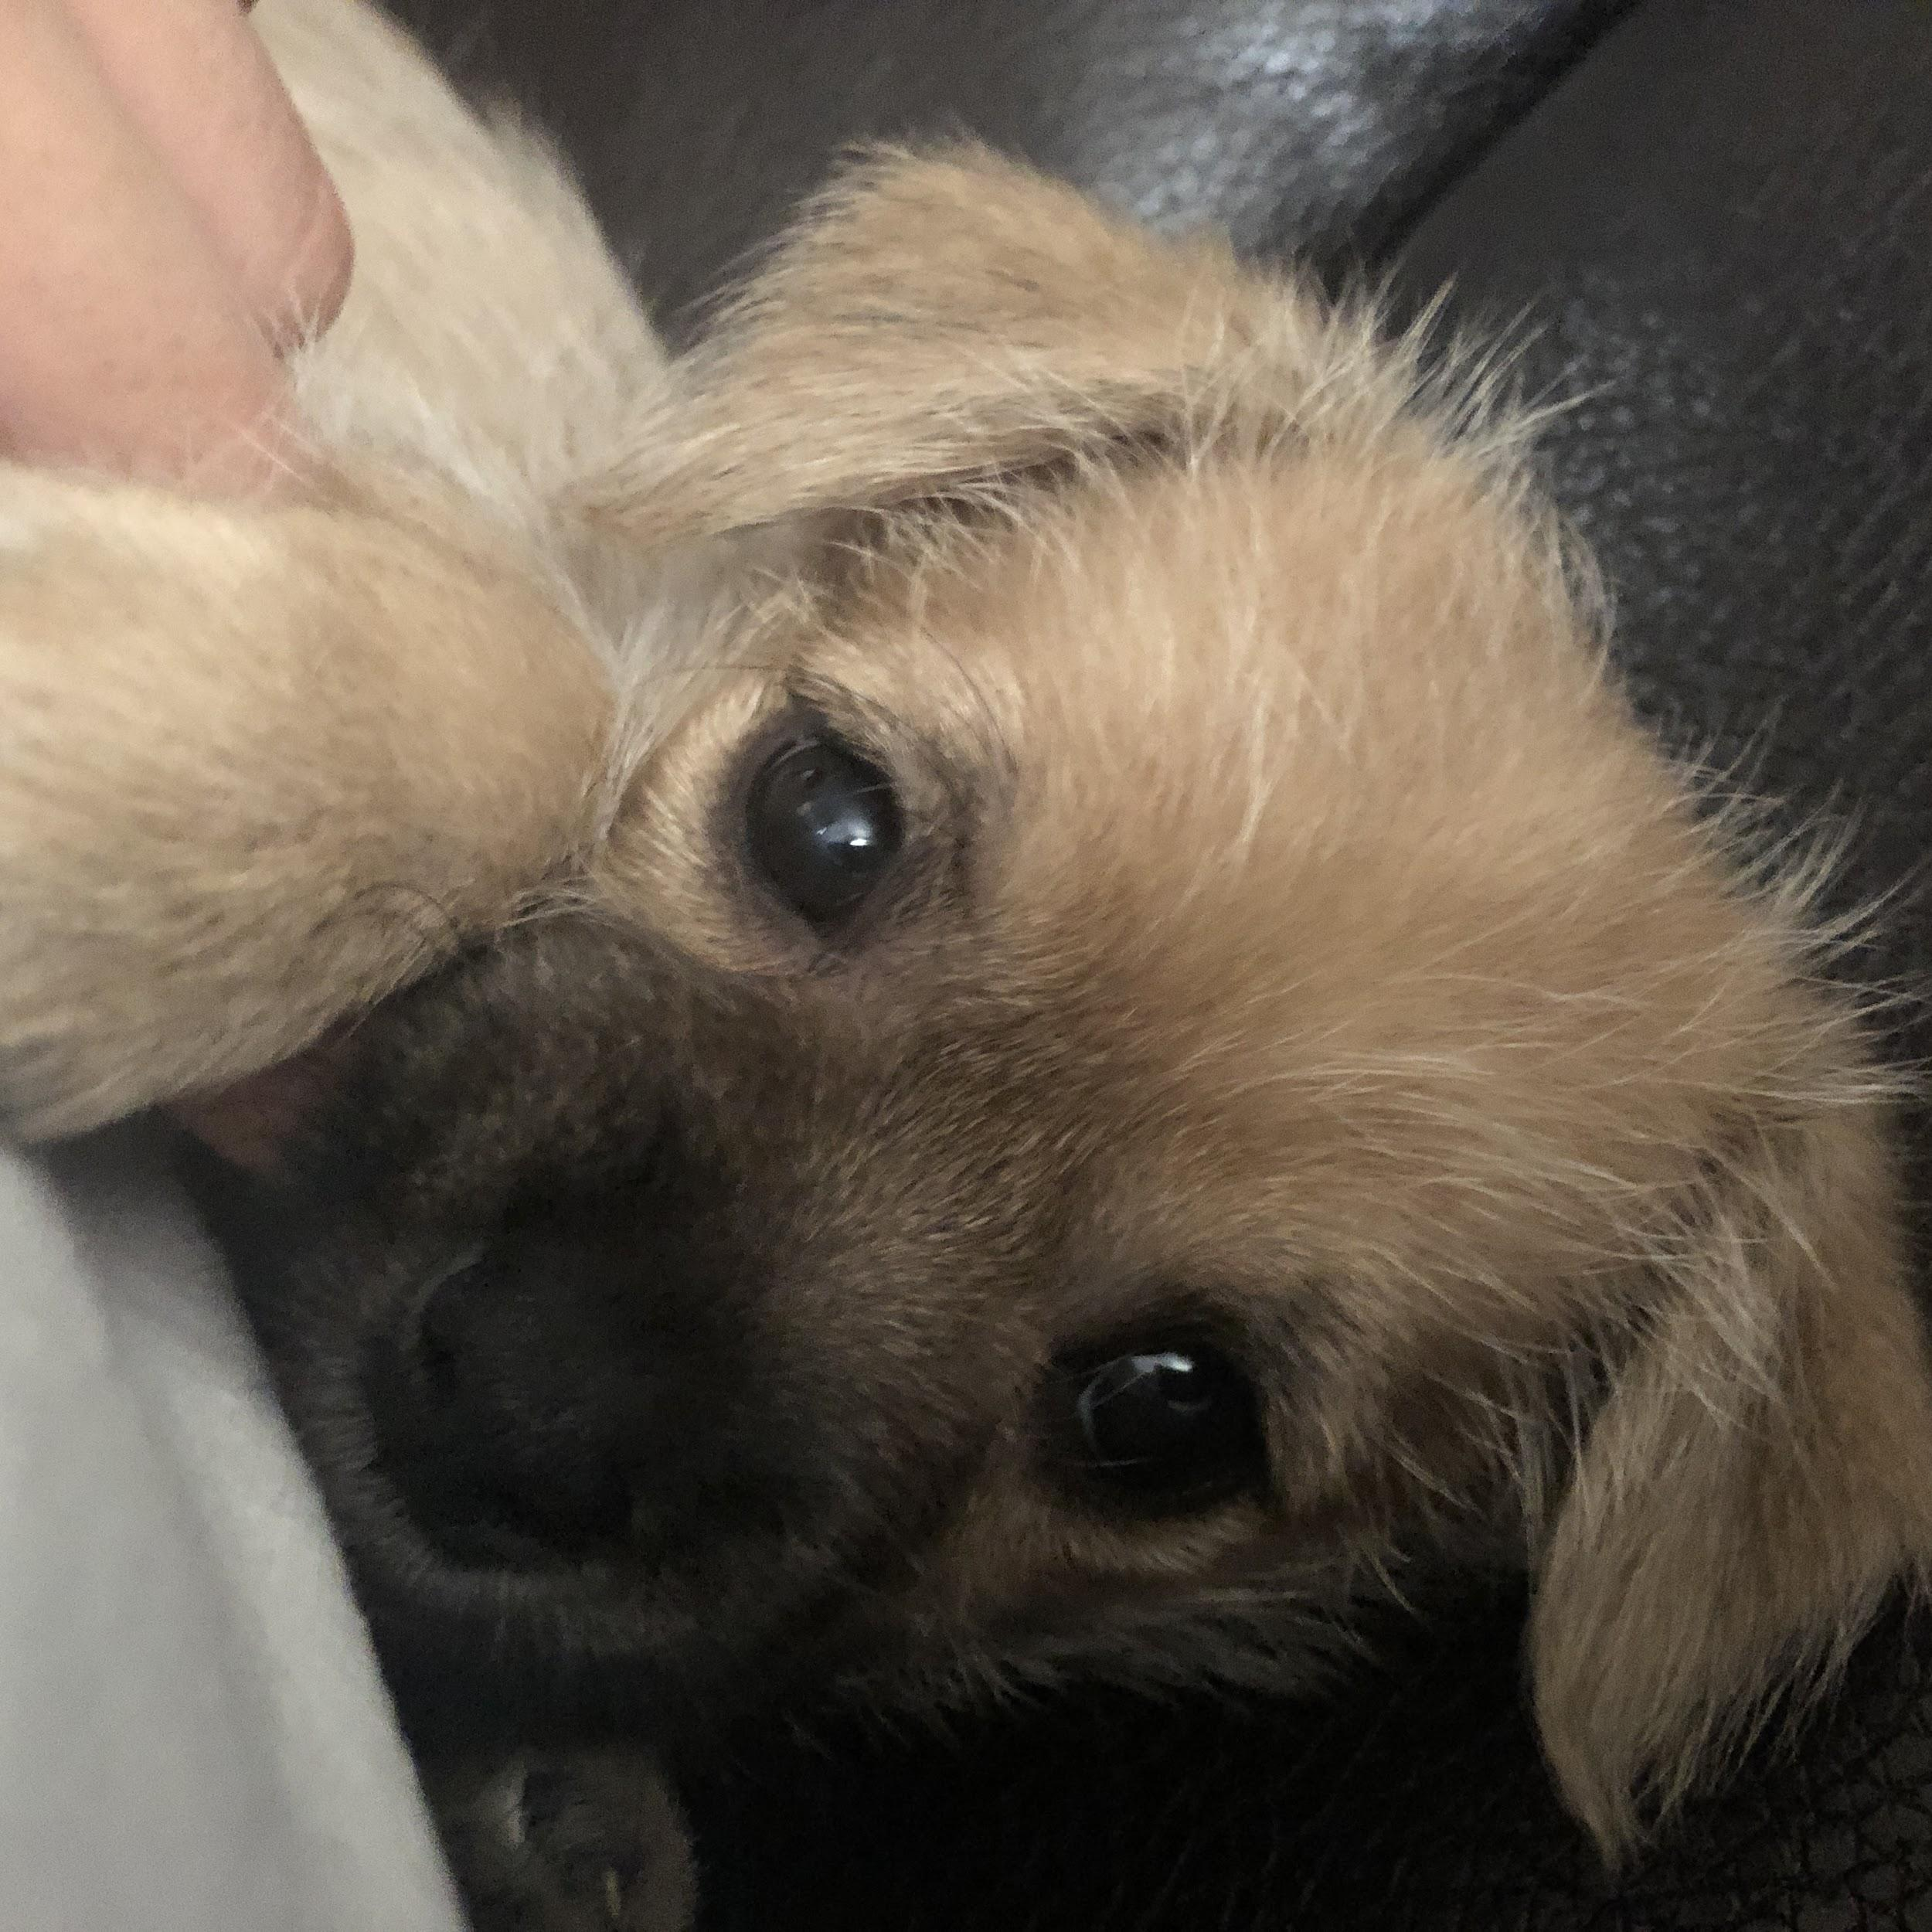
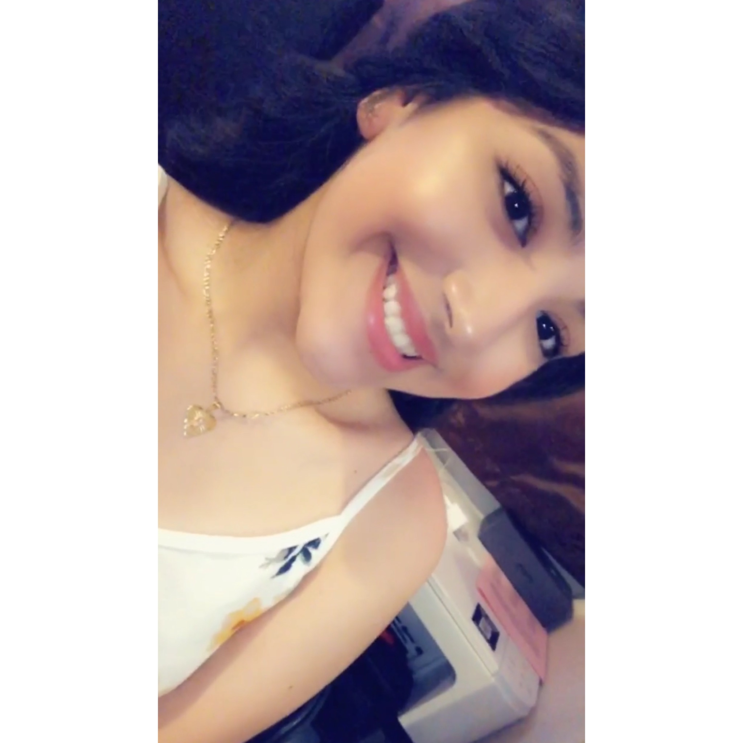
Melissa Diaz (She/Her)
Tell us about yourself! Suggestions:
I am from Chicago, IL
I love to listen to music and spend time with my family.
My major is Human Services.
I have 2 siblings, my parents, and dog, Nugget.
I’m a full time student, but I babysit my brothers and cousins during the week/weekend.
I love watching Friends and I’m currently re-watching Stranger Things.
Besides English I speak Spanish and I took 2 years of Russian in high school.
One place I would want to visit would be Cancun & L.A
One of my favorite things to do in Chicago is go to the Water Tower Place.
The way I'm coping with this pandemic is with my new puppy (Fun fact: I've always wanted a puppy and I finally got him this summer).
Notes:
Sample completed slides with contact info removed to protect students’ privacy

Slide 8
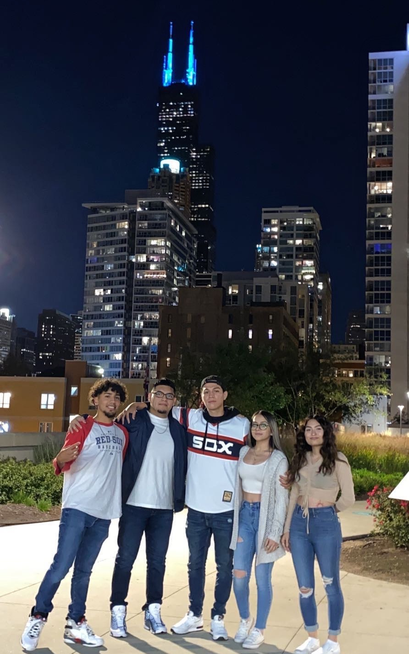
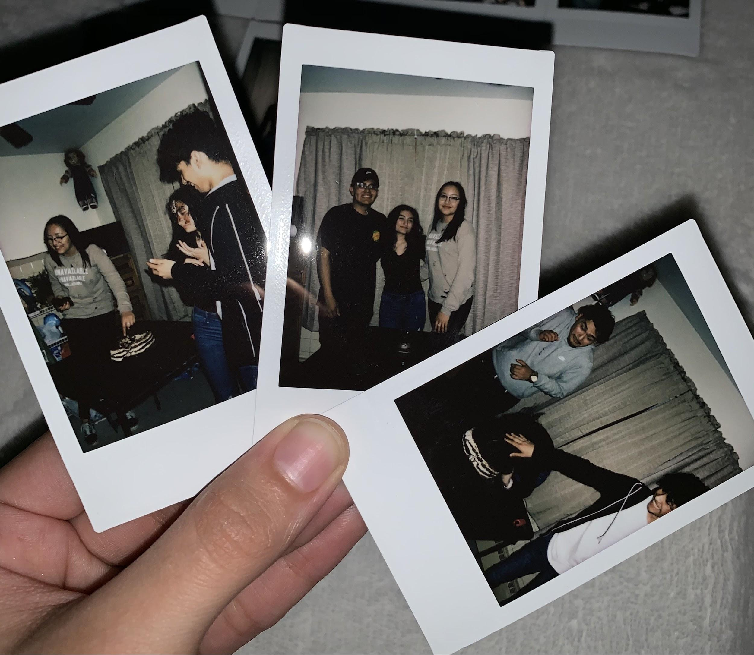
Ruby Cervantes ( She / Her )
I am from Chicago, IL
I absolutely love being with my closest friends and I like play around with the piano.
My major is psychology and I’m going to be a clinical psychologist / therapist specializing in teens and children.
I only have my mom, my two brothers, my niece and two cats.
As of right now I am a sales associate at Charlotte Russe.
I love to watch anime, I don’t have a favorite but I do have my top 7 anime’s, besides that I do have a favorite show which is Friends. I enjoy reading but I don’t have a favorite book, I watch/watched a lot of movies.
I speak english and my spanish is fair, I understand more than I speak it. I learned some French in high school but I barely remember any.
I would love to travel to Italy and see the Sistine Chapel.
My favorite place in Chicago has to be where ever I am with my friends.
Fine, I still go out with my friends, nothing has really changed.
Notes:
Sample completed slides with contact info removed to protect students’ privacy

