Slide 1
Culturally Responsive Teaching
“Cada cabeza es un mundo”
Valerie Vistain
Keisha Rembert
Notes:
“every mind is its own world” speaks to the intricacy of culture
Both introduce ourselves and give a little background of work on CRT
As we go through this session, we suggest having a document open or a notebook near by where you can take notes and do some self-reflection. Some of this is very personal work and it will be up to you to reflect

Slide 2
Land Acknowledgement
We would like to acknowledge that National Louis University, Chicago campus is located on the traditional unceded homelands of the Council of the Three Fires: the Ojibwe, Odawa, and Potawatomi Nations, as well as the Miami, Ho-Chunk, Menominee, Sac, Fox, Kickapoo, and Illinois Nations.
We commit to honoring and preserving Indigenous rights, racial justice and cultural equity, not only through this statement, but also through our actions (i.e., incorporation of Indigeneity in our coursework).
Notes:
Both valerie then keisha
https://nativegov.org/a-guide-to-indigenous-land-acknowledgment/
https://native-land.ca/

Slide 3
Do Now ...
Select one of the questions to answer in the chat.
Q1: Name one culturally significant event, holiday, celebration occurring in September.
Q2. How many state/federally recognized indigneious tribes are there in Illinois?
Q3. The first slide references a cultural adage/saying. What is an adage/saying from your culture or another culture with which you are familiar?
Use A1, A2, A3 before your answer in the chat to help identify the question you’ve selected to answer.
Notes:
Keisha

Slide 4
Session Outcomes
Gain understanding of CRT
Offer opportunities for critical self-reflection
Share best practices and tools for cultural competence/consciousness
Provide space to discuss application of CRT
“Teachers must teach all students the explicit and implicit rules of power as a first step toward a more just society.” Lisa Delpit (1988)
Notes:
Valerie

Slide 5
What’s the Difference?
Relevant Gloria Ladson-Billings | Culturally Relevant Pedagogy problematizes teaching and encourages teachers to ask about the nature of the student teacher relationship, the curriculum, schooling, and society.
Responsive Geneva Gay | Culturally Responsive Pedagogy uses cultural knowledge, prior experiences, frames of reference, and performance styles of ethnically diverse students to make learning encounters more relevant to and effective for them.
Sustaining Django Paris | Culturally Sustaining Pedagogy seeks to perpetuate and foster—to sustain—linguistic, literate, and cultural pluralism as part of schooling for positive social transformation and revitalization
Notes:
Keisha
Culturally Relevant Pedagogy is the result of work done by Gloria Ladson Billings. After extensive teacher interviews, she sought to capture and address student achievement while challenging deficit views of Black students and their academic success. Ladson-Billings defined CRT as a “theoretical model that not only addresses student achievement but also helps students to accept and affirm their cultural identity while developing critical perspectives that challenge inequities that schools (and other institutions) perpetuate” thus problematizing the system in which students are taught.
Accordingly, Culturally relevant teaching is a way to “empower students intellectually, socially, emotionally, and politically by using cultural referents to impart knowledge, skills, and attitudes” and is based on three propositions: academic success, cultural competence, and sociopolitical consciousness.
Geneva Gay expanded this notion of culturally relevant pedagogy. She argued for a “shift in the pedagogy used with non-middle-class, non-European American students in U.S. schools.” Gay’s believes a different pedagogical model is needed to improve the performance of students from various ethnic groups. At the heart of culturally responsive teaching is this idea that we are responsive to students first. To be responsive to students, teachers need to be acute observers of their students. So educators are responding to the cultural wealth and needs of their students. But it’s not enough to know about your students. You must change what and how you teach because of what you learn about your students. It is a pedagogy that is validating, comprehensive, multidimensional, empowering, transformative, and emancipatory.
Culturally relevant and culturally responsive pedagogies are concerned with liberatory teaching so that instruction and learners gain an understanding of the social, political, and historical knowledge to challenge and critique society.
Culturally Sustaining Pedagogy builds upon the Asset-Based Pedagogies that came before it but presents the need to not only affirm and connect to students’ cultural backgrounds, but also to sustain them through schooling. CSP explicitly calls for schooling to be a site for sustaining—rather than eradicating—the cultural ways of being of communities of color. The goal is not cultural assimilation or erasure, but instead a means of strengthening cultural appreciation and understanding. When I think of CST, I think of how education has adopted the Kill the culture. Save the Student. CST is a pedagogical model against this ideology. The features of CSP are valuing community languages, practices, and ways of being, accountability to communities, honors cultural and linguistic histories.

Slide 6
Culturally Responsive Teaching
Myths
CRT reduces academic rigor.
CRT is just good teaching.
CRT is all about building relationships with students.
CRT is all about choosing the right strategies.
CRT is for the success of students of color.
Notes:
https://jamboard.google.com/d/1nG-vTcOYUBchzxXCR8bp-Pt5oncDTtEZBQsT2EfT7do/edit?usp=sharing
Keisha - Create anonymous jamboard (or something similar) that allows participants to write myths they have heard or negative beliefs they have about CRT. Then we could choose a few and debunk?
Cultural and Cognitive Process which requires our instruction to include cultural and cognitive thinking activities and resources.
Curricula where racial, ethnic, and linguistic connections are made as students learn makes learning more meaningful and engaging.
intentionally planned part of the curriculum and instruction that happens in the classroom

Slide 7
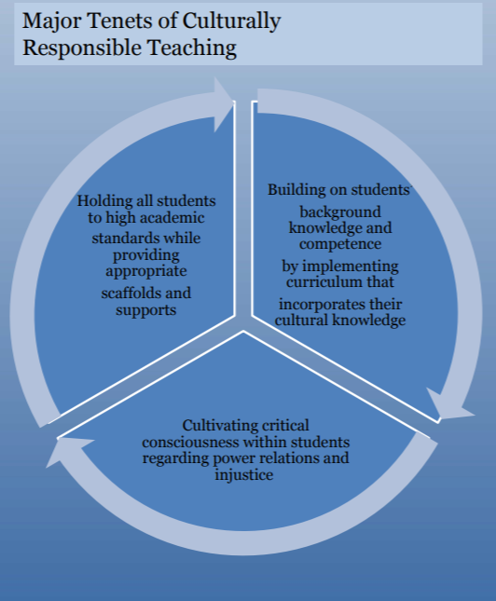
Culturally Responsive Teaching- An overview
Culture is central to learning. It plays a role not only in
communicating and receiving information, but also in
shaping the thinking process of groups and individuals.
A pedagogy that acknowledges, responds to, and
celebrates fundamental cultures offers full,
equitable access to education for students from all cultures.
(Ladson-Billings, 1994)
As the student population is increasingly non-white,
there is an inherent duty to ensure that education is in the
“service of the humanity and rights of diverse students” (Gay, 2018, p. xxxi).
“Classroom studies document the fact that underserved
English learners, poor students, and students of color routinely
received less instruction in higher order skills development than other students.”
(Hammond, 2015, p. 12).
Notes:
As Keisha explained, there are a could of ways that culturally responsiveness is approached. In this slide, I will focus on the tenets established by GLB. Read tenets and go over quotes.

Slide 8
Classroom principles of culturally responsive teaching
Communication of High Expectations
Active Teaching Methods
Teacher as Facilitator (No sage on the stage!)
Inclusion of Students who are Culturally and Linguistically Diverse
Cultural Sensitivity
Reshaping the Curriculum (Decolonize!)
Student-Controlled Classroom Discourse
Small Group Instruction and Academically-Related Discourse
Notes:
You have likely heard all this before, but I wanted to take some time to go over these main principales. As we go over it, feel free to pop some examples int he chat at to how you consider these principles in your classroom or workplace

Slide 9
Examples from NLU
As a way to introduce narrative writing, have students identify songs they like that tell a story or teach a lesson. Let them share with the class, play song or show the lyrics. Then lead into lesson on narrative writing | STEM-Empower students to use STEM as tools to understand their world and solve community and global issues | In a course on working with groups: focus on how different cultures have varying standards in “how” to interact (eye contact, male/female speaker, etc) | Use multiple modalities to present information and directions for assignments
Use primary sources from diverse voices, consider allowing students to read primary sources in their native languages if available | Decolonize curriculum! Look at WHO is portrayed in your class materials -- is everyone white? Male? English-speaking? | Project based assignments | Activities or questions where students get to apply a first-person perspective. Ex) how would your family respond to this crisis situation? What would lead you to participate in a revolution?
Notes:
This slide includes some example from NLU practitioners using CRT

Slide 10
History and its influence
Major dates in Higher Education
1636- First University established (Harvard)
1862-Morrill-Land Grants Act
1940s-1960s-Rise of women’s colleges
1944-GI Bill
1954-Brown v Board of Education
1964-Civil Rights Act
1965-Higher Education Act
1965- Historically Black Colleges and Universities (HBCU) designation
1972-Education Amendments
1979- Dept of Ed established
1990-American with Disabilities Act
1992- Hispanic Serving Institutions (HSIs) designation
“Education then, beyond all other devices of human origin, is the great equalizer of the conditions of men, the balance-wheel of the social machinery.”
Horace Mann, 1848
-Think about the above quote as we consider the history of education in the US
-Is it accurate? Why or why not?
-Is there equal access to this institution
deemed the “great equalizer”?
JAMBOARD ACTIVITY
Notes:
I think it is incredibly important to understand how history created the education system we have today. I want us to think about this quote from Horace Mann, a ed refomener from the 19th century. I chose this because I had an experience where when discussing inequity and institutional racism in education, I was countered with this quote. What do you think about it? Take a minute or two to add your thoughts to the Jamboard. As you continue on with your thoughts, I am going to go over some history. I would also like to point out tht by no means is this exhaustive. I am giving a very simple outline of history and education in the US. There is so much more and if you want to have some in depth historical disucsions, reach out!
https://jamboard.google.com/d/1Xp8tJA8naQ7JAfVhhlR0Vj5WCpnr0oVL-RJUmFOu2kM/edit?usp=sharing

Slide 11
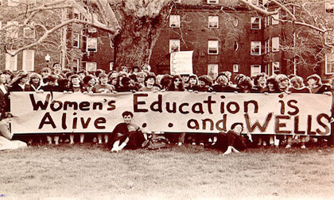
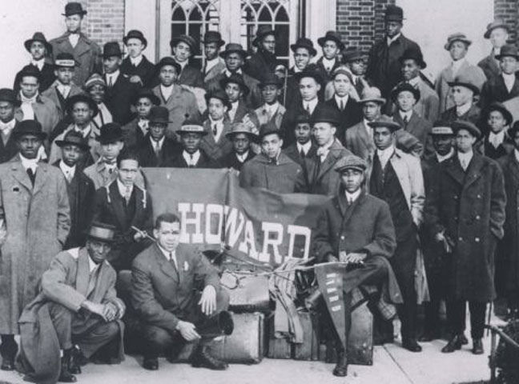
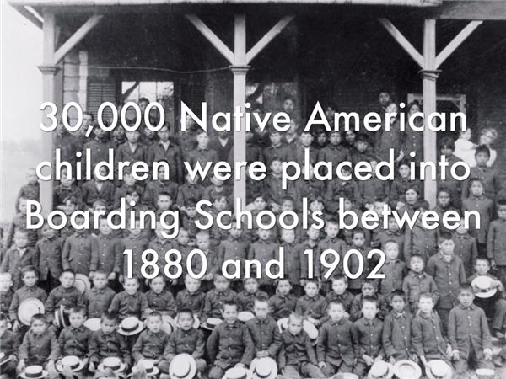
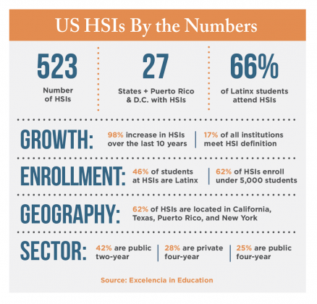
Education’s inequities
First colleges were for affluent, white males primarily
Indigenous students pushed into boarding schools
Women denied access until 20th century
Black/African Americans largely denied access until after Civil War ends in 1865, even then still subjected to segregation
Hispanic/Latinx students subjected to mission schools and segregation
In 2021 inequities still remain despite the rising number of culturally and linguistically diverse students
History, as nearly no one seems to know, is not merely something to be read.... On the contrary, the great force of history comes from the fact that we carry it within us, are unconsciously controlled by it in many ways, and history is literally present in all that we do."—James Baldwin (1965)
Notes:
As a historian it is impossible to ignore how the systems of oppression and inequality in the US have permeated into education. While there has been progres in access, there are still issues. In her 2006 Presidential Address to the American Educational Research Association(AERA), Gloria Ladson-Billings called into question the prevalence of the term “achievement gap” to explain the academic gap between BIPOC students and their White counterparts. Using the idea of national debt to explain her thoughts, Ladson-Billings (2006) states, “we do not have an achievement gap; we have an education debt” (pg. 5). She goes on to explain factors that have contributed to this debt; economic, historical, sociopolitical, and moral. Many of the decisions and policies related to these factors have created an education debt, accumulating over time to create the gap we see in the achievement of students of color. Since the founding of the United States these factors have created a system that continues to benefit White students and disadvantage students of color, particularly Black and African American, Latinx, and Indigenous students. As this system progressed and matured, it became harder and harder for people of color to combat the structural racism so embedded in American institutions (Ladson-Billings, 2006). Educators and researchers have long evaluated these factors, and others, and how they might perpetuate systems of inequality, often offering ideas as to how teaching and learning could be done to alleviate this education debt. We would be remiss if we did not take into account how history has influenced education. As we will see in the next slide, the history and culture of the US is one that continues to put the culture of whiteness at the top of the hierarchy. As educators and colleagues it us up to us to rebel against the status quo and challenge these systems of inequality in education.
https://www.nationalgeographic.com/history/article/a-century-of-trauma-at-boarding-schools-for-native-american-children-in-the-united-states
"History, as nearly no one seems to know, is not merely something to be read.... On the contrary, the great force of history comes from the fact that we carry it within us, are unconsciously controlled by it in many ways, and history is literally present in all that we do."
—James Baldwin (1965)

Slide 12
White Supremacy Culture Characteristics
Pause before we go into this and set your intention for this session.
“If you find yourself becoming defensive as you read them, lean into the gift of defensiveness and ask yourself what you are defending. The description of these characteristics are meant to help us see our culture so that we can transgress and transform and build culture that truly supports us individually and collectively. Breathe into that intention if you can.” https://surj.org/resources/white-supremacy-culture-characteristics-test/
JAMBOARD ACTIVITY
Fear | Perfectionism | One Right Way | Paternalism | Objectivity | Qualified | Either/or and the Binary
Progress is bigger/more | Quantity over quality | Worship of the written word | Individualism | I am the only one | Defensiveness | Denial
Notes:
For some of us, this might be a tough slide to discuss. I want you to take a minute and pause before we go into this and set your intention for this session. In this chart are the 14 characteristics identified by SURJ that are white supremacy culture characteristics. I have bolded the ones that I see most frequently, but let’s hear what you all think. If you are comfortable, use this jamboard to share you ideas.
https://jamboard.google.com/d/1Xp8tJA8naQ7JAfVhhlR0Vj5WCpnr0oVL-RJUmFOu2kM/edit?usp=sharing

Slide 13
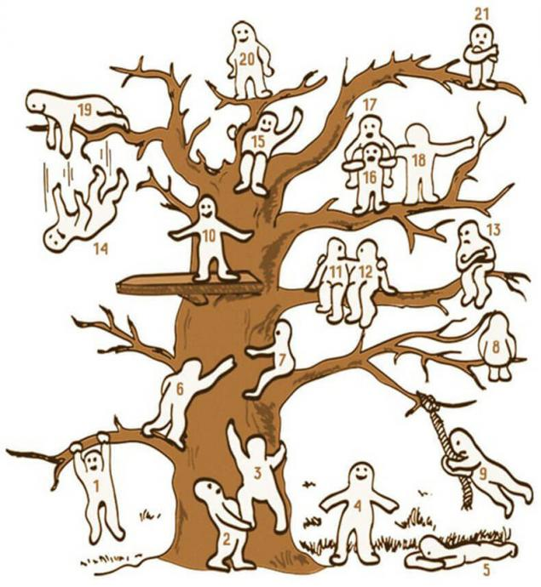

Pause
You can use this time to do any of the following:
Get up and move
Journal to process your thoughts about White Supremacy Culture Characteristics
Examine the tree on the screen. Identify where you’d place yourself relative to culturally responsive teaching and why you are there.
Notes:
2 minute reprieve

Slide 14
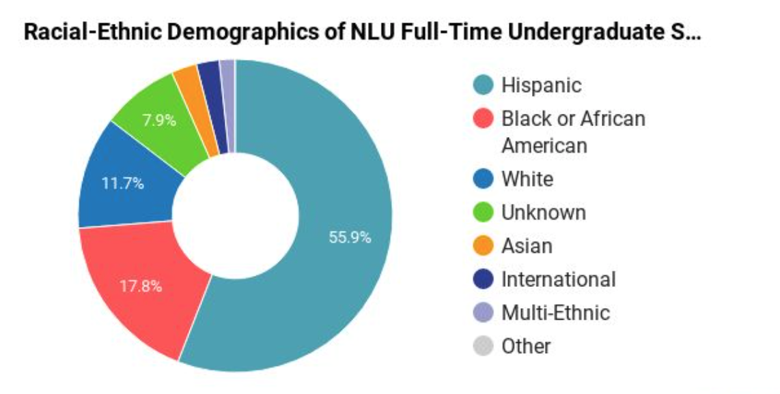
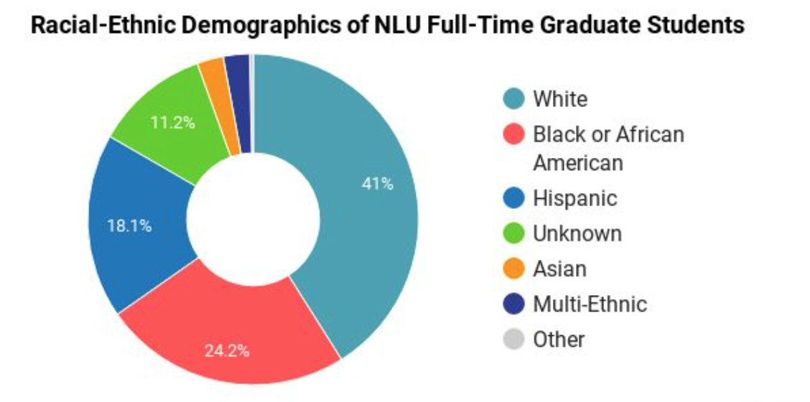
Our students ...
“Culturally Responsive Practice views the culture, languages, experiences and learning modalities of each student as an asset in the classroom, not a deficit.”
From Including Students with Severe and Multiple Disabilities in Typical Classrooms, Third Edition, by June E.
Downing, Ph.D.
Notes:
Let’s contextualize our learning thus far. These graphs represent the demographics of students in our UG and GS.
What are your thoughts about Culturally Responsive Pedagogy as it relates to our students? I look at our student demographic and think about the beauty of this diversity. I think it will require that I continually increase my cultural, racial and emotional literacies/intelligence to ensure I am bringing that awareness to students, the whole NLU community, my teaching strategies and curriculum.
What about you? What do you think? What does an understanding of our students require of you?
https://www.collegefactual.com/colleges/national-louis-university/student-life/diversity/

Slide 15
Cultivating Student’s Funds of Knowledge
✷ Culturally Responsive Educators leverage student’s funds of knowledge ✷
Student background/experiences are strengths
Students come with values and knowledge—build on it
Avoid deficit models (stereotyping students and communities)
The classroom is only one place of learning—leverage and recognize communities as learning environments
Moll, Amanti, Neff & Gonzalez (1992)
Learning in Indigenous cultures is not about institutions or formal education. Learning is guided by learning spirit who travels and guide individuals on their earth walks, offering guidance, inspiration, and quiet unrealized potential to fully realize self. Without an understanding of the interrelational complexities of learner and learning journey, the learner lacks a sense of identity, voice and has low self-esteem that ultimately damages the learning spirit.
From Aborginial Learning by Scott Tunison
Notes:
“Funds of knowledge is based on a simple premise ... that people are competent and have knowledge, and their life experiences [and based in the various worlds they inhabit that] have given them that knowledge “
Many of us have been socialized to believe that students of lower socioeconomic status and students of color do not experience school success because their home experiences have not provide them with the requisite knowledge to succeed. This assumption begets lowered expectations or a need to fit or assimilate them rather than recognize that there is a richness of our students lifeworld experience that tends to exceed that of their school experience and is often untapped.
When we don’t recognize this, there is a tension for students and educators that often result in dual academic failure. For example, a student’s vast knowledge from taking care of their grandparents or switching between two cultural worlds, is a great asset and knowing this can help an educator build on those skills without the is inherent conflict of trying to get this student focused or fit them. Due to underlying differences or misunderstandings of “our ways of being and knowing in the world,” success for some students comes at the cost of their cultural identity (Fordham & Ogbu, 1986).
FoK offers a conceptual framework for informing effective practice for diverse students. It is centered on the principle that the best way to learn about lives and backgrounds is through a focus “what people do and what they say about what they do” (Gonzalez, 2005, p. 40). For educators, it is a means of informing our instruction practices through inquiry to engage with individuals, rather than assumptions and stereotypes. Tapping into students fund of knowledge also makes room for them to be co-constructors of learning as they insert a cultural awareness and intelligence to our courses.
Cultivating students FoK enables educators to more clearly see students needs, their goals, passions, talents and potential.
Let me ask you, how do you know what students value?
How can those values lead instruction?
How can those values be used in instruction as entry points for criticality or in your feedback as a motivator for continued success?
For the chat: http://www.ijscl.net/article_23912_c64f753feaff48d0faa80e0bc8e0e8b1.pdf

Slide 16
CRT & FoK = Education without walls
●Culture as asset
●Leveraging cultural capital of community
●Shared knowledge = shared power
●Courses and strategies viewed through the lens of culture
●Foundational, not additive
●Product of a ever-changing dynamic society
●Grounded in the present
Notes:
Taking a list at these principles that ground culturally responsive teaching & funds of knowledge.
Which resonate with you? Do you have questions about? Had you not considered before? Have examples/experiences with?
When culture is explored via curriculum or via your teaching strategies, it begets power and agency for students. When I teach Children’s Literature, I do not start its history where the book does. We talk about children’s literature as an oral tradition first and discuss the stories of Indigenous, Central and South America, Mexico and Africa. Students who may not remember their favorite book remember the stories their parents, grandparents and community of support share with them. We build on what the text has ignored, and we construct shared knowledge and power. In this way, we also see culture is an asset to our understanding and our development.

Slide 17
How to I move from awareness to critical consciousness ?
Awareness | Cultural competence | Critical consciousness
Understanding one’s own cultural framework and how it may inform teaching practices and student interactions | The ability understand, appreciate, and interact with cultures and belief systems different from our own. In education, the ability to effectively teach students from different cultures | The ability to identify, challenge, and critique the social forces that produce inequity, oppression and injustice
Social analysis: the ability to name and analyze social, political, and economic forces that contribute to inequity and inequality
Political agency: the belief that one has the capacity to affect social and political change, the feeling that if one wanted to make a change, they could do it
Social action: the wide range of activities that individuals engage in to challenge oppressive forces
https://onlinelibrary.wiley.com/doi/abs/10.1002/cd.310
Notes:
Critical consciousness if coined by PAulo Friere (FRAY REE) in Pedagogy of the Oppressed. If you are in this room, you likely understand the necessity to be culturally responsive. What have you done to get yourself to awareness? What do you do to understand others cultures? The work of CC has progressed to include
#1. Teach the language of inequality.
#2. Create space to interrogate racism.
#3. Teach students how to take action.
But, in order for you to do this as teachers and coworkers, you need to do some interrogation yourselves. You need to have your own critical conscioubess in order to support it in students. This also means interrogating your own biases, where they come from and how they might affect the classroom. This can be painful work as we may realize we do have biases that we were not aware of.
Helpful links: https://www.learningforjustice.org/magazine/publications/critical-practices-for-antibias-education/teacher-leadership
https://facingtoday.facinghistory.org/cultivating-critical-consciousness-in-the-classroom

Slide 18
Breakout
Consider and discuss the following questions in your breakout rooms.
What have you done to increase your cultural competency?
What have done or plan to do in the classroom as a result of your increased competency?
What knowledge do you value that our students bring into your classrooms?
If someone were to visit one of your classes, how would this value of knowledge be demonstrated?
Personal reflection: What biases do I bring to the classroom? What can I do to mitigate those biases?
Notes:
Keisha: Time 15-20, shoot for groups to be no more 4

Slide 19
Tools/Resources
Books/Articles | Media/Websites
Culturally Responsive Teaching and the Brain by Zaretta Hammond Funds-of-Knowledge-in-Higher-Education-Honoring-Students-Cultural-Experiences by Kiyama Rios Aguilar The Dictionary of Cultural Literacy by E.D. Hirsch Jr. Culturally Responsive Teaching in Higher Education by Patricia Larke What are we seeking to sustain through culturally sustaining pedagogy? by Almin & Paris Development and Validation of Critical Consciousness Scale | Culturally-responsive-practice-shared-funds-of-knowledge-with-our-community first-generation-college-student-/community-cultural-wealth Racial Literacy: A Call to Action for Teachers Learning for Justice: Anti-Bias Education Facing History: Cultivating Critical Consciousness Creating a culturally responsive STEM classroom
Explore Culture
if-they-mango-tree-could-speak (learn more about Central American culture) | Follow Shermann Dilla Thomas on Twitter (Chicago History from a cultural perspective)
Notes:
Not sure if this is our resource slide, but will add my resources here for now:
Book: https://www.routledge.com/Funds-of-Knowledge-in-Higher-Education-Honoring-Students-Cultural-Experiences/Kiyama-Rios-Aguilar/p/book/9781138213890
Website: https://graduate.bankstreet.edu/admissions-financial-aid/admissions-blog/culturally-responsive-practice-shared-funds-of-knowledge-with-our-community/
https://scalar.usc.edu/works/first-generation-college-student-/community-cultural-wealth.10
Media:
Want to learn more about Central America https://www.patriciagoudvis.com/if-they-mango-tree-could-speak
Here are some sources I have: Cruz, R., Manchanda, S., Firestone, A., & Rodl, J. (2019). An examination of teachers' culturally responsive teaching self-efficacy. Teacher Education and Special Education, 1-18.
Gay, G. (2018). Culturally responsive teaching: Theory, research, and practice (3rd ed). Teachers College Press.
Hammond, Z. (2015). Culturally Responsive Teaching and the Brain: Promoting Authentic Engagement and Rigor Among Culturally and Linguistically Diverse Students. London: Corwin.
Jackson, T., & Boutte, G. (2018). Exploring culturally relevant/responsive pedagogy as praxis in teacher education. The New Educator, 14(2), 87-90.
Ladson-Billings, G. (1995). Toward a theory of culturally relevant pedagogy. American Educational Research Journal 32(3), 465-491.
Ladson-Billings, G. (2006). From the achievement gap to education debt: Understanding achievement in U.S. schools . Educational Researcher 35(7), 3-12.
Nieto, S. (2000). Placing equity front and center: Some thoughts on transforming teacher education for a new century . Journal of Teacher Education 51(3), 180-187.
Paris, D., & Alim, H. S. (2014). What are we seeking to sustain through culturally sustaining pedagogy? A loving critique forward. Harvard Educational Review 84(1), 85-100.
Cruz, R., Manchanda, S., Firestone, A., & Rodl, J. (2019). An examination of teachers' culturally responsive teaching self-efficacy. Teacher Education and Special Education, 1-18.
Gay, G. (2018). Culturally responsive teaching: Theory, research, and practice (3rd ed). Teachers College Press.
Hammond, Z. (2015). Culturally Responsive Teaching and the Brain: Promoting Authentic Engagement and Rigor Among Culturally and Linguistically Diverse Students. London: Corwin.
Jackson, T., & Boutte, G. (2018). Exploring culturally relevant/responsive pedagogy as praxis in teacher education. The New Educator, 14(2), 87-90.
Ladson-Billings, G. (1995). Toward a theory of culturally relevant pedagogy. American Educational Research Journal 32(3), 465-491.
Ladson-Billings, G. (2006). From the achievement gap to education debt: Understanding achievement in U.S. schools . Educational Researcher 35(7), 3-12.
Nieto, S. (2000). Placing equity front and center: Some thoughts on transforming teacher education for a new century . Journal of Teacher Education 51(3), 180-187.
Paris, D., & Alim, H. S. (2014). What are we seeking to sustain through culturally sustaining pedagogy? A loving critique forward. Harvard Educational Review 84(1), 85-100.

