Slide 1

Workload Planning
AY2627

Slide 2
FP102 Implementation Plan
Policy Activation: Revised FP102 Workload Policy becomes official in January 2026 but not operational until July 1.
Faculty Planning Timeline: Faculty submit 2026–27 workload plans in May–June 2026
Policy Fully Operational: All workload decisions guided by FP102 starting July 1, 2026
College Meeting Visits: Provost’s Office will attend college meetings in April–May 2026 to support rollout
Updated Resources: Load planning guides and FAQs posted to the FP102 Revision Webpage

Slide 3
Workload Planner (WLP) - Tips
Review Guidelines for Workload Planning AY2627.
  https://nl.edu/about/leadership/provost/workload-planning-guidelines/
Verify Faculty Information (Appointment Duration, Rank, Track).
  Workload requirements in WLP match FP-102 requirements.
Review Assigned CRN’s section for Accuracy
  Load type always defaults to overload.
Override SH / QH if necessary when entering courses.
Review Faculty Work Plan Summary Report for outliers.

Slide 4
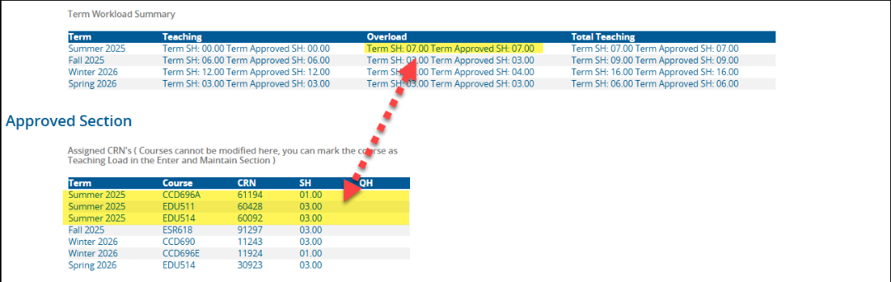
Correcting Load Type in Assigned CRN’s
Due to a complication in Banner, these scheduled courses are always OVERLOAD.
  This is not an ideal situation, but incorrect entries can be corrected.

Slide 5
Assigned CRN’s
When a course should be Teaching Load
  Select “Add New” in the Maintain Load Section and re-enter the course as Teaching Load.
  Save. Refresh.
  When approved and the ‘page refreshed’, the course will be eliminated from the Assigned CRN list, and appear as Teaching Load in the Dean Approved Section.

Slide 6
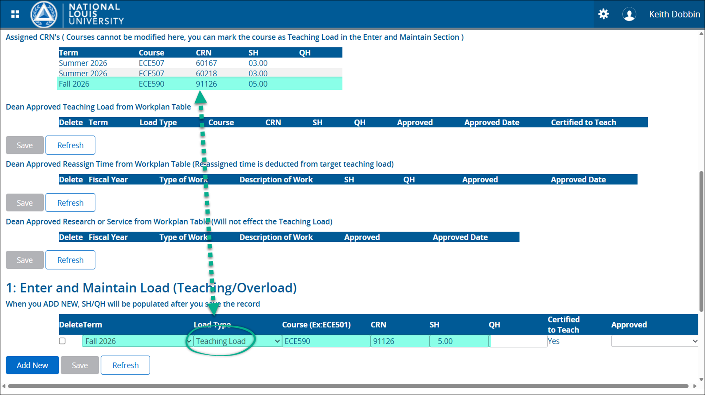
Assigned CRN’s

Slide 7
Overriding SHs and QHs
The SH and QH fields are ‘auto-fill’ fields – it is not necessary to enter load into either field.
How the course was created in Banner determines how the load auto-fills.
Example - If the course displays 3.00 SHs and quarter hours are needed:
  Highlight the SH value and delete.
  Enter 5.00 in the QH field.
  Save. Refresh

Slide 8

Editing Functionality
Workload Planner was released in two versions:
  Faculty (limited editing) and Approver (enhanced editing).
Current Faculty functionality is limited to adding “Teaching Load”, “Reassign Time”, and “Research/Service”.
  Useful for initial load planning, but discourages direct faculty engagement with their plan as the year continues and workload assignments inevitably change.​
  The ability to delete or modify entries is limited to “Approvers”. This necessitates a significant amount of “offline” communication between faculty and their Approver to execute edits, often resulting in faculty plans not being properly updated throughout the year.​ ​

Slide 9
Editing Functionality
Providing faculty with the enhanced editing functionality will give them the ability to directly maintain an accurate workload plan. ​
In this new model, to ensure transparency when edits are made, notifications will be sent to Approvers on a regular interval summarizing the changes made by their supervisees.​
Improving the end-of-year accuracy of individual faculty WLP’s will result in more reliable data for programs, colleges, and administration, to inform future workload planning, budgeting, staffing, and many other operational decisions​.

Slide 10
Editing Functionality
The Delete function has already been added to the Faculty - Work Plan version of the application.
As assignments change, faculty can delete the original entry and enter new entries.
Additional editing functionality is in the works.
The approval hierarchy does not change. Faculty Load Plans must still be approved by their “Approver” as exists today.

Slide 11
Addendum

Slide 12
Key Implementation Phases
Winter 2026: Email announcement, college meeting prep, and assessment of workload tool
Spring 2026: Updated resources, college visits, and load planning kickoff
Summer 2026: FP102 added to Faculty Guidebook; starting July 1 - governs overload, summer contracts, and base load
Fall 2026: Full use of policy and ongoing support for load management and adjustments

Slide 13
Interdependent Project: Faculty Management System
Tool Evaluation Underway: Core team assesses whether to update or replace the current Workload Tool
Goal: Ensure University and faculty can manage faculty processes and operations, including teaching, service, thought leadership, and overload on a term-by-term basis
Charter Linked in Implementation Plan: Project to select a vendor or build in-house solution will launch in late January
Decision Timeline: Recommendation due June 2026, implementation plan released Fall 2026

