Slide 1

CTLE (Online and On-ground Teaching)
Module 3 Practice

Slide 2
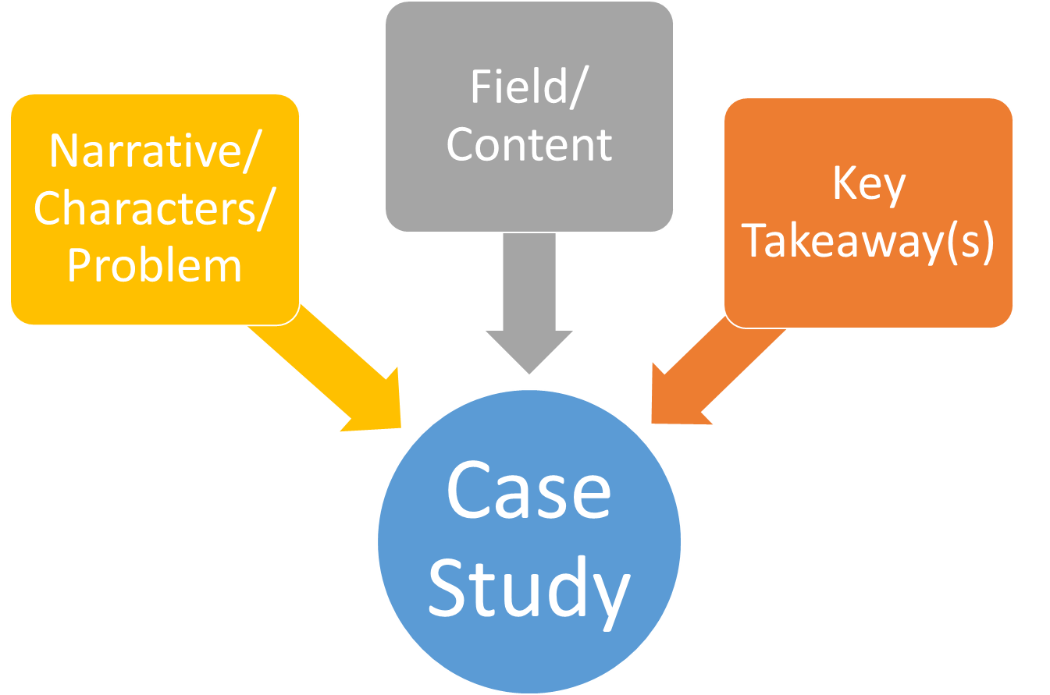
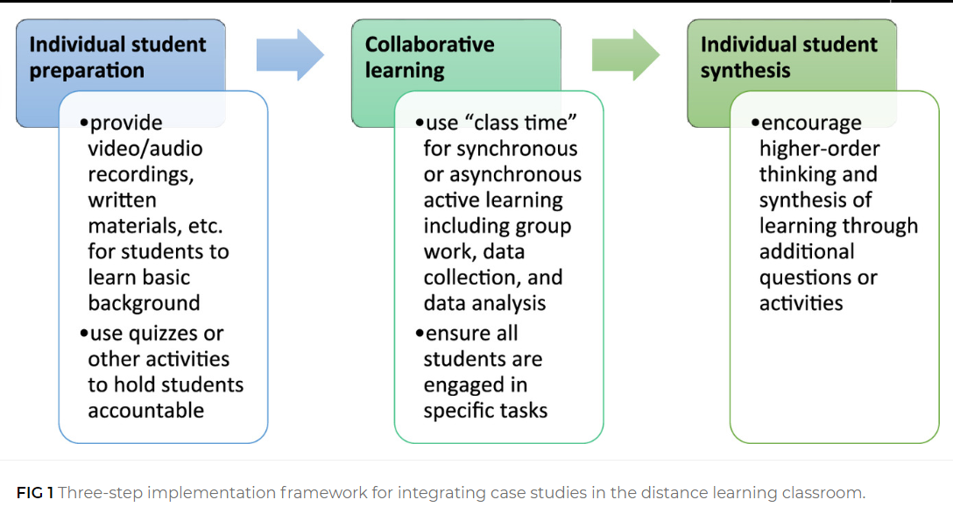
Create a Case Study
Think about the ways to implement it in an online & on-ground learning environment
Key Elements
Example: Three-step implementation framework (Bixler et al., 2021)
Notes:
Leave your comments here!

Slide 3
Issue or problem that arises in the field
Sample: A disrespectful patient in a group therapy setting. How to orient new therapists to running group therapy sessions.
Your examples:
Notes:
Leave your comments here!

Slide 4
Characters and context
Sample
Context - You run a clinic which offers group therapy sessions for substance use disorder, which meet 3x/week for three hours
Characters - Jim, a patient who is new to the group, has been ordered by his employer to attend sessions. Caroleena, a therapist who supervises the group and intern. Jackie, an intern who has finished her coursework and is graduating at the end of this internship. Nancy, Sidney, Robert, Colin, and John are the other group members.
Your Example
Context [This is a scenario or challenge that arises. Or this could be an ethical dilemma that could be faced in the field.] -
Characters [Relevant people who will play a role in the case] -
Notes:
Leave your comments here!

Slide 5
Field or content relevant information
Sample
Key terms - Intensive Outpatient Program (IOP) is a modality of therapy where patients attend at least three days a week for at least three hours a day. Transference - When the therapist/authority figure activates memories and emotions related to a significant person in one’s life, such that they react toward the therapist/authority figure as they would toward that significant person.
Key concepts - It is common for group members to be randomly screened for drug or alcohol use prior to group. Clinical staff can also spot test if they suspect drug or alcohol use (by smelling it or seeing patients “nod-off”). Professional Ethics standards (normally this would include a link).
Your Example
Key terms -
Key concepts -
Notes:
Leave your comments here!

Slide 6
Use a narrative to introduce the concepts in the previous three slides
Sample
Caroleena wants to make Jackie’s learning experience as robust as possible, and so she asks Jackie to get today’s group started. Caroleena introduces Jackie to the group, as there is a new member today, Jim. Jim has been mandated by his employer to seek help for his alcohol dependence in order to return to work. Jim’s body language indicates he doesn’t want to be here. As Jackie is introducing herself, Jim interrupts her, “You mean to tell me we have college students running this thing? You guys take advice from her?” The rest of the group doesn’t respond at first. Jackie responds, “I’m not a college student, I’m a graduate student who’s about to…” Jim again interrupts, “Hey, as long as you sign-off on my sheet, I don’t really care.” Sidney responds, “This is going to be a long process…” Jim asks, “what’s that supposed to mean?” Nancy replies, “He means for you… If you think you’re going to be done in 10-weeks with that attitude, you’re dreaming.” Jim stares at Nancy and Sidney, plotting his next retort. Caroleena interjects, “Nancy, tell me what you mean by that.” This moment is a turning point for the day’s session. Nancy begins to talk about her own experience when she entered the group and how recovery has to be something you want to do, not something you have to do. While Jim’s body language didn’t change, he sat quietly for the duration of the day. Caroleena takes over the session, and occasionally invites Jackie to participate via questions or prompting.
Notes:
Leave your comments here!

Slide 7
Use a narrative to introduce the concepts in the previous three slides
Your Example:
Notes:
Leave your comments here!

Slide 8
Key takeaways to be addressed during conversation
These will help you create questions for students to consider at the end of the Case Study
Sample
It is important to understand where each patient is at in their recovery.
We need to consider our role in the recovery process and that transference may guide a patient’s responses to us.
We need to operate within our bounds of competence and know when to ask for help.
Your Example
Notes:
Leave your comments here!

Slide 9
Questions for Students
Sample
Caroleena and Jackie debrief with you after the session, and you pose the following questions. Work together in groups to discuss the answers to these questions.
What about Jim’s body language might tell you he doesn’t want to be in the group?
Why was Jackie’s reply (being a graduate student) not likely to be successful?
What is your sense of Jim’s view of authority?
What support might Jackie have needed to be successful in this situation?
Your Example
Notes:
Leave your comments here!

Slide 10
Implementation for online vs. on-ground learning
Adapt to Your Modality (Which parts of this you assign prior/during/after class? Which technologies will help students work on this collaboratively, if needed. For example, using D2L Groups to create group discussion boards to discuss the material; creating a separate Google doc of the narrative for each group to annotate; Zoom breakout rooms for discussions)
Notes:
Leave your comments here!

Slide 11
References
Bixler, A., Eslinger, M., Kleinschmit, A., Gaudier-Diaz, M., Sankar, U., Marsteller, P., Goller, C., and Robertson, S. (2021). Three steps to adapt case studies for synchronous and asynchronous online learning. Journal of Microbiology & Biology Education, 22(1). https://doi.org/10.1128/jmbe.v22i1.2337
Notes:
Leave your comments here!

