Slide 1

SIMPLE SYLLABUS SETUP
STEP 1: ADD DUE DATES
Set Due Dates for Assignments, Discussions, and quizzes if you have them.
Discussion Due dates must be entered in Content – this guide will show you how to enter due dates.
.
STEP 2: EDIT SIMPLE SYLLABUS
Click the Syllabus Link (on the course homepage) to edit, add your information and course policies.
.
STEP 3: PUBLISH & CHECK STUDENT ENGAGEMENT
Submit and publish simple syllabus so it is visible to students. Once submitted you can check student engagement with the syllabus.
BROWSER SETTINGS:
Google Chrome is recommended, with these settings (for both instructors and students): Cookies should be enabled, to check this run the D2L System check here https://d2l.nl.edu/d2l/systemCheck if cookies are not enabled follow this guide:
https://support.google.com/accounts/answer/61416?hl=en&co=GENIE.Platform%3DDesktop
Ensure “Chrome’s” Pop Up Blocker is turned off, this guide shows how to allow popups https://support.google.com/chrome/answer/95472?hl=en

Slide 2
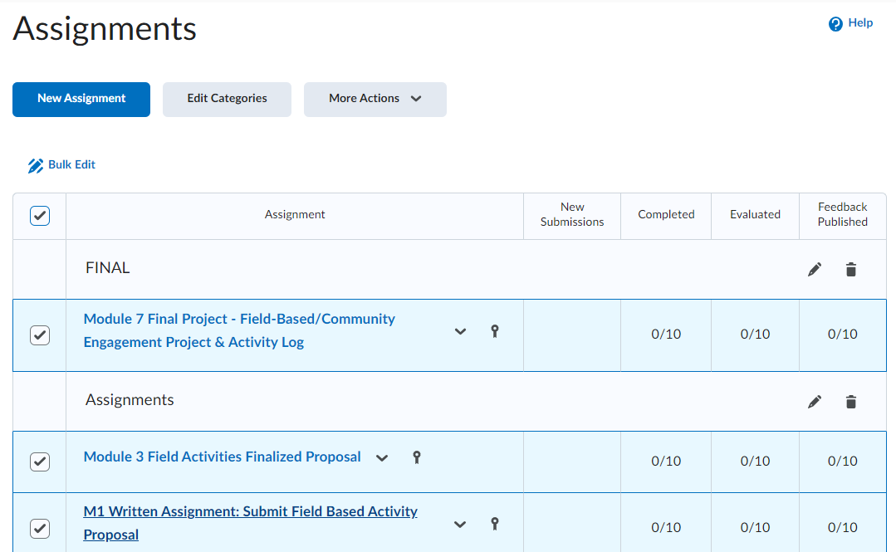
ADD DUE DATES (ASSIGNMENTS)
1. Go to “Assignments”.
2. Select the first box as seen in this image to select all assignments.
3. Select the “Bulk Edit” button above the box to add Due dates to all assignments

Slide 3
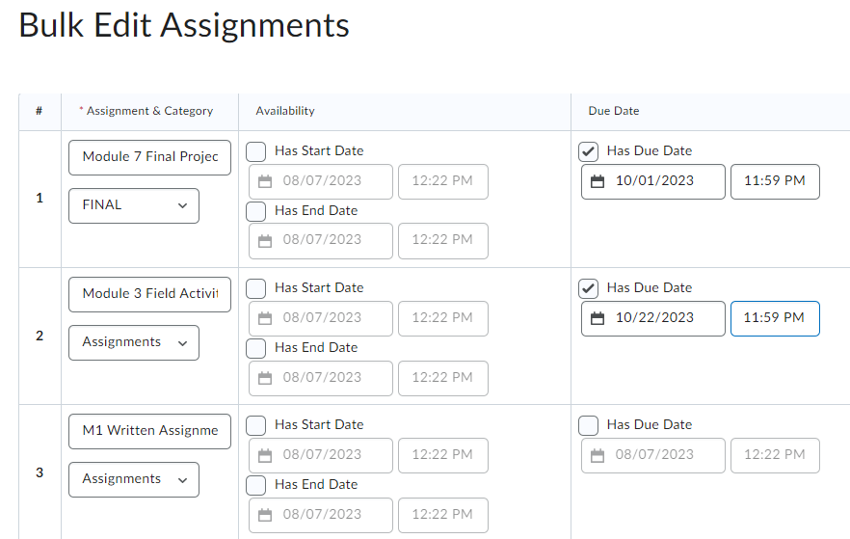
ADD DUE DATES (ASSIGNMENTS) Pt 2
On the Bulk Edit Assignments page:
Click the “Has Due Date” check-box next to each assignment, and enter the date and time the assignment is due.
Complete for all assignments and choose Save at the bottom.

Slide 4
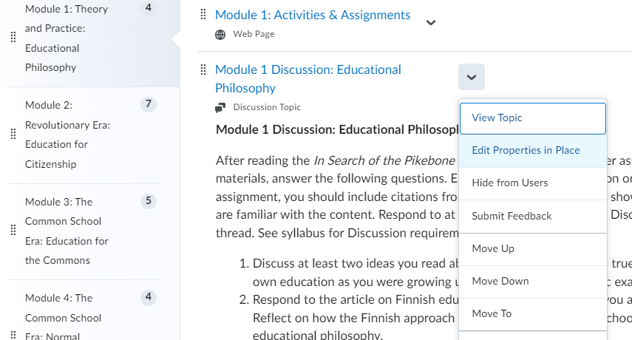
ADD DUE DATES (Discussions) Pt 1
Instructors enter due dates for discussions in Content
Click Content, and select a Module that has a discussion topic.
Next to the Discussion Title
select the down arrow and choose “Edit Properties in Place”

Slide 5
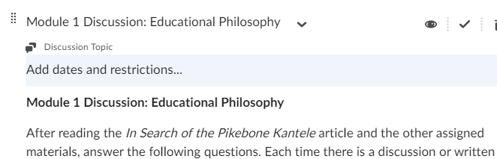
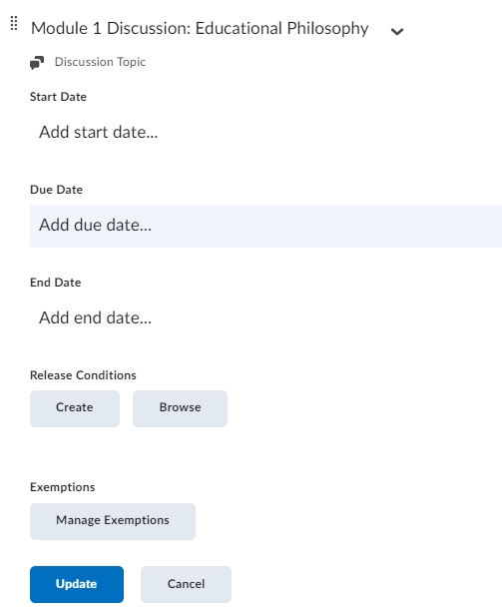
ADD DUE DATES (Discussions) Pt 2
The Add dates and restrictions field appears – click on the field
The Due Date field will appear – click to add the due date and time.
Click Update to save your changes

Slide 6
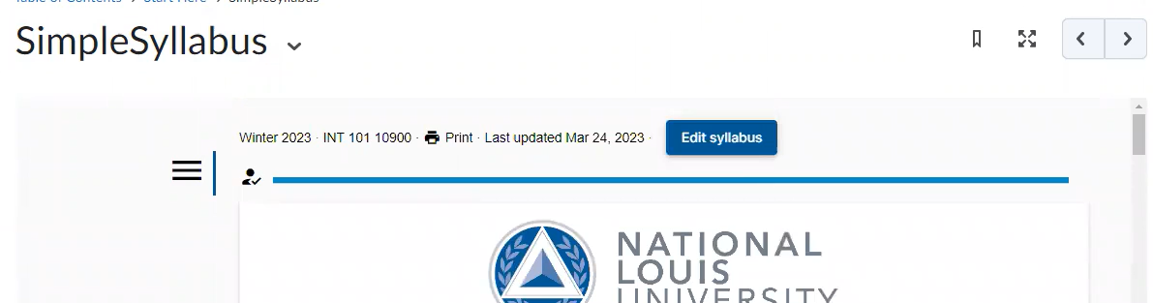
EDIT SIMPLE SYLLBUS
Click the Syllabus link on the D2L Course homepage, a similar window to below appears, then select the “Edit Syllabus” Button:
NOTE:
If you see a blank or NLU portal screen – return to Slide 1 and review the browser requirements.

Slide 7
Required Areas in Simple Syllabus
Required areas are marked with a red asterisk (*)
Instructor Information
Name and email are added from Banner and may not be edited. Pronouns, Response Time, Grading & Feedback, are optional. Faculty phone and office hours are required fields
2. Expected Course Practices:
In this area add your course policies, e.g. late work, attendance, assignment or other expected practices or requirements
  VIEW:
  Annotated Simple Syllabus
  & see which areas are optional, required, editable or not

Slide 8
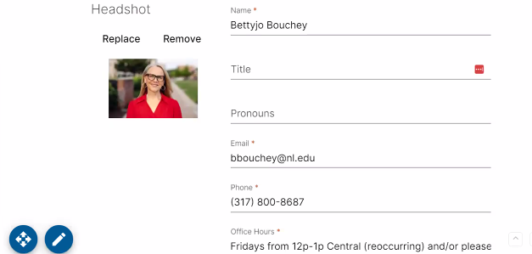
Items with a Red Asterisk * are required to be updated
Required Areas to update in Simple Syllabus

Slide 9
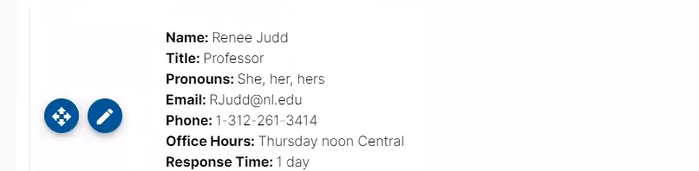
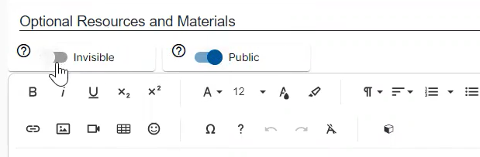
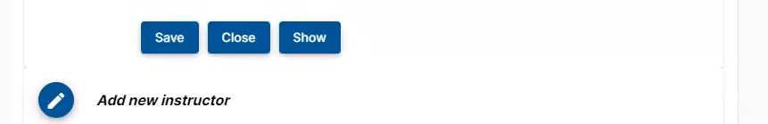
SIMPLE SYLLBUS – ICONS & BUTTONS
The Blue Pencil icon indicates areas you can edit
Invisible hides items. Public makes items visible –
Save allows you to save your edits

Slide 10
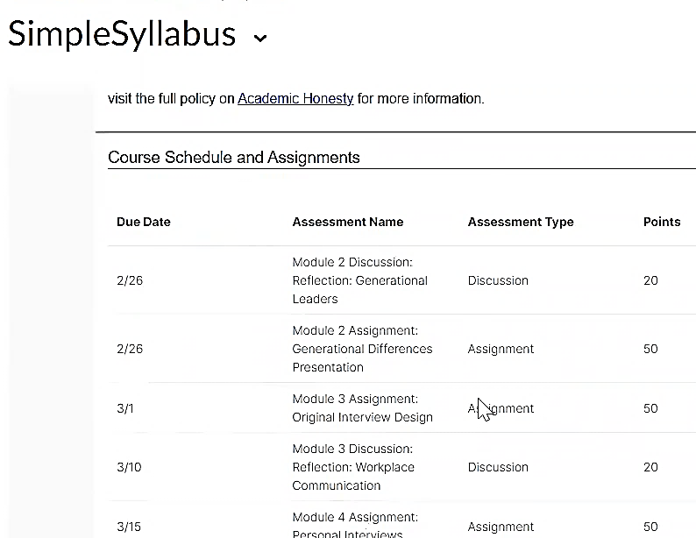
Simple Syllabus Schedule
This section is populated by D2L automatically - it will be BLANK if Due Dates are not entered.
The Schedule cannot be directly edited in Simple Syllabus. If you modify due dates in D2L, changes will be visible in Simple Syllabus only when you open and then close the syllabus for editing. Alternatively, the changes will be updated during the next auto sync at 10 am, 2 pm, or 6 pm.

Slide 11
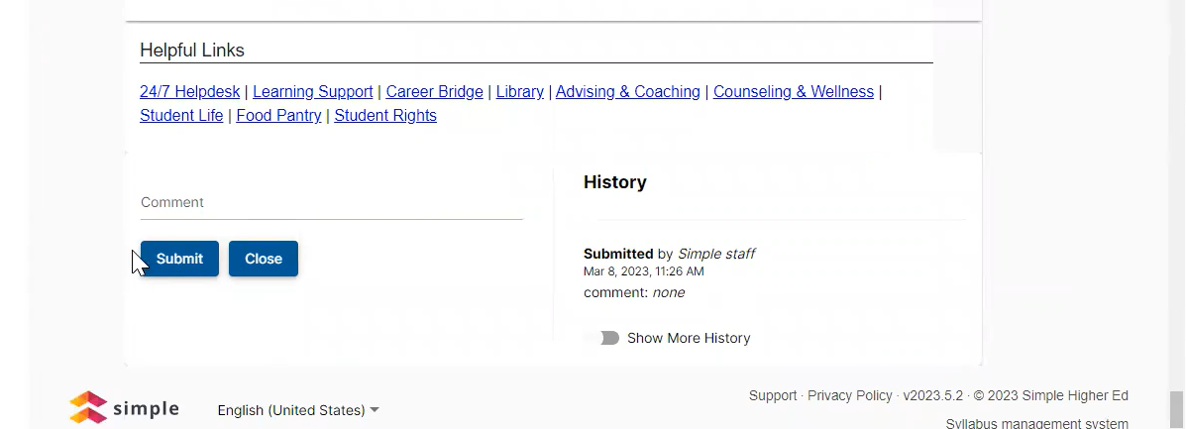
Click Submit to Publish the Syllabus
Instructors need to update required fields before they can submit.
If you don’t see a submit button check for required fields you may have missed.

Slide 12
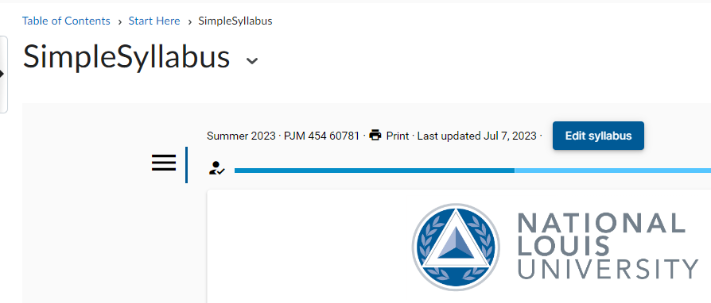
Confirm the Syllabus is Submitted
Once submitted the “Last Updated” date will appear

Slide 13
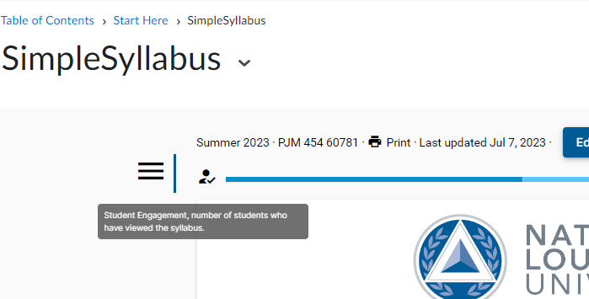
Check Student Engagement
Click the Student Icon to access the engagement report, to check if students viewed the syllabus

Slide 14
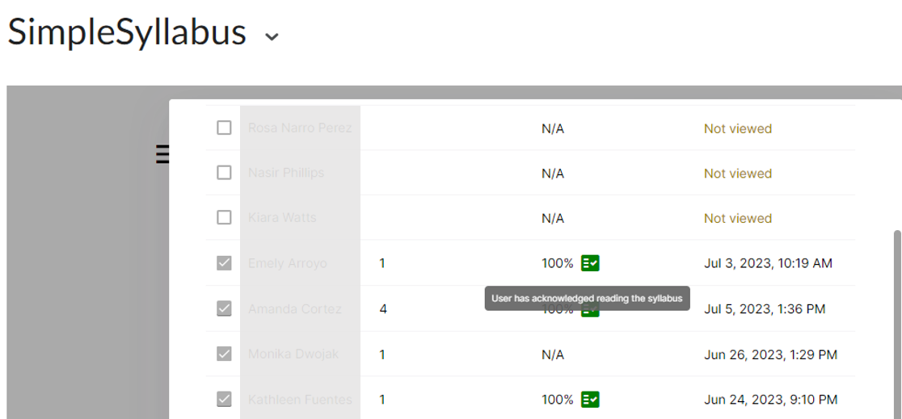
Student Engagement Report
The Engagement Report shows if students viewed the syllabus and what % they read. A green box appears if they acknowledged reading the syllabus

