Slide 1
Introducing
Our “Next Normal”
in Remote Teaching
UGC Remote Instructor Orientation
9/15/21
Margeaux Temeltaş

Slide 2

Jamboard #1:
Participant Check-in
How are you doing today?
What is on your mind?
Go to this link to access the jamboard for this presentation:
https://jamboard.google.com/d/1G_G3EEd3SH1T-dRsY1l4j3vxAT1lEh7zHBsdhS9RETc/edit?usp=sharing
You can use the sticky notes to add text, or insert images.
You can also use a sticky note to respond to another person’s check-in.

Slide 3
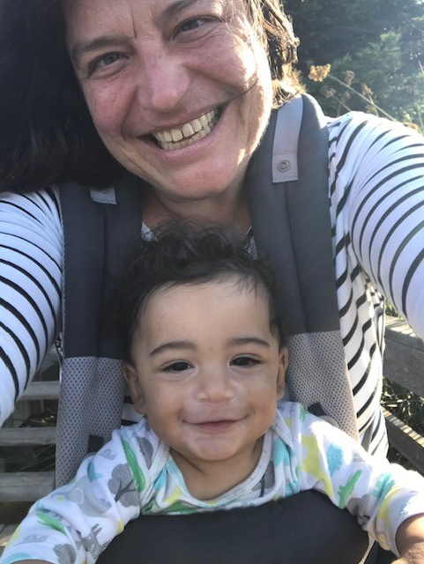
Who am I?
Margeaux Temeltaş
Associate Director of Remote and Online Academics, NLU Undergraduate College
Associate Professor and previous UGC English Department Chair
19 years as a teacher (6 years at NLU)
Taught all modalities: in-person, blended, remote, and asynchronous online
Voracious reader, sometime writer, yoga enthusiast, and mother of Langston
Happiest barefoot

Slide 4
Associate Director of Remote and Online Academics
Focus and goals for 2021-22
REMOTE
Establish operational plan for remote daytime instruction, including faculty professional development and best practices remote playbook.
Develop and launch Infinity Academy at NLU (remote regional/national model).
ONLINE
Execute operations for FY22 for pilot programs (BABA, BSM, CAR, COM, and CSIS majors).
Evaluate pros, cons, and resource implications of moving all UG Online programs to UGC in FY23.
If needed, create efficient and effective operational plan for FY23 Online transition to UGC.
Notes:
BABA = Business Administration, BSM = Management, Career, Communications, Computer Science Information Systems

Slide 5
Optimizing Digital Learning Experiences: A Checklist
Adapted from Optimizing High-Quality Digital Learning Experiences: A Playbook for Faculty.
The complete checklist is included as an Appendix at the end of this presentation.
Each concept in the checklist includes recommendations and resources at all 3 levels: Design, Enhance, Optimize.
The Key to Success:
Embrace the Design-Enhance-Optimize framework to adopt a continuous improvement process to your virtual course.
Gunder, A., Vignare, K., Adams, S., McGuire, A., & Rafferty, J. (2021, June 8). Optimizing high-quality digital learning experiences: A playbook for faculty. Every Learner Everywhere. https://www.everylearnereverywhere.org/resources/.

Slide 6

Next Normal,
New Vocabulary
The Remote classroom is now the
Virtual Classroom (VC)
*new designation in Banner

Slide 7

Key Difference for 2021-22:
Student Choice
For freshman and sophomore daytime courses, students choose their modality - virtual or in-person - during registration.
For junior and senior courses, modality is determined by course type.

Slide 8
Scheduling Virtual (VC) and In-person (F2F) Courses
Freshman and Sophomore daytime courses:
VC and F2F options are offered on both days.
Freshmen: Monday/Wednesday
Sophomores: Tuesday/Thursday
Junior and Senior (major) daytime courses:
Major courses F2F, minor/concentration courses VC
Juniors: Tuesday F2F / Thursday VC
Seniors: Monday F2F / Wednesday VC
*Note these describe typical scheduling for 2021-22, but there may be some exceptions.

Slide 9

FAQ: How will SSC work for virtual sections?
For Fall 2021, student success collaboration teams will include both virtual and in-person instructors in the same scheduled SSC meetings.
Rationale:
Many faculty teach both virtual and in-person sections.
Coaches and advisors would only need to attend one meeting for their cohort.
We will continue to collect evidence and feedback to evaluate this approach for future terms.

Slide 10

FAQ: Will there be separate virtual course shells?
No. For 2021-22, virtual sections will use the standard blended/F2F D2L course masters (as in 2020-21).
Chairs and Course Owners are encouraged to access both the online and blended masters in order to identify opportunities to enhance the blended lesson plans for the virtual environment.
Depending on the growth of the remote program, there may be virtual course shells developed in future years.

Slide 11

FAQ: What is the late work policy for virtual classes?
The late work policy in a virtual section should be consistent with the UGC-wide late work policy as articulated on our master syllabi.
Know your students’ approved ADA accommodations and honor them. (Consider setting consistent, personalized deadlines for those students.)
Extended time for extenuating circumstances remain at the instructor’s discretion, per NLU policy.
Communication is key. Students should communicate requests for extra time before the due date whenever possible.

Slide 12
FAQ: What is the zoom camera policy?
NLU Guidelines for Zoom Camera Use in Virtual Classes:
Faculty should expect students to turn cameras on at least twice during each class meeting, and ideally as much as possible.
Faculty should set classroom norms - including camera usage norms - at the start of the term along with a discussion with students about why camera use is important (e.g., for connection, building communication skills, helping to check for understanding, preparing for employer expectations). These norms should be developed with students’ input during Week 1 classes.
Faculty should use their professional judgement about which class activities are best suited for on-camera student engagement and when to consider exceptions to the guidance above. Some suggested times for on-camera engagement are:
  During attendance
  During in-class discussions and activities
  During break out groups
  While assignment instructions are being reviewed
  Any time a guest speaker is in the classroom, especially employers

Slide 13
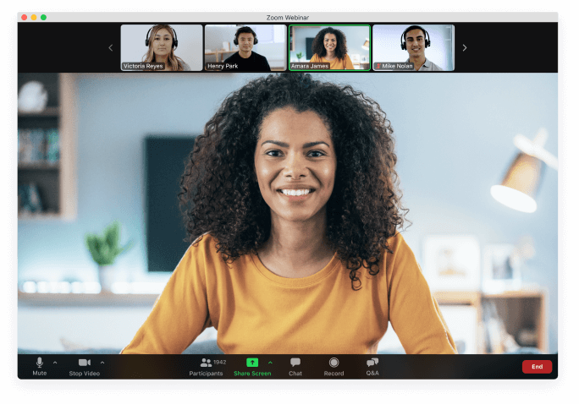
FAQ: What is the zoom camera policy?
NLU Guidelines for Zoom Camera Use in Virtual Classes:
As always, some students will identify extenuating circumstances for keeping their cameras off, and faculty should make exceptions to provide the best student experience.
Students should not be penalized if they have their cameras off during class time; yet, we hope students will engage with the above guidance as much as possible because of the connection, learning, and career readiness benefits. We also understand extenuating circumstances and ask that students let us know of any barriers to camera use, especially because the barriers might be things we can help them with, such as technology access or use of a virtual background.
Faculty are not expected to track camera usage as part of their teaching responsibilities.

Slide 14

Remote instruction at NLU is no longer an emergency initiative. In order to meet direct instructional time mandates:
For virtual sections, the class session should be a well-structured, 3 hour synchronous session with healthful breaks.
Key Difference for 2021-22:
Synchronous Learning Expectations

Slide 15

Key Difference for 2021-22:
Student Choice
Remember, this year remote students are choosing the virtual modality as the best option for them.

Slide 16
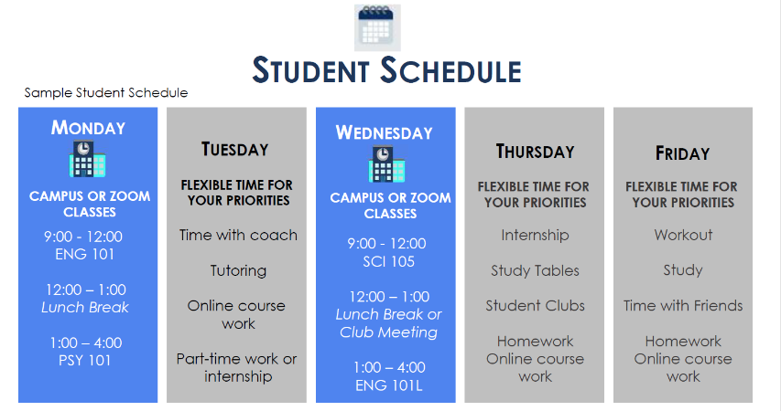
FAQ: What has been communicated to students?

Slide 17


FAQ: What has been communicated to students?
First Day of Classes!
Double check your schedule and professors
Introduce yourself to your classmates, share something about yourself to start building a new community
In-person Classes
For in-person classes, give yourself lots of time to get to campus! Commuting takes longer than you might expect and the elevators take a while!
Bring a bottle of water to stay hydrated and a lunch (or money to buy lunch around campus)
Remote Classes
Try to find a quiet space in your home, and use headphones to help with noise
Make sure your internet is reliable and have your camera on whenever possible
If something goes wrong with your internet or you have an unexpected emergency talk to your professor as soon as possible!
Notes:
Coach #2

Slide 18
NLU - Preparing for Student Success
Student Support Needed - feedback from students | SOLUTIONS - https://nl.edu/return/remote-learning/
Access to technology and technology assistance | Computer labs at the Chicago and Wheeling campuses will be available for student use. The Student Support Concierge is available via zoom Monday – Friday from 9am – 5pm to assist. 24/7 technical assistance is available at (866) 813-1177 or helpdesk@nl.edu.
Finding quiet and dedicated space at home for zoom classes and homework | Dedicated classrooms will be available at the Chicago and Wheeling campuses for students. More information to come related to days, times, and locations.
Personal Support – Coaching, Career, and other Support Services | Instructors, Coaches, and Career staff will hold virtual office hours. Virtual Study Tables and 1:1 meetings with Writing/Math Specialists, Learning Specialists, and Peer Tutors will be held via Zoom.

Slide 19
NLU - Preparing for Student Success
Student Support Needed - feedback from students | SOLUTIONS - https://nl.edu/return/remote-learning/
Student Engagement in College Life | On campus and virtual events are being planned for the fall term in compliance with all health and safety regulations. This year, Eagle Fest will kick off the year for students.
Mental Health Concerns | Jillion Caldwell is our new counselor for daytime undergraduate students. She is available at jcaldwell7@nl.edu. Counseling services for transfer and online undergraduate students also continues to be available through Skylight Counseling Center. There is now a dedicated space for Counseling and Wellness located on the 4th floor at 122 S. Michigan. https://www.nl.edu/studentservices/studentexperience/studentwellness/ https://nl.edu/food-pantry-and-thrive-resources/campus-and-community-resources/ https://www.nl.edu/continue/continuethriving
Financial Assistance | NLU Emergency Fund NLU Tuition Completion Program COVID Scholarships Summer Credit Recovery Scholarships

Slide 20
Best Practices for the Synchronous Zoom Session:
Make your zoom classroom easy to access.
Set expectations for zoom camera usage up front and be consistent with them.
Break up the time into a variety of active learning experiences.
Schedule health breaks during class and keep to them.
Intentionally build community and infuse culturally responsive practices into your virtual classroom. ← click link for CRT resource
Remember, a 3 hour synchronous session does not mean a 3 hour lecture! Students may be collaborating in groups or partners, working independently, or meeting 1-1 with the instructor or a learning specialist. They may even go on a virtual field trip; just make sure there is a checkpoint back in the zoom classroom.

Slide 21

Jamboard #2:
Modes of Engagement
What are some ways that you engage your students (and measure engagement) in the virtual classroom?
You can choose to respond to either Jamboard #2 or #3
(or do both!)
Go to this link to access the jamboard for this presentation:
https://jamboard.google.com/d/1G_G3EEd3SH1T-dRsY1l4j3vxAT1lEh7zHBsdhS9RETc/edit?usp=sharing

Slide 22

Jamboard #3:
Physical & Mental Health
How do you combat “zoom fatigue”
and nurture physical well-being
in the virtual classroom?
You can choose to respond to either Jamboard #2 or #3
(or do both!)
Go to this link to access the jamboard for this presentation:
https://jamboard.google.com/d/1G_G3EEd3SH1T-dRsY1l4j3vxAT1lEh7zHBsdhS9RETc/edit?usp=sharing

Slide 23
Best Practices for the Synchronous Zoom Session:
Make your zoom classroom easy to access.
Use a consistent zoom classroom and make sure that the link is posted clearly and in multiple modalities (email, D2L announcement, syllabus).
Communicate the zoom classroom link well in advance of the first class session.
Use a consistent zoom room for office hours and communicate your 1-1 availability clearly and regularly.
Be sure that coaches, department chairs, and the online concierge have access to your virtual classroom location. Add your zoom link to the UGC Master Course Links and Office Hours spreadsheet (Fall 2021 tab) ASAP.

Slide 24

New for 2021-22:
Zoom-D2L Integration
is now available!
There is a new, seamless way to set up Zoom meetings for your class and share them on a dedicated calendar page in Content, inside D2L. Visit the Zoom-D2L Integration page linked below for more information, including a video and step-by-step instructions with screenshots.
https://oit.nl.edu/rich_content/LMS/WhatNew/ZoomSteps.html

Slide 25
Best Practices for the Synchronous Zoom Session:
Break up the time into a variety of active learning experiences.
Small group work in collaboration.
Partner work and peer reviews.
Student-centered, whole class discussion.
Small group discussion & share to whole class.
Structured independent work time with instructor checkpoints.
Virtual field trips with reflections or reports back.
1-1 meetings with students (while the class is engaged in partner, group, or solo work). Breakout rooms work well for 1-1 meetings.
Consider inviting a writing, math, or learning specialist to your virtual classroom who can work with students 1-1 or in small groups during the synchronous zoom session (in a breakout room).

Slide 26
Best Practices for the Synchronous Zoom Session:
Break up the time into a variety of active learning experiences.
Incorporate student voice regularly through a variety of modalities - sharing aloud, structured discussion, zoom chat, padlet, and other technologies.
Try a “waterfall” approach to zoom chat responses to encourage 100% participation and more effective comprehension check.
Consider utilizing a consistent “Do Now” activity (journal, quizlet) to begin class. Regular structures to the daily agenda help create consistency for students.
Combine attendance-taking with a more meaningful activity (such as a check-in using Googledocs, Padlet, or Jamboard) to set the tone and gauge students’ mood and needs.
Incorporate regular informal writing opportunities.
Jamboard #2 share-out

Slide 27
Best Practices for the Synchronous Zoom Session:
Schedule health breaks during class and keep to them.
Be intentional about remembering to give 1-2 breaks every session. Schedule them into your lesson agenda and set alarms if needed.
Offer healthful suggestions for students about what to do during the breaks (a simple stretch routine, for example, or a guided meditation).
Remind students (and yourself) to give your eyes breaks by getting up from the screen and looking at objects in the room.
Take care of your own needs too!
Don’t go more than 90 minutes (60 is better) without building in some steps or other physical movement.
Jamboard #3 share-out

Slide 28
Recommended Professional Development:
Excellence in Online and Remote Teaching (EORT)
All instructors teaching virtual/remote courses in the UGC are strongly encouraged to participate in the Excellence in Online and Remote Teaching (“EORT”) course offered quarterly through the Center for Teaching and Learning Excellence at NLU.
For more information and to register: https://nl.edu/ctle/engaging-and-supporting-faculty/excellence-in-online-and-remote-teaching/
EORT includes readings, resources, asynchronous discussion activities, and periodic synchronous workshops.
EORT is free, self-paced, and you only need to consume what is most meaningful to you!

Slide 29
Recommended Professional Development:
Excellence in Online and Remote Teaching (EORT)
EORT is self-paced - you only need to engage in the modules most meaningful to you! You can return to other modules on your own time as desired.
Module 1: Beginning Your Course
Module 2: Online and Remote Teaching Foundations*
Module 3: Creating Faculty Presence in an Online Environment*
Module 4: Teaching Your Course: Engaging Students Synchronously*
Modules 5 & 6: Teaching Your Course: Engaging Students Asynchronously
Module 7: Teaching Your Course: Data-Driven Instruction*
Module 8: Wrapping Up Your Course
Module 9: Bimodal Teaching
*EORT modules especially recommended for remote/virtual instructors
EORT registration link

Slide 30
Additional Resources
Adapting Your Course to Remote Online (PPT for those new to remote)
EORT PPT from Synchronous Instruction Workshop, Kimberlee Hendricks and Neal Green (with recommended teaching tools)
NLU’s Center for Teaching and Learning Excellence (CTLE) online teaching resources, including:
  ADA Accessibility & Accommodations in a Remote Learning Environment, Kaydra Bui and Kendra Syed-Abdul
  Exemplifying Social Justice Allyship in the Synchronous Classroom Setting, Caroline Perjessy
  Pulling the Weeds in Your Remote Garden, Renee Gugel and Elizabeth Minor
  Synchronous Lecture Delivery, Bettyjo Bouchey
(These links are directly to the videos. Corresponding PPTs and additional recordings are available on the CTLE page.)

Slide 31
Recommended Reading
Adams, S., Bali, M., Eder, Z., Fladd, L., Garrett, K., Garth-McCullough, R., Gibson, A. M., Gunder, A., Iuzzini, J., Knott, J. L., Rafferty, J. & Weber, N. L. (2021 June 8). Caring for students playbook. Every Learner Everywhere. https://www.everylearnereverywhere.org/resources/.
Gunder, A., Vignare, K., Adams, S., McGuire, A., & Rafferty, J. (2021, June 8). Optimizing high-quality digital learning experiences: A playbook for faculty. Every Learner Everywhere. https://www.everylearnereverywhere.org/resources/.
Rhodes, C. M., & Schmidt, S. W. (2018, November). Culturally responsive teaching in the online classroom. eLearn Magazine. https://elearnmag.acm.org/archive.cfm?aid=3274756.

Slide 32
Appendix
Optimizing Digital Learning Experiences: A Checklist
Supporting Student Learning through Effective Design
Create and maintain an inclusive and equitable digital learning environment.
Strive for alignment between learning outcomes, learning experiences, assessment practices, and technology integration.
Be consistent.
Adapted from Optimizing High-Quality Digital Learning Experiences: A Playbook for Faculty.

Slide 33
Optimizing Digital Learning Experiences: A Checklist
Building Your Syllabus, Course Schedule, & Communication Plan
Build your course with predictable learning cycles to help students find rhythm and consistency with assignments and due dates.
Include a statement on your syllabus about expected email response times to let students know how much time might pass before receiving a response from you.
Provide clear expectations for when students can expect to receive feedback on their work.
Create conditions to encourage your students to log into the digital classroom each day.
Ensure that your digital classroom, such as your D2L course shell, is well-organized.
Adapted from Optimizing High-Quality Digital Learning Experiences: A Playbook for Faculty.

Slide 34
Optimizing Digital Learning Experiences: A Checklist
Create Instructor Presence and a Sense of Community
Use active learning strategies during synchronous meetings.
Be easily accessible to your students.
Send weekly announcements or a weekly task checklist to your students.
When communicating with your students in writing, aim to use a welcoming and encouraging tone.
Adapted from Optimizing High-Quality Digital Learning Experiences: A Playbook for Faculty.

Slide 35
Reminder!
Add your zoom classroom link to the UGC Master Course Links and Office Hours spreadsheet (Fall 2021 tab)
by Friday 9/17/21

Slide 36

Jamboard #4:
Q & A
What questions do you still have about
teaching remotely this Fall?
Go to this link to access the jamboard for this presentation:
https://jamboard.google.com/d/1G_G3EEd3SH1T-dRsY1l4j3vxAT1lEh7zHBsdhS9RETc/edit?usp=sharing

Slide 37

Thank you for your engaged participation!
Have a wonderful Fall Quarter.
Feel free to contact me directly with questions:
Margeaux Temeltaş
Associate Director of Remote and Online Academics
mtemeltas@nl.edu

