Slide 1
Note-Taking Tools: Structure For Enhanced Learning
Center For Student Accessibility Resources
November 26, 2024

Slide 2

The first step to getting a good grade on an assignment is to … wait for it … do the assignment!
Notes:
1st step before note –taking is organizing the things you need to take the note on
2nd Organize your assignments level of priority of the due date
3rd Mark off when completed to promote crossing things off the things
4th There are tools that can assistance you with accomplishing theses task and organization.
I will show you some tools that could be beneficial to you during finals, if you are not already using them.

Slide 3
Organizing Your Week:
For some students, knowing how to keep track of assignments and their due dates is a huge challenge.
Here, I’m going to explain how to keep track of assignments and projects, and give you some tips for staying organized and taking notes
A cool angle to this is that what I’m going to be talking about is completely applicable outside of school.

Slide 4
Here’s what you should be keeping track of:
Daily homework assignments (short-term)
Project due dates (long-term)
Upcoming tests/quizzes
Books that have to be read by a certain point
Things you’re supposed to remember to do (ie: talk to math teacher)
After-school activities, sports (even if you have practice every day from 2:30-5, block out that time on your calendar)
Weekend activities
Appointments (doctor, dentist, guidance counselor, coach, etc.)
Job hour
Notes:
Some of you many have job’s, families, and outside responsibilities to added to the things you need to complete in a week. Organization will assist in keeping up with everything by calendar remember, notification from email, and planner.
It depends on what is your preference of staying organizes.
Some may need a accountable partner or team mate to assist them withing checking in on their priorities for the week.

Slide 5
Create A System For Yourself:
    The KEY step for keeping track of tasks for the week, which I’ll get to next, is to write everything down.
Have a system to Keep track of all your assignment's and notes.
Examples:
1) paper
2) digital
3) a combination of both

Slide 6
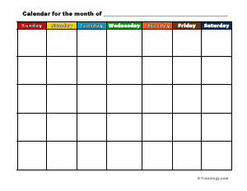
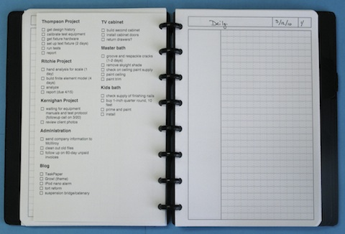
A monthly calendar allows you to see, at a glance, what assignments and appointments are coming up over the next few days or weeks or months. It’s key for long-term planning.
A daily calendar/agenda allows you to see and plan for what’s coming up tomorrow and in the very near future
Notes:
If you need a digital planner or monthly planner. Feel free to reach out to me regarding those and I will get a copy to you.

Slide 7
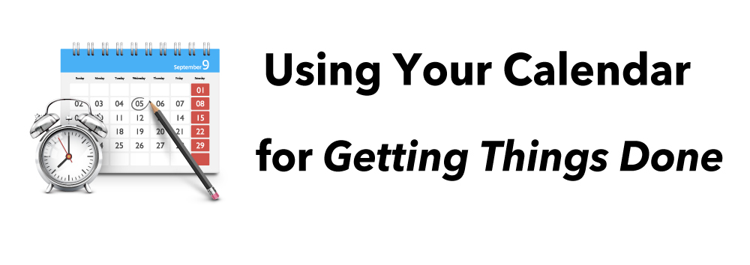
It’s important to use your system multiple times a day because the more you use it, the more you trust it. And the more you trust it, the more it will work.

Slide 8
My System:
One Note
Outlook
Calendar
Physical Planner
I set a time to organize my week
Add a new temple weekly schedule and planning out the week of task.
Notes:
Do you set reminders for yourself or how to you organize your week ?

Slide 9
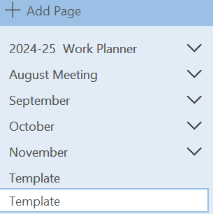
Build A Weekly Planner in One Note

Slide 10
Glean Note-Taking Software
I’ve heard so many students say “I’ve tried using an assignment notebook and calendar, but it doesn’t work.” But when I ask them if they write everything down, they say no
So you’ve got to commit to your system. Use it multiple times every day. Get in the habit of checking it every morning or every night before bed so you know what’s on your agenda.
Glean helps students by taking the pressure out of note-taking in class or on Zoom.
Some diagnoses may affect a person from being able to note – take in class.

Slide 11
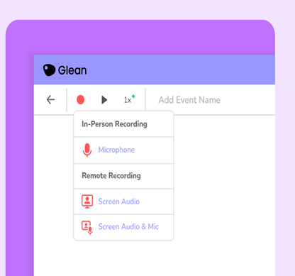
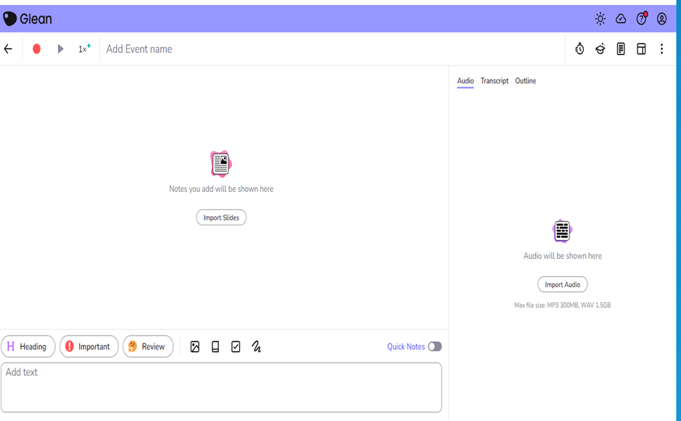
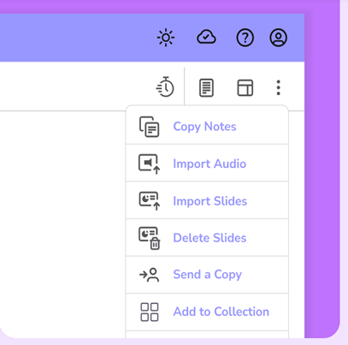
Glean Features:
Features:
Remote/In-Person
Quiz ME Feature
Transcript of Recording
Organize Note
Import Lecture Slides
Available on Mobile, Tablet, and desktop
Print
Dark Mode
Light Mode
Focus Timer
All students have
Access to the software
Notes:
You can upload lecture notes and follow along withing Glean.
You can organize your classes and notes in Glean to easily locate the notes for that class.
Our department provides the premium version to students who are approved for the accommodation.

Slide 12
Tips to Staying Organized.
Set Reminders
Let’s say you have a project due in one week, so you write down “biology project due” on your calendar on the date it’s due. Sound good? No! No, because you don’t want to end up checking your calendar on the project’s due date and realizing “Oh crap! It’s due today!” So the hack for remembering to do the assignments you write down is this: remind yourself along the way.
A reminder system also helps you manage your time for long-term assignments because it encourages you to work a little bit each day towards the larger goal.

Slide 13
Keep your planner/calendar accurate and up-to-date
Your homework management system is only going to work if it’s accurate.
So you’ve got to be sure that you update your calendar and your agenda as things change. So if your teacher gives an extension or changes the due date of a project, or if your band concert or meeting is rescheduled, make those edits in your calendar. (Try to keep it neat if you’re using a paper system, so that might mean using whiteout. Messy on paper equals messy in the head.)
remember the rule: make these changes immediately if possible
Keeping all systems will the same information for accuracy

Slide 14

When you may need to change your method of organization or notes:
Whenever you stop using your agenda or calendar,
Ask yourself why? Why did you stop?
What part of the system wasn’t working?
If the system was easy enough to use, you wouldn’t have stopped. Is your notebook so big that it’s annoying to bring with you? Then get a smaller one.
You are forgetting on a daily basis, it may be a signal.
It may take a couple systems until you find what works for you.

Slide 15

Reminders To Take With You:
Take your planner with you to every class.
Go back to review lecture notes to see if there is something you missed.
Set a day before the week begin to get organized.
Set timers to remind you to check in with your planner
Celebrate yourself when you follow through with tasks and checking everything off for the week.
Give yourself room for growth and to learn your style.
Use your resources to guide you in moment of uncertainty or questions.
You are not alone.

Slide 16
Questions
Any Questions or Comments
Please share if something has worked for you in the past.

