Slide 1
Center for Student Accessibility Resources
Academic Accommodation: Navigating College with Support Workshop

Slide 2

Workshop Objectives
Understand the Purpose of Academic Accommodations
Learn the Legal Framework
Navigate NLU Accommodations Request/Approval Process
Incoming Freshmen High School Vs. College
Self-Advocacy
Explore Assistive Technologies/Tools
Ask your accommodations questions

Slide 3
Purpose of Academic Accommodations
As a starting point, here are a few things to know about accommodations:
Provide students with disabilities with equal access to course instruction, materials, and evaluation
“Level the playing field” by reducing/eliminating barriers caused by the interaction between a student’s disability and the learning environment.
Do not guarantee student success and do not provide an unfair advantage
Must be reasonable and cannot alter the essential requirements of a course or program
Resource: The Basics: Providing Accommodations - Disability and Access (utexas.edu)

Slide 4
Learn The Legal Framework
A student with a disability has the right to obtain timely and reasonable accommodations for their disability to have the same opportunity for success enjoyed by students who do not have a disability. Under the Rehabilitation Act of 1973:
“No otherwise qualified person with a disability in the United States…shall, solely by reason of … disability, be denied the benefits of, be excluded from participation in, or be subjected to discrimination under any program or activity receiving federal financial assistance.”
The Americans with Disabilities Amendment Act (2008) defines a person with a disability as having:
A physical or mental impairment that substantially limits one or more major life activities;
A record of such an impairment; or
Being regarded as having such impairment.

Slide 5
Is my information confidential?
Yes, The Family Educational Rights and Privacy Act of 1974 (FERPA) and the Americans with Disabilities Act (ADA) do not allow faculty or others access to disability-related information (ex., diagnosis, medications).
Whenever possible, faculty and staff may only be aware of a student's accommodations and will not be given confidential details of a student's disability and symptoms.
However, there are occasional instances where the nature of the disability must be disclosed to faculty to facilitate an accommodation.
For example, a student who requires a Seizure Safety Plan on campus must have their faculty and campus security informed so that campus personnel can provide student safety during a seizure.
We can’t discuss anything with your family without your approval.
Students can choose to disclose information to faculty independently if they wish. Still, they should not be asked by faculty, staff, or administration about the exact nature or diagnosis of their condition or documentation.

Slide 6

Center for Student Accessibility Resources
Who can tell what they think this image means?

Slide 7
Center for Student Accessibility Resources
Visual
Hearing
Physical
Cognitive

Slide 8
Navigate NLU Accommodations Request/Approval Process

Slide 9

What is C.S.A.R?
Center for Student Accessibility Resources is committed to providing inclusion, accessibility, and equal opportunity for ALL students.
Enhance equity and provide a platform for innovation and inclusion.
We provide accommodation and assistive technology that enable students to access academic success.

Slide 10

Who Do we assist?
We Provide access needs to all students and specialized services with IEPs or 504 Plans.

Slide 11

Meet the Team:
Vez Osmani- She. Her ( TJ Martin )
Andrea Shaw- She, Her
Director of Access and Campus Resources
Phone Number: 312-261-3488
Email: vosmani@nl.edu
Location: 122 S. Michigan Ave
Room 5045
Hours: 8:00-4:00 P.M
Graduate, Veteran's, P.A.C.E
Student Affairs Specialist
Phone Number: 312-261-3742
Email: ashaw6@nl.edu
Location: 122 S. Michigan Ave
Room 5044-B ( Veteran’s Center)
Hours: 9:00-5:00 P.M
Undergraduate, Kendall

Slide 12
Common Disabilities
Learning and developmental (e.g., ADHD, dyslexia, autism)
  Access to class slides and recordings, text-to-speech software
Psychological (e.g., depression, anxiety, PTSD)
  Extra time on exams and assignments
Communication/speech
  Alternative format assignments
Physical
  Accessible classrooms, ergonomic seating, voice dictation software
Hearing
  ASL interpreter services, Zoom captions, written instructions
Visual
  Alternative format textbooks, enlarged print course materials, text-to-speech software
Other medical (e.g., migraines, seizures, sleep disorders, COVID)
  Excused absences, extra time on exams and assignments

Slide 13
What are reasonable accommodations?
Reasonable accommodations:
Adjustments to policy, practice, and programs that will provide equal access to students with disabilities. Accommodations can’t significantly alter fundamental course goals or academic rigor.
Some examples of reasonable accommodations:
Exam accommodations include extended time, a separate testing room, readers or text-to-speech for exams, etc.
Extended time for assignments: Students must communicate with faculty to advocate using their extensions..
Note-taking assistance: Glean note-taking software, advanced access to lecture slides and materials, video recording of lectures
Assistive technology: Natural reader: text-to-speech software that converts text into audio, voice typing software, etc. ( CSAR will also order any technology needed to support student needs)

Slide 14

What Services Are available?
Course Exam Accommodations
Extended Time on Assignments
Recording Class Lectures
Alternative Format Textbooks
Flexibility in Course Attendance Policy
American Sign Language Interpreting Services
Alternative Classroom Furniture
Temporary Accommodations ( ex. pregnancy )
Religious Accommodations

Slide 15

When Should I Apply?
At least 3-4 weeks before the beginning of the term
Accommodations will not be approved two weeks before the end of the term
Please allow up to two weeks to complete the approval process and letters to be sent to your faculty
We will always communicate with you through your school email

Slide 16
Documentation required for accommodations
Students can provide an IEP or 504 plan
Medical documentation stating diagnosis and signed by a medical professional
  Doctor
  Therapist
  Counselor
  Students have 30 days to get all documents in; temporary accommodations will be provided.

Slide 17
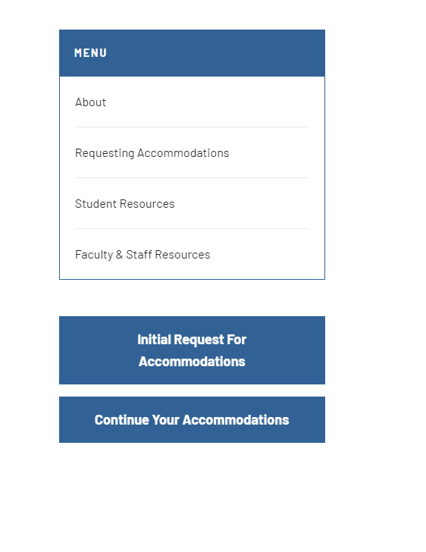
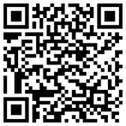
How Do I Apply?
Steps
Fill out the Initial Request for Accommodations
Add supporting documentation – 30 days to submit
Schedule a consultation
Approved Accommodation Letter
This QR Code will take you directly to our page:

Slide 18
Incoming Freshmen

Slide 19
High-School Vs. College
High- School
College
Parents/teachers can coordinate your accommodations
Classroom Aides
Students can be placed in self-contained classes if the need shown in the IEP
Most of the work is done in class
Parents can’t coordinate your accommodations with NLU staff and professors on your behalf.
In college, you are your primary self-advocate! Parents aren’t always involved; if a parent wants to be involved, the student signs a consent form, which must be signed by the student at the Center for Student Accessibility Resources office.
Colleges do not provide 1-on-1 classroom aids, but you can access tutors, counselors, and Center for Student Accessibility Resources.

Slide 20
High-school vs. College
Higher | More | Less
Academic performance | Studying | Time to prepare for great clarification on courses
Amounts of information from courses | Homework/Labs/Tests | Grades that have higher assignment points
Organizational skills | Tutoring | 1:1 support from an assigned teacher or aide
Comprehension | Self-Advocacy | School managing your attendance
Reading textbooks from multiple classes | Time Management | Daily reminders of obligations
Self- Accountability | Note-Taking

Slide 21
Trivia Time

Slide 22
What year was the First Iep Written?
1. 1990
2.2005
3.1975
4.2008
Answer: 1975 (The Education for All Handicapped Children Act required all public schools accepting federal funding to provide equal access to education.

Slide 23
Self-Advocating

Slide 24
Communication With Faculty
Strongly recommended that the student discuss their accommodation letter with faculty during week 1 of classes.
Communication can be verbal, but we encourage sending an email confirmation regarding your conversation. For example, Thank you for meeting with me today, I wanted to send a follow-up email of our conversation. We agreed that I could submit my assignments two days after the due date using my approved accommodation for extended time on assignments.
Communication between faculty and students is vital for accommodations and advocating for yourself.

Slide 25
Explore Assistive Technologies/Tools

Slide 26
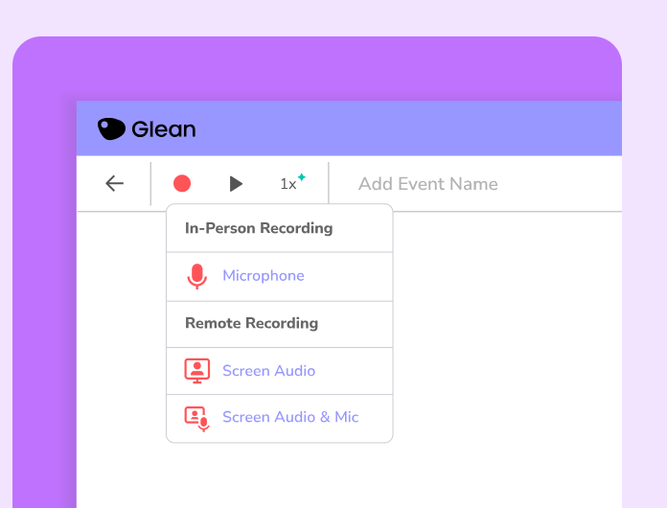
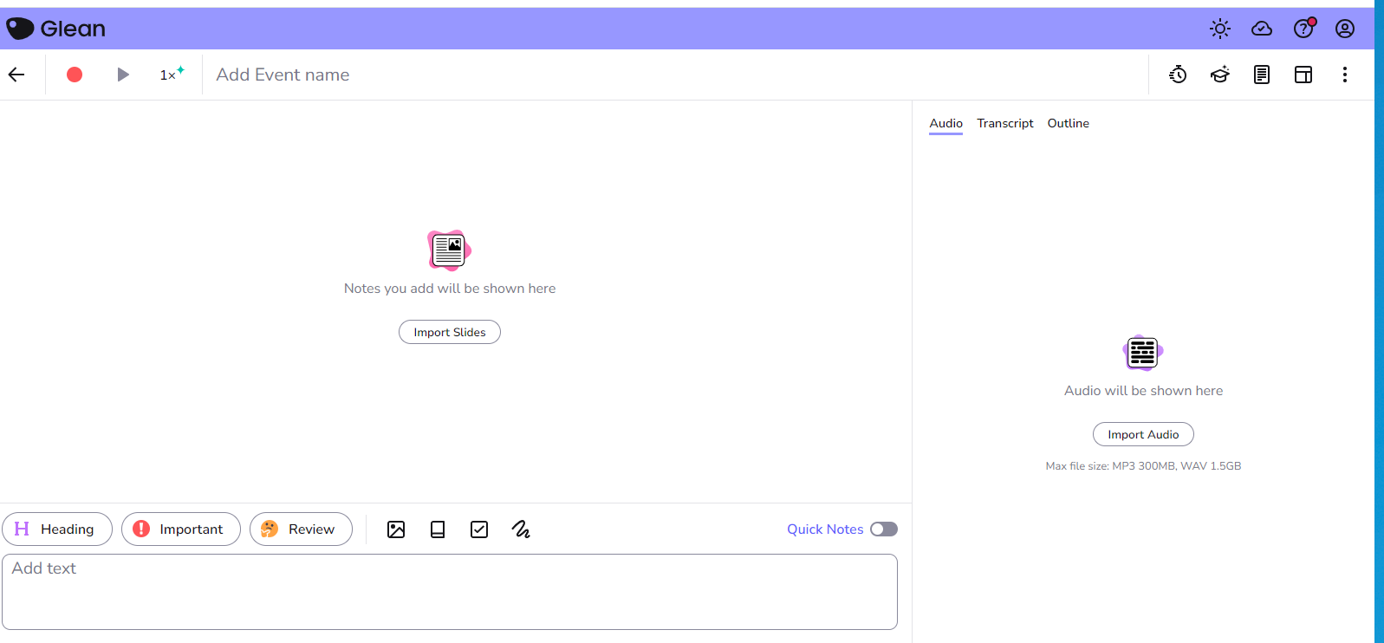
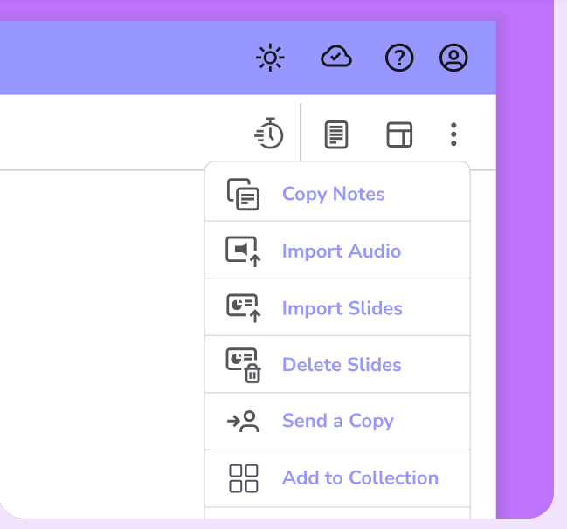
Software
Glean
Features
Remote/In-Person
Quiz ME Feature
Transcript of Recording
Organize Note
Import Lecture Slides
Available on Mobile, Tablet, and desktop
Print
Dark Mode/Light Mode
Focus Timer

Slide 27
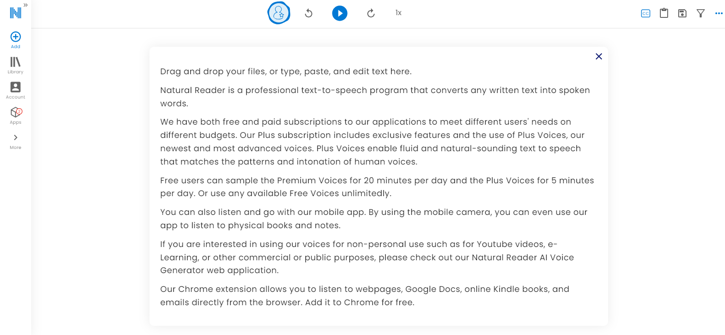
Natural Reader
NaturalReader converts any text, PDF, image, webpage and physical book into natural-sounding audio featuring the newest and highest AI voice technology
Create your own AI voice, ready to read in over 100 languages!
Supports PDF and 20+ Formats pdf, txt, epub, doc(x), ppt(x), xls(x), numbers, pages, key, csv, odt, ods, odp, html, rtf, xlt, psd, bmp, png, xml, svg, cdr, eps, psw, dot, tiff, and more.
Closed Caption
Read along with word-by-word highlight, enlarged text size and the option to turn on dyslexia font.
NaturalReader is designed to make reading more accessible for individuals with dyslexia, ADHD and other reading-based learning differences.
Light and Dark Mode

Slide 28
Free Accessibility Tools
Natural Reader: Text-to-speech also offers a Google Chrome extension to read anything
online ( CSAR provides the premium version to students)
Microsoft Office Lens: Converts photos of text into PDFs or Word documents.
Beeline Reader: Converts text into a color gradient to promote reading focus and comprehension.
Openlexia: Dyslexia-friendly font to improve reading.

Slide 29

Thank You
Any Questions or Comments?
Please Survey this presentation

